Slide 1
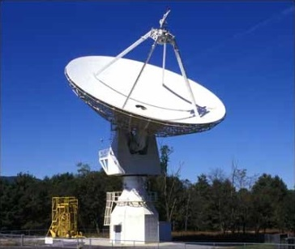
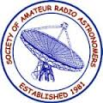
SARA East Conference 2022
Demo: Raster Scans and Considerations

Slide 2
Agenda
20m Project Updates
20m Dish Demo
20m Useful Comments
Raster Scans and Considerations
20m Observing Podcasts
Contact and Open Forum

Slide 3
20m Project Updates
This raster presentation and SARA Section Update are posted on SARA Analytical Section webpage
Also Posted:
  2019 demo presentation posted (Cas A Flux Density Estimate)
  2020 demo presentation posted (Pulsars)
  2021 demo presentation posted (Masers)
Annual 20m Demos attempt to understand different radio astronomy targets and/or calculations to build a reference resource on the Analytical Section webpage. Comments for improvement are welcome.

Slide 4
20 Meter Dish Demo
Green Bank Conference Account – Explore.
Skynet Account (free UNC Course).
SARA Account.
Demo Example – Watch the dish move outside.
Tutorial: Raster Scans and Considerations.
20m Observations https://www.gb.nrao.edu/20m/

Slide 5
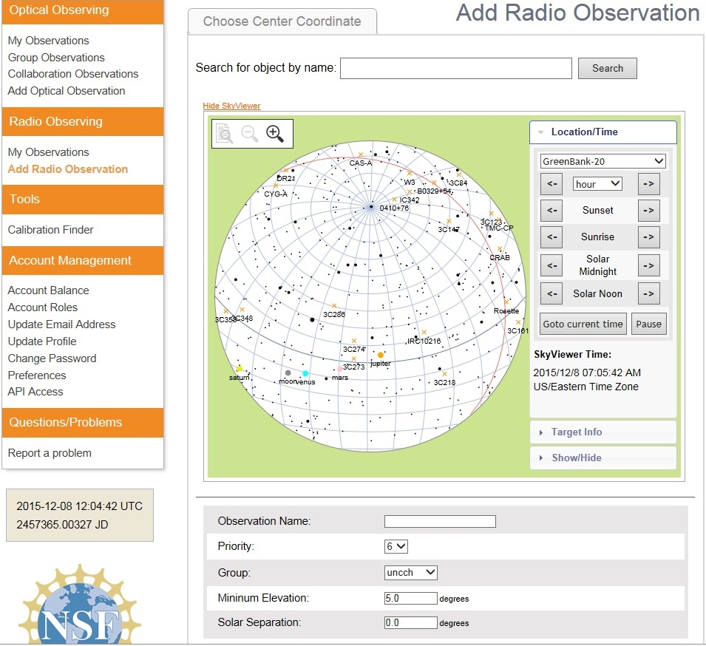
20 Meter Dish Demo
Add a Radio Observation
-Select an Object
(Database or RA/Dec)
-Minimum Elevation
(Used for mapping)
-Solar Separation
(to prevent solar side lobe
interference)

Slide 6
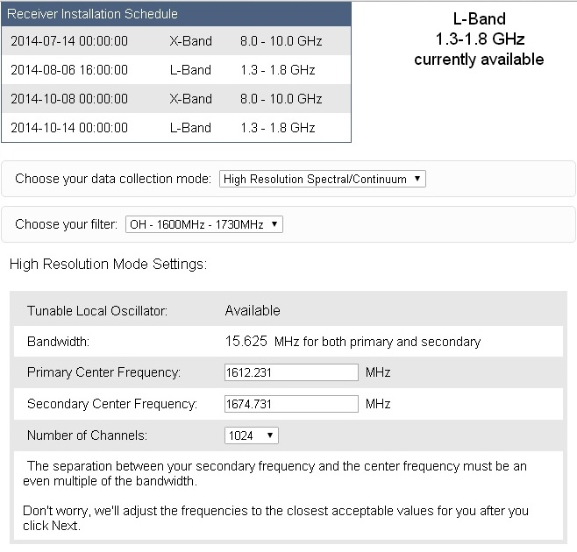
20 Meter Dish Demo
Configure Receiver
Low Resolution: continuum mapping/pulsars
High Resolution: Spectral Lines
No Filter Full Band (with interference)
H1 Filter (continuum maps, 1355-1455 MHz)
OH Filter (Iridium sat. interference, 1.6-1.73 GHz)
Data Collected in Bins: Time bins (data collected in a small chunk of time) or frequency bins (data collected in a small chunk of observing frequency).

Slide 7
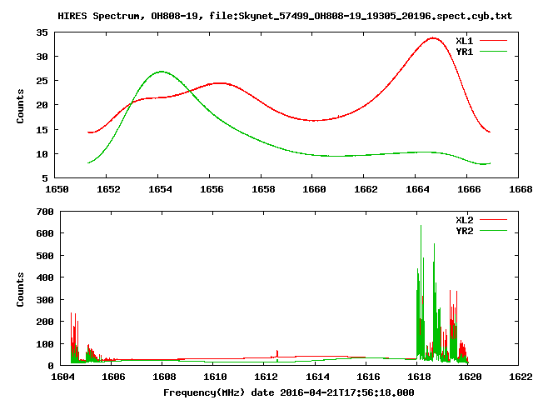
20 Meter Dish Demo
Electron polarization: A property of electrons defined by the Pauli Exclusion Principle but simply described as up or down, or left and right. Radio telescopes are equipped with polarizing filters that distinguish between the two electron polarizations.
Tracking Example
Maser OH808-19
1612 MHz (Tzikas)
Shows the average spectra
averaged over all integrations. The upper and lower plots are for the two frequency bands and the two traces in each plot are for the two polarizations.

Slide 8
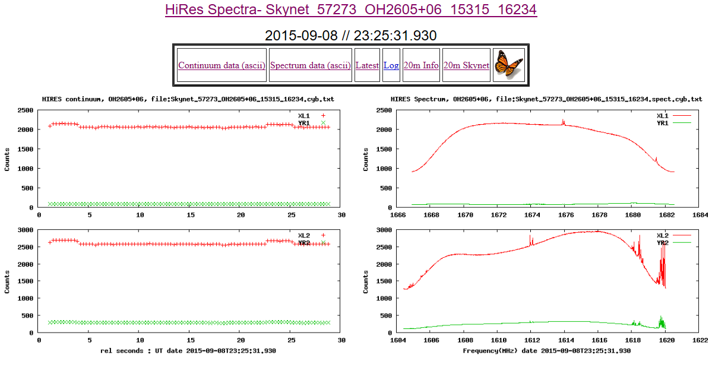
20 Meter Dish Demo
Tracking Example
OH2605+06
1612 MHz (Tzikas)
Shows the continuum. This is the average of the central 80% of each spectrum pattern vs time. The four traces are two polarizations and two frequency bands. Note Baseline, Calibration, and Target traces.

Slide 9
20 Meter Dish Demo
https://www.gb.nrao.edu/20m/map20m_advice.html
Good Raster Map: Uses 6x6 Beam widths (8x8 provides better quality). Sampling density (Gap between sweeps) default is 1/10 Beam width (about 18 minutes duration). Increasing gaps to ¼ beam width will considerably reduce time and cost. Notice too how slew speed changes and effects overall duration of observation. If you want better sensitivity, you can increase the integration time, but do not increase it to more than 2 seconds. Generally, you are discouraged from making maps that take more than 30 minutes or so to complete. If you want to map a very big area, it is more efficient to make several smaller maps. NOTE: Maps should be at least 5 beamwidths across, otherwise you cannot distinguish the object from the background.
Daisy: Quick look use 90-180 arcmin radius (4 petals) and 120-180 seconds; for denser use 240 arcmin radius (8-12 petals) and 240-360+ seconds. Use 0.2 - 0.3 seconds integration time for both.
Elevation: Set the minimum elevation to 25 degrees. NOTE: Blocking near the horizon: Use a minimum elevation somewhat higher than the default 5; there is blockage in certain directions near the horizon. The horizon is less blocked to the south; for far south sources such as the galactic center, the minimum elevation of 3 degrees will probably be ok. Due to the radiation from the atmosphere, mapping near the horizon shows the variations in system temperature due to the atmosphere, which may drown out the brightness from weaker sources. Best to use a minimum elevation of 25 degrees when doing maps.
Solar Separation: Set the solar separation to 15 degrees. NOTE: The 20-meter can pick up radiation from the Sun in its far sidelobes. To avoid, try to keep all parts of a map at least 15 degrees away from the Sun. In the Skynet interface, set the "Solar Separation" to 15, unless you really want to observe the Sun. Viewing near the Sun: It only takes a tiny specular reflection from something like a feed support component to cause a response from the Sun.
Slew Speed: if greater than 0.6, increase the integration time in steps of 0.1 until slew speed is less than 0.6.

Slide 10
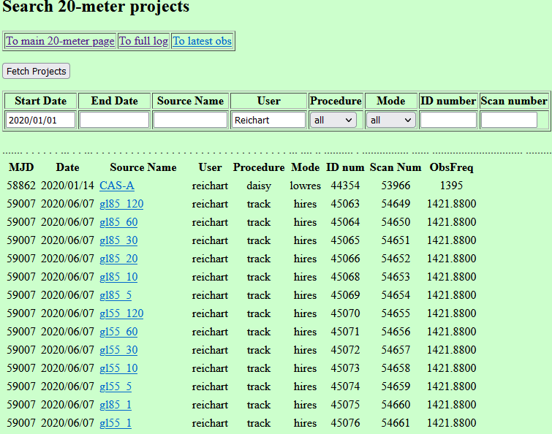
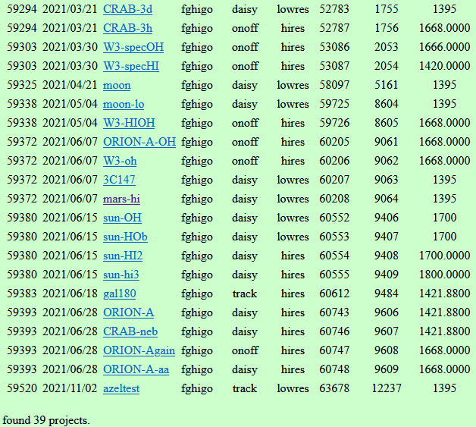
20 Meter Dish Demo
Search Options
To search by user, type person’s name into User Box (e.g., Dr. Reichart or Frank Ghigo, GBO Scientist [fghigo])
To search by Source Name, type a target into that box (e.g., Mars)
Look for classes, events, tests, calibrations, observations

Slide 11
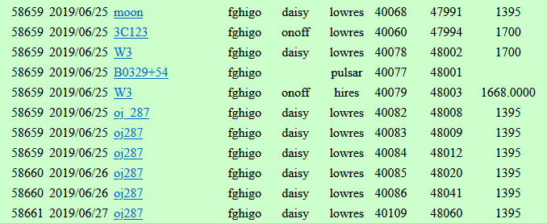
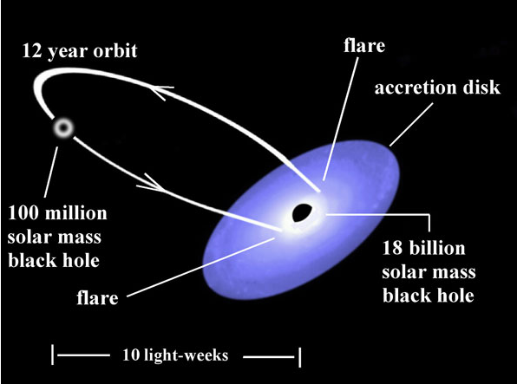
20 Meter Dish Demo
Search Option Example
Frank Ghigo (GBO Scientist) and OJ 287 Target
Credit: https://skyandtelescope.org/astronomy-news/black-hole-duo-flares-right-on-time
The OJ 287 system “flares” when the smaller black hole plunges through a disk of gas around the larger one, an event that occurs twice during each 12-year orbit.

Slide 12
20m Useful Comments
Key Points Before We Start
Archived Raster Observations were submitted by both knowledgeable scientists and exploring students. Quality varies greatly.
A lot of raster scan results can be:
H I
Satellites
Noise & Software Imaging Artifacts
For raster scans of real targets:
They will not show detail within the beamwidth
The target’s radio raster apparent size should not be confused with apparent optical size
Be mindful of raster scan Field of View (FOV) to the apparent optical size
There is a lot to explore with the 20m dish. This slide deck provides considerations on how to interpret your results.

Slide 13
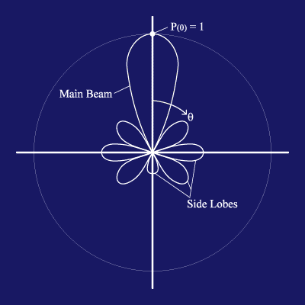
20m Useful Comments
https://www.gb.nrao.edu/20m/map20m_advice.html
Credit: http://www.ras.ucalgary.ca › radiotel › calibration
Beam and Beamwidth (Visualization Basics)
The beam is the area on the sky in which radiation will be detected by the radio telescope. In terms of the telescope as a receiver of radiation, it will respond to the radiation coming in along that same beam as if it were a transmitter. In general, a smaller telescope has a wider beam. The reflecting dish of the radio telescope gives the antenna considerable directionality by focusing radio waves from a particular direction onto the horn. It is still sensitive to radiation from directions other than the pointing direction. The largest lobe is called the main beam and the smaller lobes are called side lobes.
The beamwidth of the full width half maximum (FWHM) of the main beam: This defines the resolution of the telescope. When a point source is in the most sensitive part of the main beam, the measured signal will be highest. As the point source is moved away from the center of the main beam, the measured signal will decrease. Therefore, by moving the point source through the main beam, the shape of the main beam is mapped out. Only structures on angular scales larger than the telescope's beam can be revealed. The angular resolution of a given antenna system is limited by the beamwidth. The 20-meter telescope is like a camera with one pixel, or beam. To make an image, one must scan the telescope back and forth across the object and build up an image, pixel by pixel.
Beamwidth (BW) = 70λ / D. It’s related to resolution. λ is the observing wavelength, and D is the telescope diameter. λ = 0.3 / frequency
For the 20m radio telescope:
The 8-10 GHz receiver has a beam size of about 7 arcmin.
The 1.4 GHz receiver has a beam size of about 44 arcmin.
(Some calculate a 0.6 degrees full width half maximum power response)
The antenna 3dB beamwidth is the angle between the half-power of an antenna pattern or beam over which the relative power is at or above 50% of the peak power. Example : An antenna has a diameter of 2m and frequency 16GHz. Calculate the 3 DB beamwidth for the antenna. To find 3 dB Beamwidth, first calculate the value of λ, Substitute the values in the λ formula, λ = 0.3 / frequency λ = 0.3 / 16 λ = 0.01875. Substitute the values in the beamwidth formula: Beamwidth = ( 70 * 0.01875 ) / 2 = = 1.3125 / 2 degrees = = 0.656 degrees
The sensitivity of a telescope is not uniform across the beam. In most cases, the telescope is most sensitive to radiation entering the telescope straight-on, and the sensitivity fades off towards larger angles. Radiation that enters in the beam but off-center might produce a response in the receiver 80% of that when it enters in the very center.
The Radio telescope system temperature is the amount of noise that will appear in a measurement and which the signal from the source (measured as antenna temperature) needs to stand out from to be detected.
The angular resolution is given by: θ ~ λ/D
See https://www.omnicalculator.com/physics/angular-resolution
(Allows use of multiple units)
BW = 1.2λ/D (in radians)
BW = 62/Fghz (in arcminutes); Fghz = GHz (instead of λ)
(for a 20-meter telescope)

Slide 14
20m Useful Comments
Why are Deep Space Objects interesting to observe in radio?
They can fade with time (e.g., Cas A)
They rotate slower with time (e.g., pulsars)
They are variable with time (masers)
General Raster Scan Tips and Comments:
Compare the known apparent size of the target vs. the raster scan’s RA/Dec size (FOV).
Consider impacts due to intragalactic dust and gas, especially concentrated in the galactic plane (Heavy H1 observations and processing artifacts can often mislead observers).
Check “Kelvins” for clues and compare to the calibration and system temperatures.
Search the 20m log for similar observations before you do a raster scan.
Look at both the raster scan and the 20m tracking observation (noise and RFI impacts?).
Find summary of input parameters at “Skynet: My Obs” tab.
Calculate your beamwidth: The smaller the beamwidth, the better the resolution of the telescope.
Understand that continuum sources (e.g., Cas A and Cyg A) show the increase of intensity across the full (receiver) spectrum as the source passes through the telescope’s beam.
Experiment: Because there are no detailed manuals for observing.
Be cost conscious: Some raster scans can be expensive.
Browse observations in the 20m log: Results may or may not always be consistent.
Assume the RA/Dec and Az/El pointing of the telescope is designed to be on-date, not set to an epoch.

Slide 15
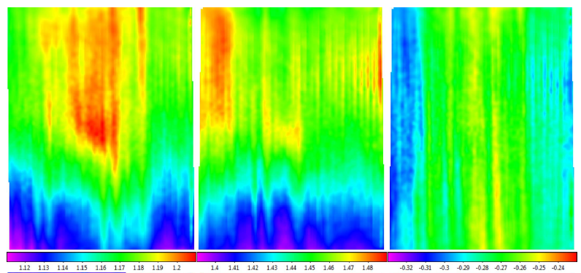
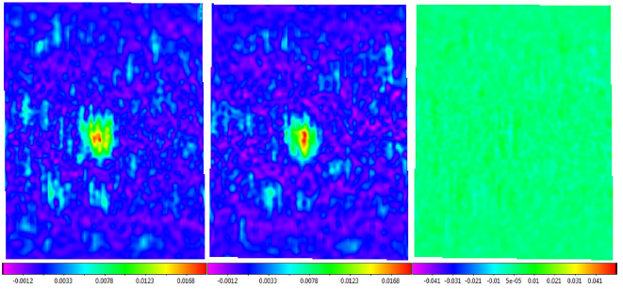
20m Useful Comments
Signal Drift
Skynet Algorithm for Single-dish Mapping. I. Contaminant-cleaning, Mapping, and Photometering Small-scale Structure: J.R. Martin, D.E. Reichart, et al.
The Astrophysical Journal Supplement Series, 240:12 (50pp), 2019 January
Top Row: Instrumental Signal Drift
Bottom Row

Slide 16
20m Useful Comments
Let’s look at some Deep Space Object raster scans and interpret them
(my opinions)

Slide 17
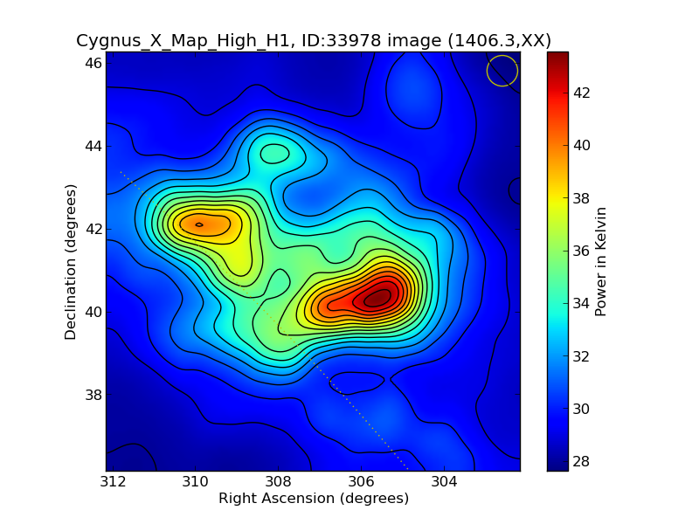
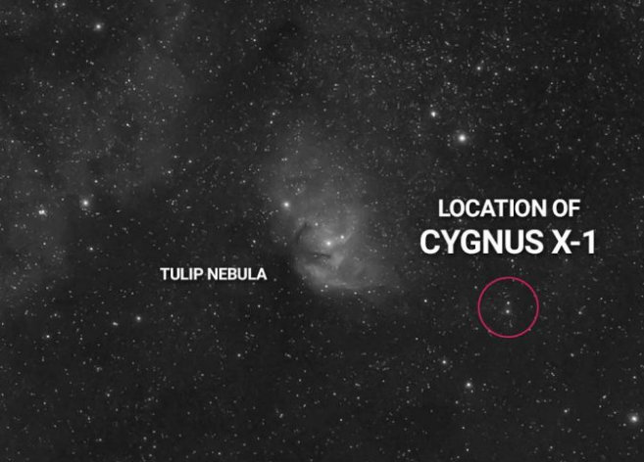
Raster Scans and Considerations
Cyg X “Black Hole” Area
Skynet_58270_Cygnus_X_Map_High_H1_33978_34808
Considerations:
Avoid casual comparisons to the optical image. Be mindful of FOV, object size, beam width, and center of FOV as it relates to the target.
Above: The Tulip Nebula’s Apparent Dimensions (optical) are 16′ x 9′, vs the 10x10 degree FOV in the radio image (on left). Notice the similar shapes are coincidence.
(Photograph Source: AstroBackyard, The Tulip Nebula)

Slide 18
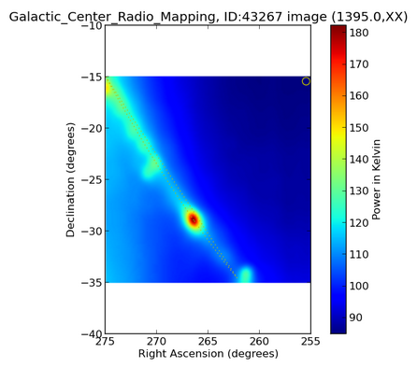
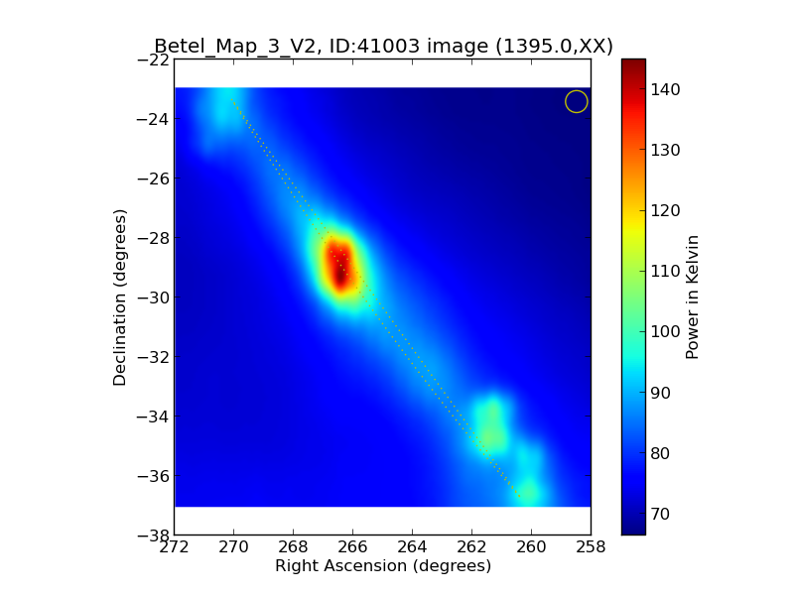
Raster Scans and Considerations
Black Hole Sag A “Black Hole” Area
Skynet_58792_Galactic_Center_Radio_Mappin_43267_52929
Skynet_58697_Betel_Map_3_V2_41003_49477
Considerations:
Easy to confuse Sag A with the off-center H1 concentration, or that the observer even used Sag A input coordinates, which is unlikely as both FOVs have a different center point. Notice the large FOV with narrow plane is likely Milky Way H1.

Slide 19
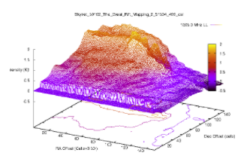
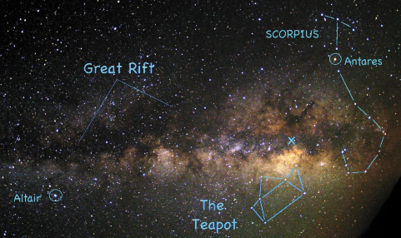
Raster Scans and Considerations
Great Rift Radio Observing
(Long dark dust cloud lane)
Skynet_59192_The_Great_Rift_Mapping_2_51504_499
Internet Example Great Rift Optical
Considerations:
Another wide FOV with narrow plane. Is it Milky Way interstellar dust, or does that even matter when observing in radio for H I?
Photograph Source: Linda Chisholm Word Press

Slide 20
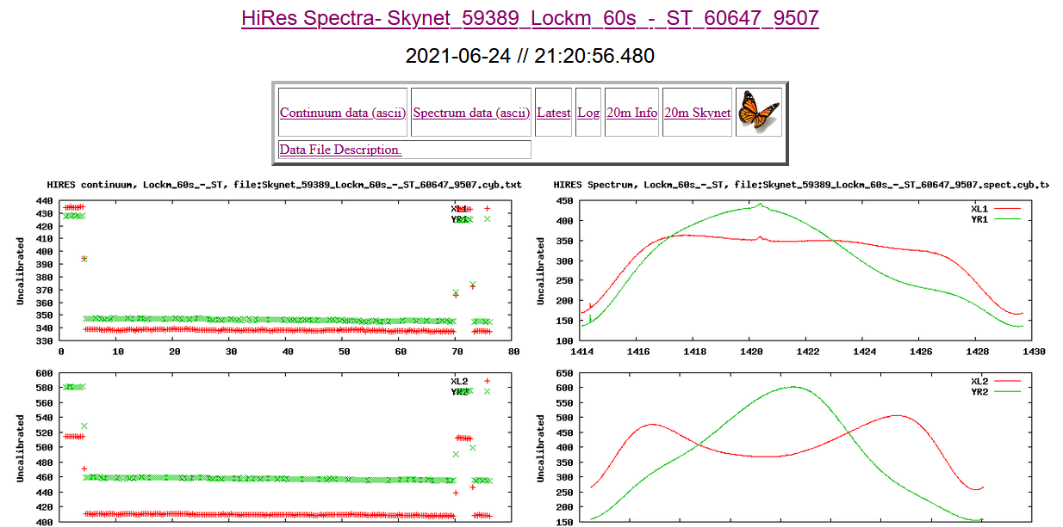
Raster Scans and Considerations
Lockman Hole - Northern Hemisphere
(Chandra Deep Field South for Southern Hemisphere)
Considerations:
A rare nothing!

Slide 21
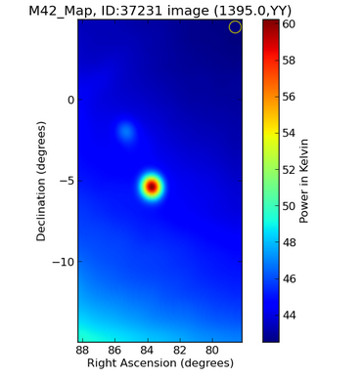
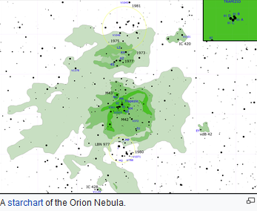
Raster Scans and Considerations
HII Star Forming Region M42 (Orion Nebula)
Skynet_58428_M42_Map_37231_38105
Considerations:
Essentially a round radio object within the beam width vs an optical view. But the next slide shows the possibilities with advanced processing radio astrophotography. Consider that with a larger FOV, some stronger radio sources may contrast better from some backgrounds.
Nebulae are simply clouds of gas and dust in space. Some nebulae are stellar birthplaces (the Orion Nebula).
Some are the remains of dead stars (planetary nebulae and supernova
remnants). Some are mixtures of several different types of nebulae (the Trifid Nebula -- a combination of emission, reflection, and dark nebulae).
Source: Wikipedia

Slide 22
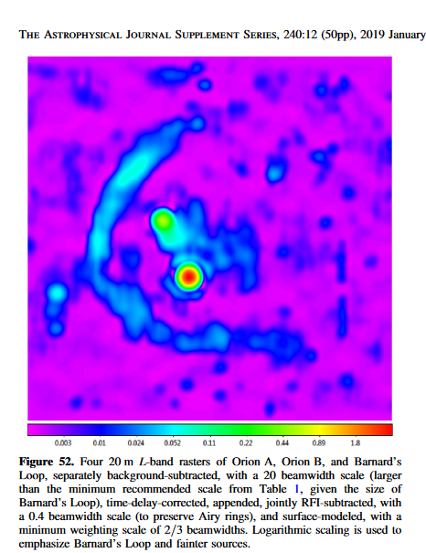
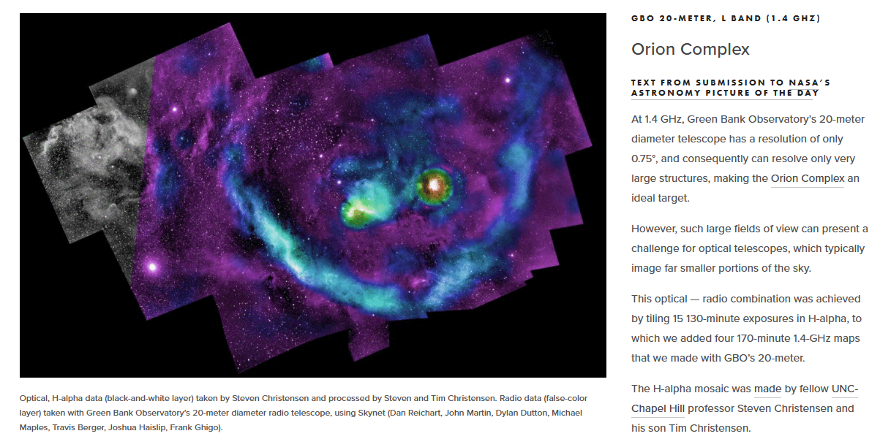
Raster Scans and Considerations
HII Star Forming Region M42 (Orion Nebula) with Barnard’s Loop
Advanced radio astrophotography with the 20m. See Dr. Reichart’s paper

Slide 23
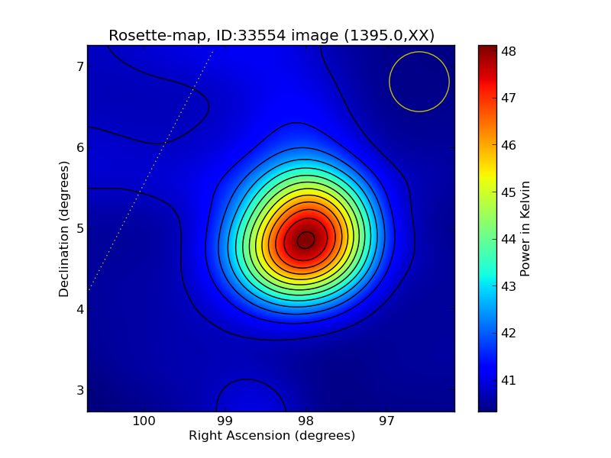
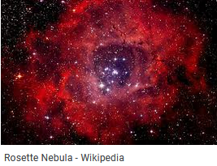
Raster Scans and Considerations
HII Star Forming Region Rosette Nebula
Skynet_58256_Rosette-map_33554_34352.A.cal_XX0_img
Internet Example Rosette Nebula Optical, Apparent dimensions: 1.3°
Considerations:
Another essentially round object within the beam width vs optical image. Notice the large optical dimensions with respect to the beam size and resolution.

Slide 24
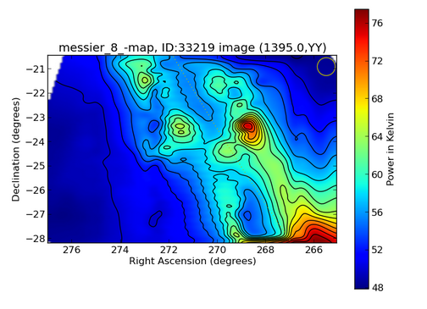
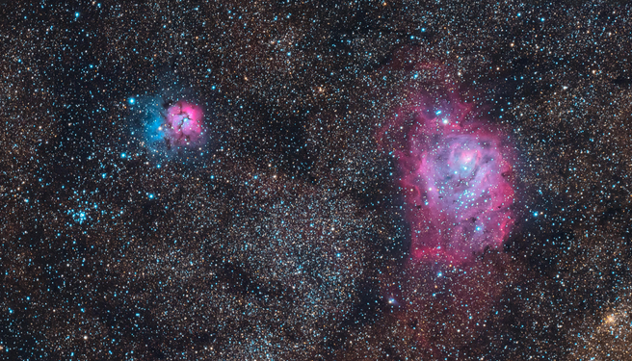
Raster Scans and Considerations
Lagoon Nebula (M8) HII Star Forming Region
Skynet_58248_messier_8_-map_33219_34009
Lagoon (M8) Nebula and Trifid (M20) Nebula
Source: Wikipedia
Considerations:
Optical objects over a greater FOV. Imagine moving your binoculars over the same wide area. Why do you think this large FOV looks different from that of Orion A?

Slide 25
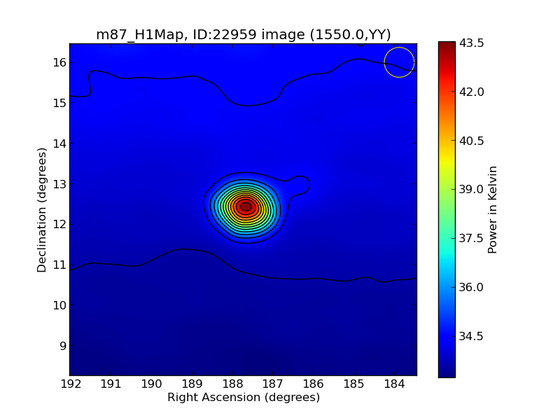
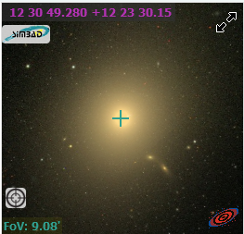
Raster Scans and Considerations
Radio Galaxy Virgo A (M87)
Skynet_57601_m87_H1Map_22959_22922.A.cal_YY0_img: Virgo A angular size 9.12’ × 7.94’ (SIMBAD Optical): What is the rest of the observation? Extended periphery? Extended antenna beamwidth angle less than the half-power of an antenna pattern, i.e., beam over which the relative power is less than 50% of the peak power?
Considerations:
Be mindful of FOV, object size, and beam width. Yes, object is centered (very strong radio object). See next slide with Dr. Reichart’s advanced processing.

Slide 26
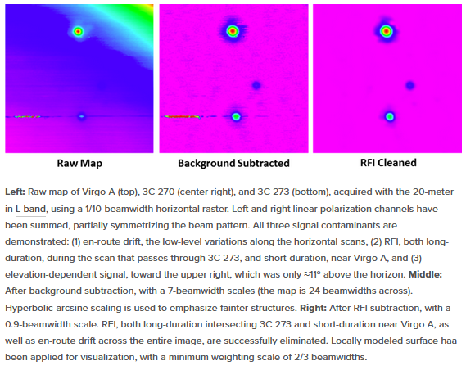
Raster Scans and Considerations
Radio Galaxy Virgo A (M87)
Dr. Reichart’s 20m advanced processing:
https://www.danreichart.com/radio

Slide 27
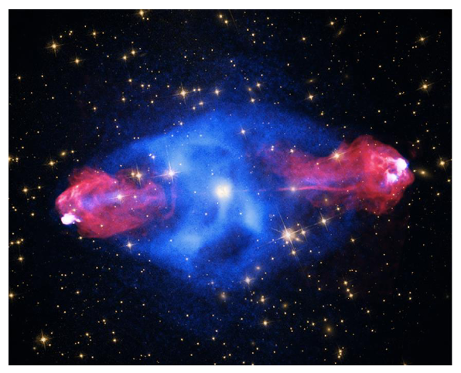
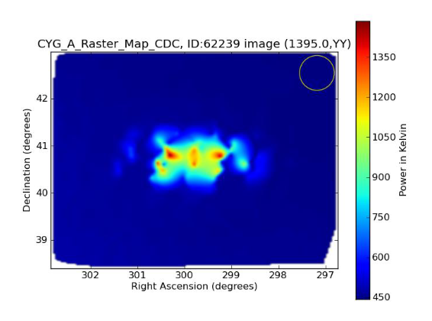
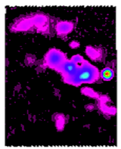
Raster Scans and Considerations
Quasar Cyg A
Skynet_59482_CYG_A_Raster_Map_CDC_62239_11066, & Internet Image, & https://www.danreichart.com/radiophoto
Considerations:
Avoid casual comparisons to the optical image. Be mindful of FOV, object size, and beam width.
Point Source: The radio source of Cyg A is a point source and is not in the 20m radio telescope resolution: no structure can be resolved.
A 20m radio telescope at L-band will have a beamwidth of about 0.8° (depends in part on dish illumination).
A scan over the region should show a single source extending over about 0.8° in declination and about 1° in right ascension (0.8°/cos(declination)), as roughly shown.
The structure inside this area is most likely an artifact due to the software’s post processing of the data into the map. This is in part due to the parameter settings for creating the plots (see next slide on how this can vary).
Sidelobes might play a role but would likely extend further out into the scan.
Source: Astronomy.com (2/18/2019) [NASA/CXC/SAO]

Slide 28
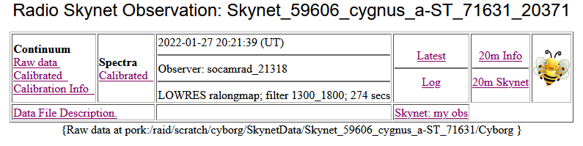
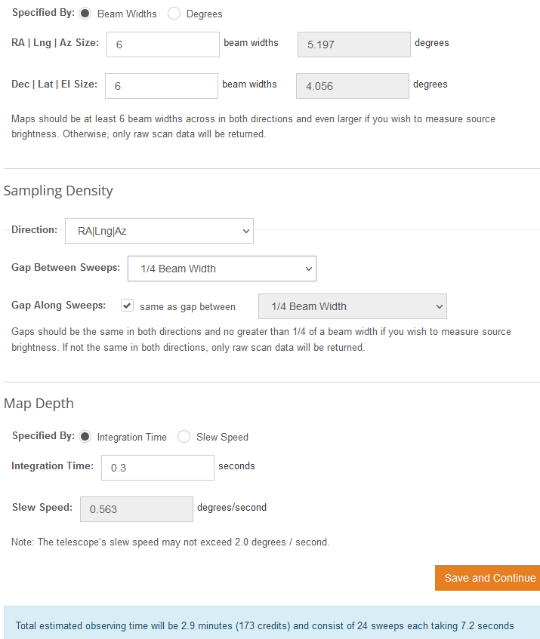
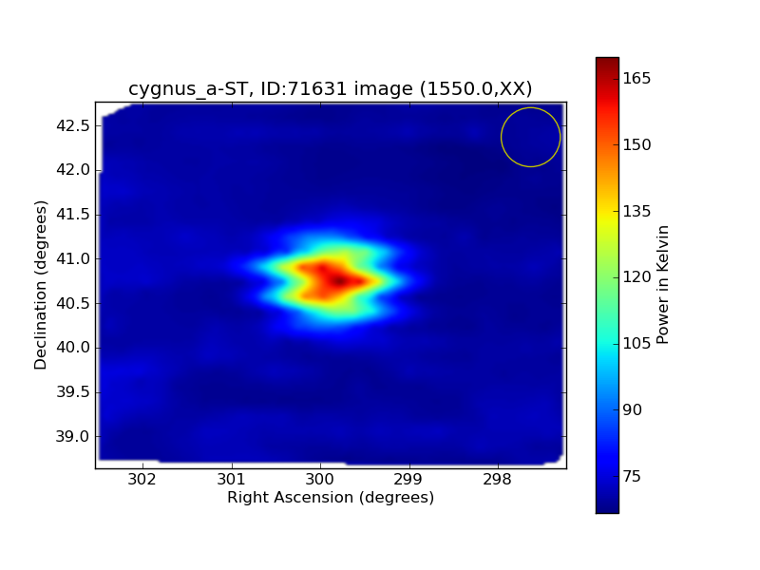
Raster Scans and Considerations
Quasar Cyg A
Considerations:
In this observation notice the sweep pattern with ¼ beam width!

Slide 29
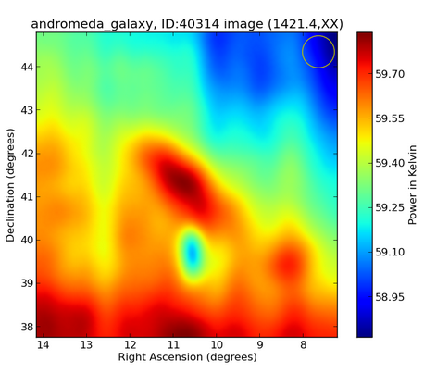
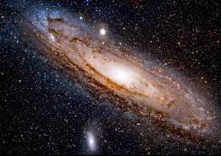
Raster Scans and Considerations
M31 Andromeda Galaxy & M110
(Moon is ½ degree, M31 is about 4 Moon lengths)
Skynet_58674_andromeda_galaxy_40314_48395
Considerations:
Just about right on the casual comparison to the optical image. M31 is huge at 4 lunar diameters as is centered in the raster scan. Be mindful of the beam width too.
However, the coordinates of the larger satellite galaxy M110 does not correspond to anything discernable in the raster scan. The “blue yellow” oval spot is unknown without further investigation.
Source: Wikipedia

Slide 30
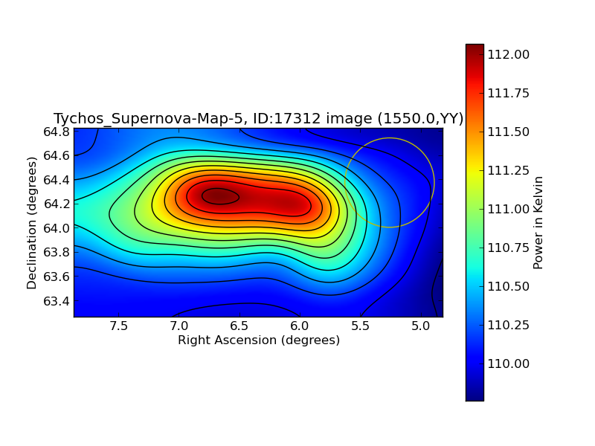
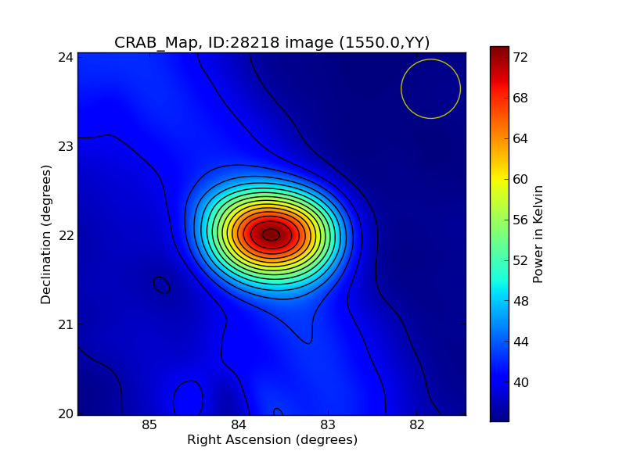
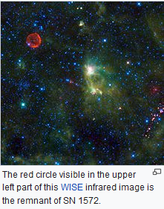
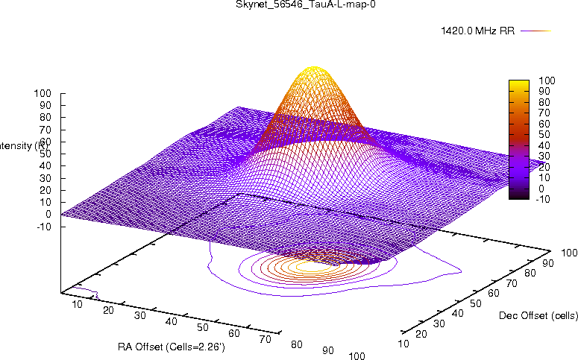
Raster Scans and Considerations
Cas B SNRb (SN 1572)
Skynet_57431_Tychos_Supernova-Map-5_17312_18325.A.cal_YY0_img
SNR Tau A Crab Nebula
Skynet_56546_TauA-L-map-0_3D_R
Skynet_57893_CRAB_Map_28218_28573.A.cal_YY0_img
Considerations:
Avoid casual comparisons to the optical image. Be mindful of FOV, object size, and beam width. A lot of H I in the Cassiopeia Constellation
From Wikipedia

Slide 31
20m Useful Comments
Let’s look at some Solar System raster scan targets and interpret them
(my opinions)

Slide 32
Raster Scans and Considerations
Solar, Lunar, & Planetary Observing
Solar System Possibilities?
Eclipses, Occultations, Jovian Comet Collisions
Active Sun and Solar Flares
Thermal Black Body and Synchrotron Temperatures
Planets are generally only thermal emitters (producing radio emission due to black body radiation from their surfaces). Since they are generally cold (700 K for Mercury down to 30 K for Pluto), they are weak emitters. Jupiter is the main exception. Its large magnetosphere would be a larger angular size than the Moon if we could see it in visible light. It traps high-energy electrons that then emit synchrotron radiation.
Can planetary objects exhibit seasonal, magnetic field, and even phase effects/events?
Jupiter Storms: I did several 20m observations of Jupiter storms in 2022 but did not find a conclusive foundation to comment one way or the other. More experimentation is needed.

Slide 33
Raster Scans and Considerations
Solar System Raster Scan Tips and Comments:
Review location in sky (solar system objects have variable celestial coordinates and angular diameters).
The 20m scope has certain result screens that provides a power in Kelvin that needs to be converted for the temperature of an object.
Note observation frequency: modest changes can produce different results.
Understand the 2 polarization curves: results can be different (synchrotron radiation)
Validate planetary observations. There are many objects potentially in the beam/FOV: celestial deep space radio objects, H I “patches,” and satellites.
Observe Uranus (near 3.5 cm ) via the 34m Goldstone Apple Valley Radio Telescope (GAVRT).
Verify that the 20m placed the target in the center of the FOV, and that the objects coordinates are correct.
Choose input parameters wisely. They make a big difference: low/high resolution, bandwidth, number of sweeps, sweep gaps, and frequency.
Understand that some events (e.g., Jupiter storms) do not occur on the planet. Different types of Jupiter storms are specific to certain locations in its magnetic field.
Avoid queuing certain observations that need to be timed to events (Jupiter storms, Solar activity).
Jupiter’s magnetosphere extends out to nearly 3 million miles on average. If detected, it should appear as an oval of synchrotron emissions in L-Band (1.4 GHz).
20m Map Depth: The system will fill in the integration time and slew speed. For better sensitivity, increase the integration time, but not more than 2 seconds.
Be mindful of a planet’s ephemeris (how accurate are your coordinates?)
Assume the raster scan algorithm can accurately center an object as accurately as the direct targeting (non-raster) capabilities of the 20m scope.
Try experimenting with Az/El raster scanning vs the default RA/Dec raster scanning.
Interest shown by professionals in planetary objects, so “theoretically” observations are possible:
- Skynet_58767_Jupiter_42525_51173 at center frequency 1395 MHz, Observer fghigo_2839. No obvious centered Jupiter image.
- Skynet_59372_mars-hi_60208_9064 (06-07-2021, fghigo). No obvious centered Mars object. Mars at apparition on 10/13/2020.

Slide 34
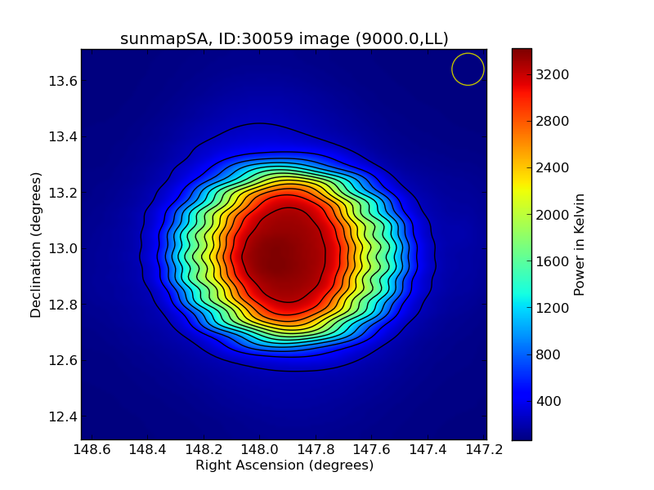
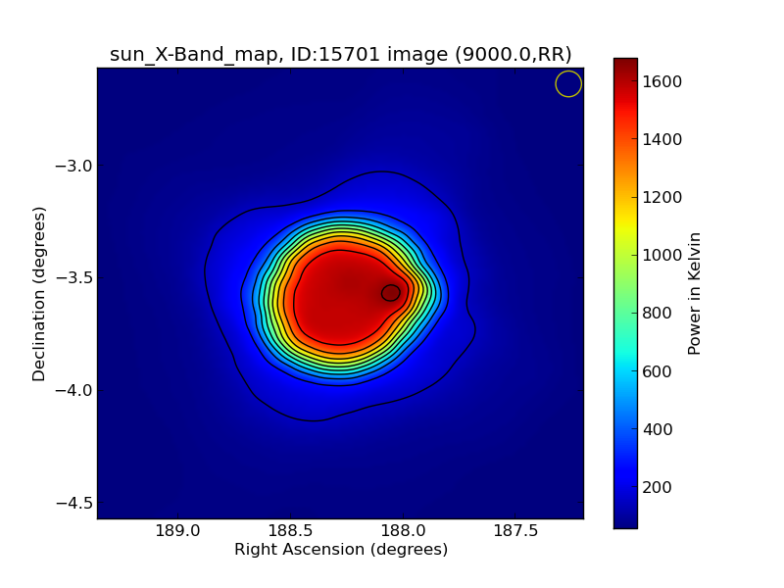
Raster Scans and Considerations
The Sun
Skynet_57983_sunmapSA_30059_30270.A.cal_LL0_img
Skynet_57297_sun_X-Band_map_15701_16626.A.cal_RR0_img (solar flare)
While the Sun’s optical corona extends up to 12 solar radii from the Sun’s surface, the L-band corona is likely smaller.
Are we also seeing the Sun’s Corona?
Did someone correlate flares to 20m observing?

Slide 35
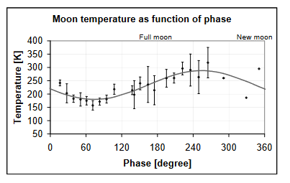
Raster Scans and Considerations
Lunar Observing
In 1946, Dicke and Beriner studied the thermal radio emission of the moon with at 1.25cm wavelength. The thermal radiation from the moon at this wavelength varied during a lunar cycle in a roughly sinusoidal fashion by about 40 Kelvin. The maximum of radio radiation was found about 3.5 days after the maximum of the surface temperature at full moon. At radio wavelengths the sun's reflected radiation is extremely small compared to the thermal blackbody emission. The infrared temperature is symmetrical with respect to full moon, reaching a maximum at full moon and a minimum at new moon. The microwave temperatures, on the other hand, exhibit not only a phase lag of several days, but definite asymmetry with respect to the maximum temperature.
See a 2002 available internet paper by Christian Monstein titled “The Moon's Temperature at λ=2.77cm.”
See a 2003 available internet paper by Marina Battaglia titled “Moon disc temperature as a function of phase a 1700 MHz.”
Monstein’s measurements over two complete cycles measured a mean temperature of Tmean=213 Kelvin. The minimum was about Tmin=192 Kelvin about 2 ½ days prior to full moon while the maximum at 236 Kelvin was about 5 days after full moon.
Battaglia’s daily measurements over one lunar cycle are shown in the chart:

Slide 36
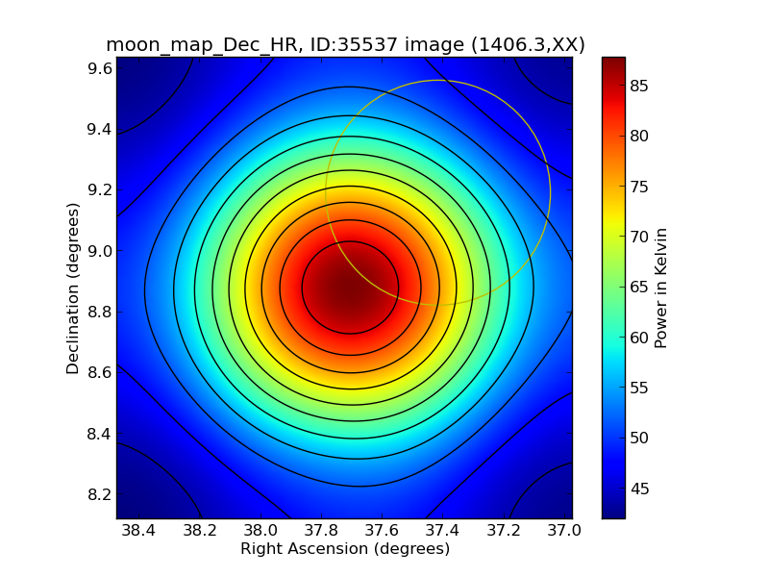
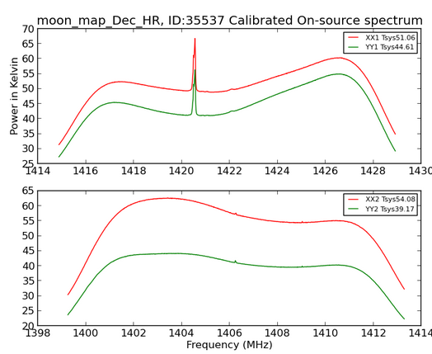
Raster Scans and Considerations
The Moon
Skynet_58334_moon_map_Dec_HR_35537_36551.A.cal_XX1_img
The Moon apparent diameter is 1/2 degree. Compare this to the FOV below.
Can a temperature vs. phase plot be constructed with 20m observational data?
Excerpted Data for this Observation
XX1 YY1 XX2 YY2 Cal Sweeps
264.6692 141.9755 247.0634 163.4958 1 0 0 ---calibration
204.8215 112.5730 194.8296 126.3973 0 0 0 ----base
557.3941 312.3885 517.2385 345.0526 0 10 1 ---moon deflection
NRAO Skynet Wiki Home: Operational Documents
https://safe.nrao.edu/wiki/bin/view/GB/Skynet/WebHome
Brightness temperature is the temperature at which a black body in thermal equilibrium with its surroundings would have to be in order to duplicate the observed intensity of a grey body object at a frequency.
Also consider that a large beamwidth (BW) will only have a little bit of the moon in it. If the beam is pointed at cold sky at 3K, and the Moon is about 200K at the observation frequency, then that 200K is divided by the fraction of the beamwidth area it occupies. For example, if the Moon occupied 1/24 of the beamwidth area, you roughly have 3K cold sky plus 1/24 * 200K, or an additional 8K of Moon noise. Be aware of this to detect that change.

Slide 37
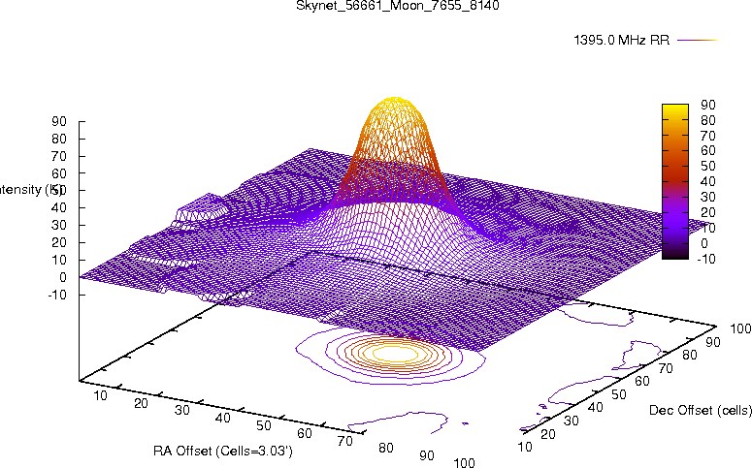
Raster Scans and Considerations
The Moon: 20m Temperature Calibration Example
For a source of known brightness temperature, the relationship between antenna temperature Ta, brightness temperature Tb, and aperture efficiency e is given by:
Ta = 0.36Tb e
Where the factor 0.36 accounts for the 21cm beam resolving the Moon. Assumptions: The Moon is a disk of 30 arcmin in diameter and the 20m is gaussian in shape.
Dcal = Calibration deflection or height of the calibration above baseline (calibration is flagged by “1” in the last column of the 20m data files.
Dmoon = Moon deflection or height of maximum above baseline.
The 20m website has the following notes:
Take the known thermal temperature of the Moon = Tb = 200K
Ta = 0.36 Tb e (use e=0.6) = 43.2K
The Calibration temperature Tcal = Ta(Moon) * Dcal/Dmoon
Tsys = system temperature
The factor Ak = Ta(Moon)/Dmoon gives the conversion from units in the txt file to temperature in Kelvin.
If you use the value of the baseline Dbase, then
Tsys = Ak * Dbase
For observation Skynet_56661_Moon_7655_8140.txt
Dbase = 300 (My note: 300 is the approximate low value in the data)
Dcal = 348-300 = 48 (My note: 348 is the approximate beginning and end values in the data)
Dmoon = 505-300 = 205 (My note: 505 is the approximate high value in the data)
Thus
Ak = 43.2/205 = 0.211
Tsys = 300 * 0.211 = 63K
Tcal = 43.2 * 48/205 = 10.1K

Slide 38
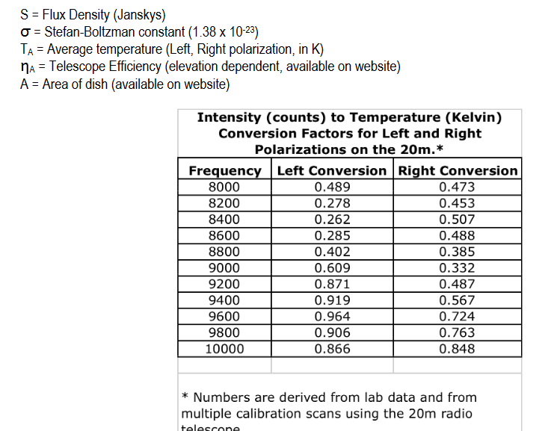

Raster Scans and Considerations
The Moon
So, can a temperature vs. phase plot be constructed with 20m observational data?
My Initial Effort:
I could not find consistent data in the 20m archive of lunar observations.
My Assumption: Each of the 2 frequency/polarization plots have their own temperatures. I did not average or add data together.
My Assumption: There appears to be a variability between observations, unless a more rigid methodology is adopted.
Converting Data to Temperature
Put 20m ASCII data into Excel and convert the given left and right intensities (in counts) to Kelvins. For Kelvins: The intensities in the ASCII file are total intensities of the object and system intensities. Subtract the system values for the left and right polarizations found in the corner of the 2D plot. Then use the following conversion factors that can be found in an Excel table on the website.
For Janskys: Use the following equation
Source: NRAO Using the 20m Radio Telescope: A Manual for Teachers.

Slide 39

Raster Scans and Considerations
Planetary Observing
Even more challenging than the Moon, the beamwidth of the antenna is now considerably larger than a planet’s solid angle.
Since planets are generally cold (700 K for Mercury down to 30 K for Pluto). They are weak emitters.
If observed, the Kelvins of temperature increase, above Tsys, would be very small.
Jupiter observing is possible (especially with its synchrotron radiation), but I have yet to see a good observation for the other planets on the 20m.
Object | Angular diameter
Andromeda Galaxy | ~ 3° × 1°
Sun | ~ 31' - 32' (arcminutes)
Moon | ~ 29' - 34' (arcminutes)
Venus | ~ 10" - 65" (arcseconds)
Mars | ~ 4" - 25" (arcseconds)
Jupiter | ~ 30" - 51" (arcseconds)
Saturn | ~ 15" - 21" (arcseconds)
An August 1999 paper appeared in Astrophysics and Space Science by Carlos Alberto Olano (Universidad Nacional de La Plata), entitled Jupiter’s Synchrotron Emission Induced by Collision of Comet Shoemaker-Levy 9. It noted the rise in Jupiter’s 21 cm-continuum due to the collision. The difference between the maximum flux and that previous to the event, averaged over all Jupiter’s System III longitudes of the central meridian was about 1.2 Jy for the distance of 4.04 AU. This difference of 1.2 Jy was equal to about 20% of Jupiter’s flux. A 30m dish was used.

Slide 40



Raster Scans and Considerations
Jupiter Synchrotron Radiation (Speculations)
Skynet_59130_Jupiter_-ST_46736_56280.A.cal_YY0_img
10-08 -2020. 1550 MHz center freq.
Possibilities: Maybe H I, as the background is in the Constellation Sagittarius. Maybe a satellite is more probable (see power/frequency chart). Maybe synchrotron radiation? Synchrotron radiation is highly polarized and may appear in only one of the polarization images. Is it an off-center Jupiter magnetosphere, which appeared only in one polarization scan (as below)? Or are these color-coding artifacts that “simulate” different images in the different polarization raster scan images?
Skynet_59401_Jupiter_60935_9794
2021-07-07 06:58:20 (UT)
Possibilities: A source is right in center where Jupiter should be. Notice reduced FOV. Center Frequency 1395.0 MHz (H1 filter), no obvious interference. Could it be H I or a Jupiter storm? In this observation, Jupiter is in the Constellation Aquarius (i.e., farther from the galactic plane).

Slide 41




Raster Scans and Considerations
Jupiter Observing
What could it be?
Skynet_59612_Jupiter_-_ST_Storm3_71675_20419.A.cal_XX0_img.png
Frequency set on H I, so it is not a satellite.
Vague patch in center.
Stronger one in top- right quadrant (Jupiter Io A storm?)
Not the sun or moon, Not a radio galaxy.
Jupiter located in Constellation Aquarius, So possibly H I.
Center vague patch extends down from top left patch.
End of storm raster no longer shows stronger patch (But notice the differences in the two charts’ power-scale for an explanation)
Ground effects becoming prominent?

Slide 42



Raster Scans and Considerations
Jupiter Observing – Professionally on the 20m

Slide 43




Raster Scans and Considerations
Saturn Observing
Possibility: A satellite!
Center Frequency 1560.0 MHz
Secondary Freq. 1421.88 MHz
An object is off-center
Probably Compass MEO signals
Source: Initial Observations and Analysis of Compass MEO Satellite Signals. Centre National D’Etudes Spatiales May/June 2007.

Slide 44


Raster Scans and Considerations
Saturn Observing
Skynet_59531_Saturn-ST_66606_16366
Possibilities: Object is in center
Saturn in Constellation Capricorn
Probably H I concentrations & a lot of radio frequency interference

Slide 45


Raster Scans and Considerations
Venus Observing
Skynet_59369_venus_ra_dec_60185_9044
Venus was approx. 95% illuminated on 2021-6-04
An object is off-center.
Possibility: IC 443 SNR (a.k.a. 3C 157 matches the coordinates)
Source: The Spectra of Radio Sources in the Revised 3C Catalogue

Slide 46




Raster Scans and Considerations
Venus Observing (Beam Sweep Experiment)
The 20m options are a scan in the RA sweep direction versus the Dec sweep direction and it has an impact. Doing RA sweeps, I believe, runs the greater risk of skimming the horizon continuously and picking up reflections with the beam's side lobes throughout the lower part of the RA scan, if low enough on the horizon, e.g., about 30 degrees. When I switched to Dec sweeps (up and down) the raster scan did not dwell in the horizontal area continuously.
See Elevation comment on Slide 9
Actual elevation in degrees from low 30s to high 30s (A reason for minimum elevation inputs)
Signal drift (see slide 15)?

Slide 47




Raster Scans and Considerations
Mercury Observing
Possibilities:
Satellite
An object is off-center.

Slide 48

Raster Scans and Considerations
Mars Observing
Skynet_59331_ASTR_344_Mars2_EmmyWisz_59473_8294 (4-27-2021)
Possibility: IC 443 (a.k.a. 3C 157) Again!
An object is off-center. Center Frequency 1396.0 MHz, Low Resolution. Bright object is IC443 Supernova Remnant (exact coordinates RA 06h 17m 13s; Dec +22d 31m 05s)
Source: The Spectra of Radio Sources in the Revised 3C Catalogue

Slide 49
20m Useful Comments
Conclusion: This presentation was “painted with a rather broad brush.” It was not possible to research every raster scan or observation in detail, but hopefully you are now better equipped to understand your own raster observations.

Slide 50
20m Observing Podcasts
The ALPO Link
The ALPO POC: Contact Tim Robertson, cometman@cometman.net
The ALPO Requests your help to create Solar, Lunar, and Planetary Audio Podcasts
-SuperSID
-Radio Jove
-Radio Meteors
-Geophysics (INSPIRE)
-Other Topics Solar System Topics (any skill level beginner to advanced)
Links will be provided on the SARA website to all solar system radio astronomy podcast tutorials.

Slide 51
Contact and Open Forum
Questions, Comments, Volunteering?
Email SARA Section Analytical Section Coordinator
Tzikas@alum.rpi.edu
stephentzikas@gmail.com

