Slide 1
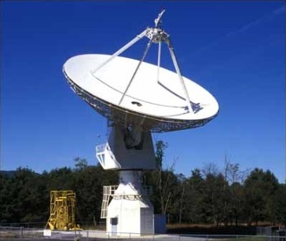
SARA East Conference 2021 Analytical Section Meeting: Demo, Masers, & W3 Radio Mapping

Slide 2
Agenda
20m Project Updates
20m Dish Demo
Maser Observing (Featured Presentation)
Some theory, charts, and maps on Masers
20m Maser Examples

Slide 3
20m Project Updates
This Maser presentation and SARA Section Update are posted on SARA Analytical Section webpage
Also Posted:
2019 demo presentation posted (Cas A Flux Density Calculation)
2020 demo presentation posted (Pulsars)
Ongoing Project: Citizen Science Database for the Fading of Cas A
Links to Astronomical League Citizen Science “awards”
Annual 20m Demos attempt to observe a different radio astronomy target type to build a reference resource on the Analytical Section webpage.

Slide 4
20 Meter Dish Demo
Green Bank Conference Account - Explore!
Skynet Account (free UNC Course) - Your Personal Account!
Demo Example – Watch the dish move outside!
Tutorial: Maser Observing

Slide 5
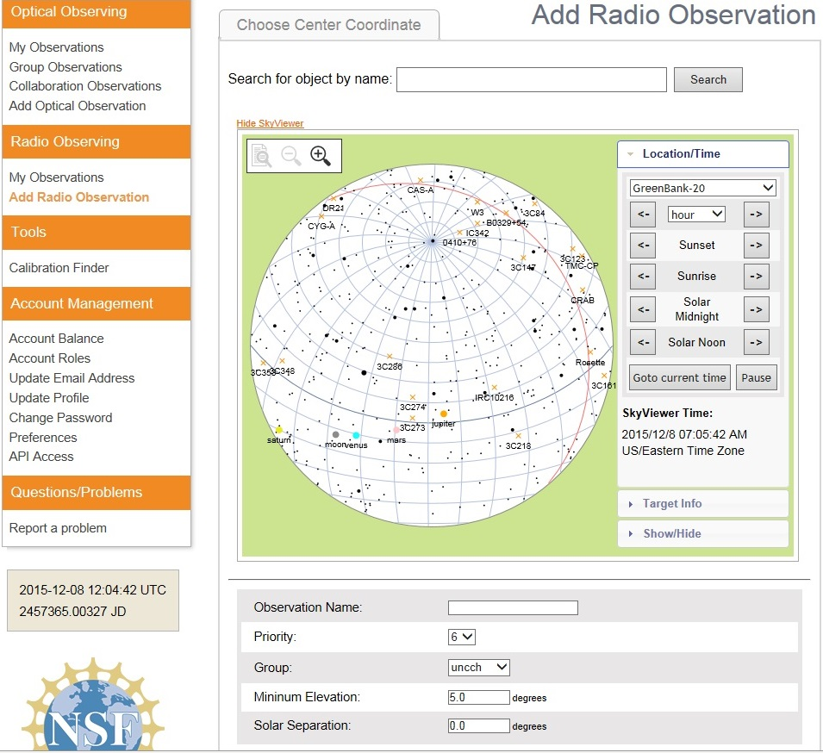
20 Meter Dish Demo
Add a Radio Observation
-Select an Object
(Database or RA/Dec)
-Minimum Elevation
(Used for mapping)
-Solar Separation
(to prevent solar side lobe
interference)

Slide 6
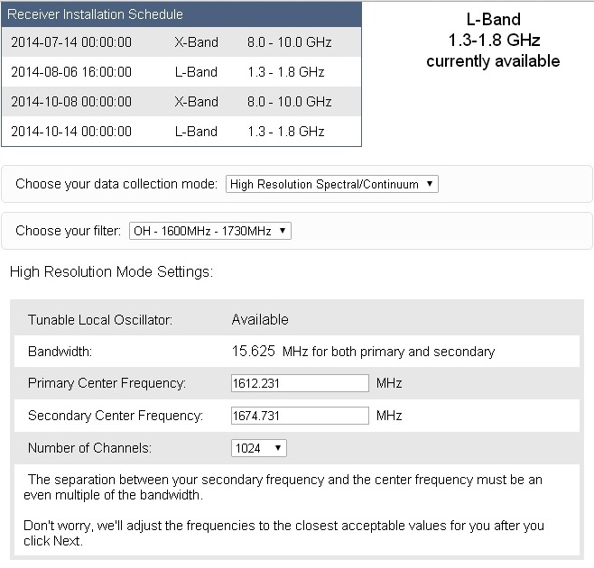
20 Meter Dish Demo
Configure Receiver
Low Resolution: continuum mapping/pulsars
High Resolution: Spectral Lines
No Filter Full Band (with interference)
H1 Filter (continuum maps, 1355-1455 MHz)
OH Filter (Iridium sat. interference, 1.6-1.73 GHz)
Data Collected in Bins: Time bins (data collected in a small chunk of time) or frequency bins (data collected in a small chunk of observing frequency).

Slide 7
Maser Observing
Introduction
(Main Source: Celestial Masers, Alan H. Cook, Cambridge University Press, Cambridge Monographs on Physics, 1977)
Observing at Radio Frequencies:
Random motion of electrons (thermal radiation)
Motions of electrons in magnetic fields (synchrotron radiation)
Atomics transition: Hydrogen at 1421 MHz
Molecular transitions
Hydroxyl (OH) Molecular Transitions Levels
1720 MHz (weak/satellite) lines
1667 MHz (strong/main) lines
1665 MHz (strong/main) lines
1612 MHz (weak/satellite) lines

Slide 8
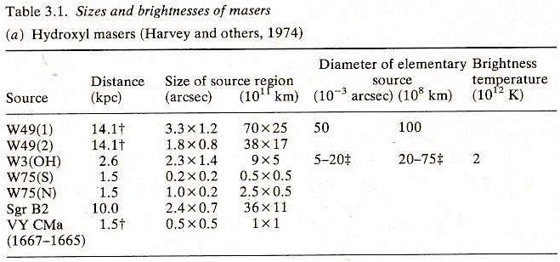
Maser Observing
List of Hydroxyl Masers
W3 is a molecular cloud 6,200 light years away in Cassiopeia and is part of Westerhout radio source catalog. W3 is associated with Heart and Soul nebula, where it is the brightest part of the heart nebula (IC1795).
Note: W3(OH) is situated 13 arcmin south-east of W3 Main. At 6 arcsec to the east of W3(OH) is a strong H₂O maser source with very faint OH maser emission – often referred to as W3(H₂O). [The angle covered by the diameter of the full moon is about 31 arcmin or 1/2°]

Slide 9
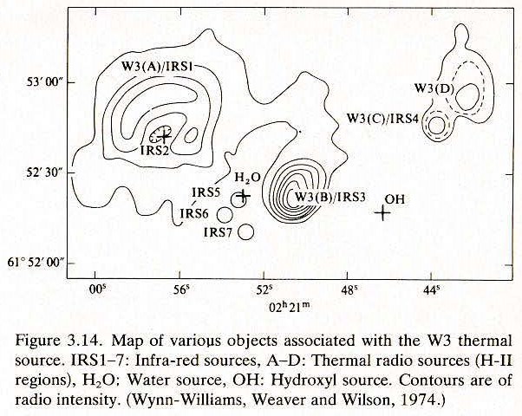
Maser Observing
Map of W3
Water and hydroxyl masers are not the only objects associated with the thermal continuum sources identified in H-II regions. This map of the W3 region shows at least two continuum sources and water and OH masers, as well as infrared sources. Other molecules have been detected in the region.

Slide 10
Maser Observing
Terminology
The angular momentum of a molecule is the resultant of the angular momentum of the nuclei rotating as a rigid body together with that of the electrons around the nuclei.
Energy of rotation of a molecule. Example: Diatomic molecules have one moment of inertia, that about any axis perpendicular to the join of the nuclei.
Abscissa: x-coordinate; Ordinate: y-coordinate.
First hydroxyl (OH) maser discovered in 1965. Afterwards a water (H₂O) emission was discovered in 1969, methanol in 1970, and silicon monoxide in 1974.
H II regions are regions of interstellar atomic hydrogen that is ionized (H⁺). H I is neutral hydrogen. O III is O⁺⁺.
Parity: a parity transformation is the flip in the sign of one spatial coordinate, which can be though of as a transformation into its chiral (mirror image) state.

Slide 11
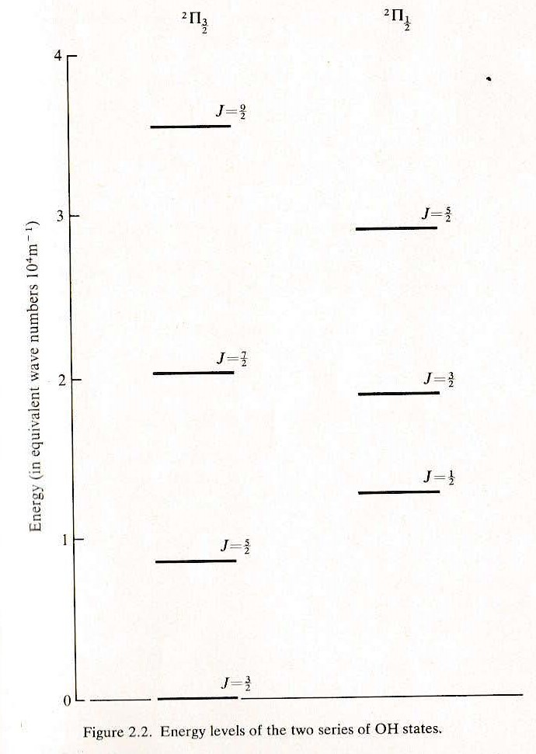
Maser Observing
Quantum Chemistry
Angular momentum of vibration of a diatomic molecule is an integral multiple, J, of the energy of rotation (because J is quantized).
Pi is the rotational state. The Superscript 2 indicates that there are two sequences of J, shown by the suffix equal to the least value of J (within that sequence).
J = ½ for the sequence of J = ½, 3/2, 5/2...
J = 3/2 for the sequence of J = 3/2, 5/2, 7/2…
An electronic interaction between the electrons and the proton depends on the quantum number F.

Slide 12
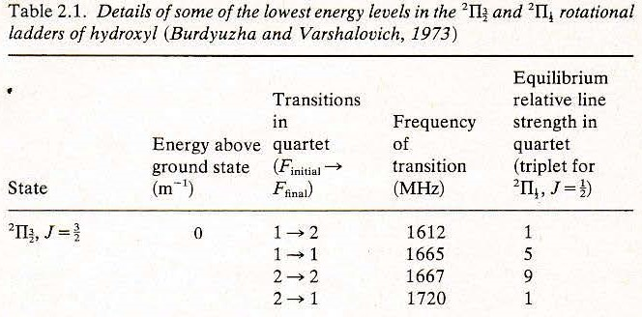
Maser Observing
Quantum Chemistry
A total wave function may be factorized into electronic, vibrational, and rotational points. The two states, Pi and J represent a doublet (called the Lambda Doublet), and the separation of the two components corresponding to a frequency of about 1666 MHz. The Lambda Doublet depends on the value of J. A doublet represents a quantum system with two possible spin states.

Slide 13
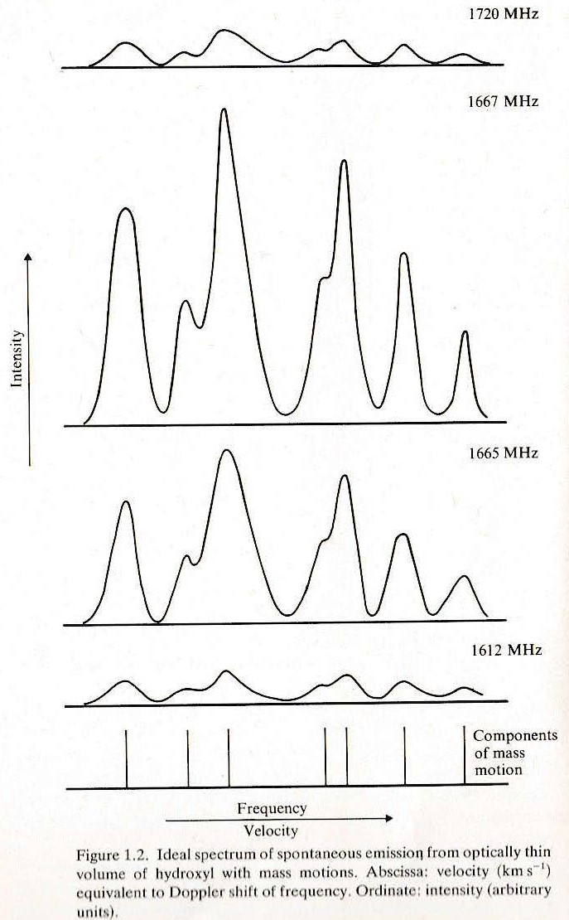
Maser Observing
Observational Charts
Spectral Lines: If a layer of gas were stationary each line would have a width determined by the temperature of the gas 2(v/c)(kT/m)^{1/2} , where v is the frequency of the transition. If the gas is moving with different mass velocities; absorption and emission will not occur at a single frequency but over a range of frequencies by vu/c.

Slide 14
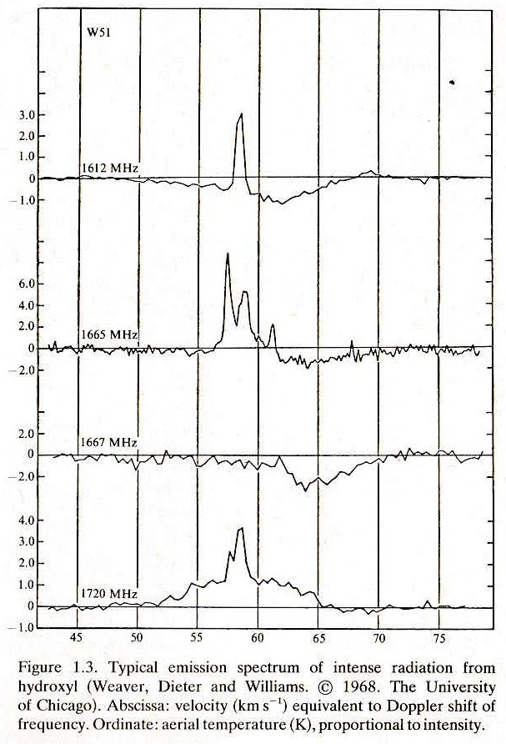
Maser Observing
Observational Charts
Dissimilar Shapes due to:
Doppler shifts by motion of radiating gas.
Different emission/absorption amounts
Different polarization amounts
Different intensities with time
Note: Positive abscissa values mean red-shifted, negative values mean blue-shifted.

Slide 15
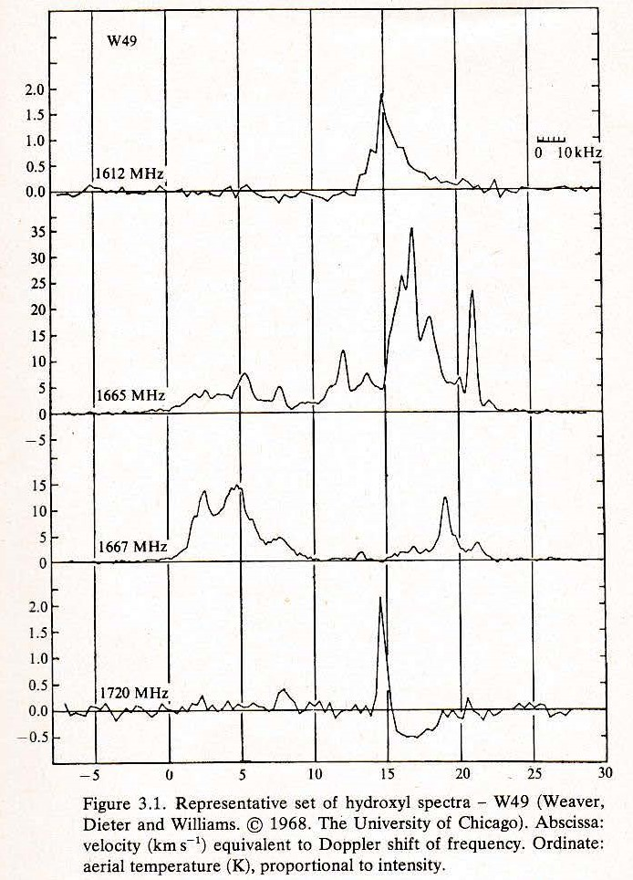
Maser Observing
Observational Charts
Frequency Spread: When a maser source is observed with a single radio receiver, the spectra of the four OH lines as determined with such a receiver can appear as shown to the right. A feature of some water sources is the extent of the spread of frequency, corresponding to a spread of mass velocities of 500 km/s. Intensities of water masers may change more rapidly than those of hydroxyl masers.

Slide 16
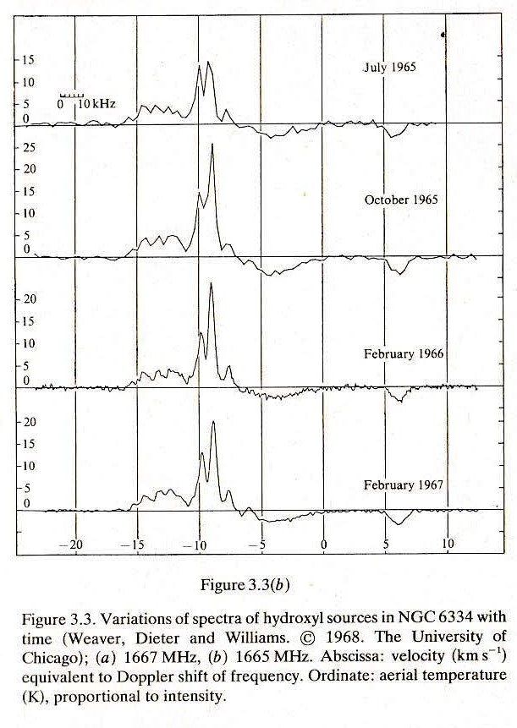
Maser Observing
Observational Charts
Variations: Hydroxyl masers vary in time. In certain type variable stars the outer atmosphere is blown off during peaks of pulsations. This blown off gas condenses with distance forming molecules such as water and silicon monoxide dust grains. The water molecules can be split by ultraviolet light to form hydroxyl molecules. The heat from the warm dust excites the hydroxyl causing maser action at 1667 and 1612 MHz. The intensity of the maser follows the changing brightness of the star as it pulsates.

Slide 17
Maser Observing
Polarization
Astronomical masers are usually circularly polarized, and to a lesser extent in a linear fashion. This polarization can be caused by the Zeeman effect, magnetic beaming of the maser radiation, and anisotropic pumping which favors certain magnetic-state transitions.
In circular polarization the electromagnetic field has a constant magnitude, and it rotates at a constant rate in a plane perpendicular to the direction of the wave. In linear polarization the electric field vector or magnetic field vector are confined to a given plane along the direction of propagation. The orientation of a linearly polarized electromagnetic wave is defined by the direction of the electric field vector. If the electric field vector is vertical (propagating up and down as the wave travels) the radiation is vertically polarized.

Slide 18
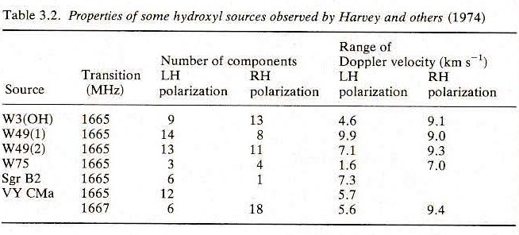
Maser Observing
Polarization
The electric field vectors of a traveling circularly polarized electromagnetic wave can be left-handed (LH) or right-handed (RH) polarizations (related by the right-hand rule to the direction the wave is moving).

Slide 19
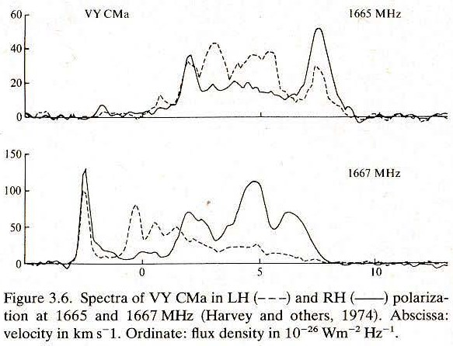
Maser Observing
Polarization
It is almost always found that each component of the radiation at 1665 and 1667 MHz from hydroxyl masers are nearly 100% circularly polarized, either RH or LH. The 1612 MHz radiation may also be nearly completely polarized. The observations of the 1720 MHz radiation of hydroxyl are not so clear.

Slide 20
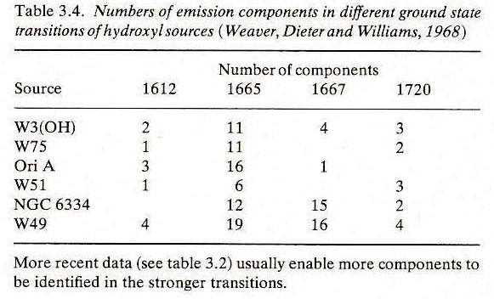
Maser Observing
Components
It is almost always found that the number of distinct sources (as identified by frequency shifts) is appreciably greater for one transition than for the three others in a hydroxyl maser.

Slide 21
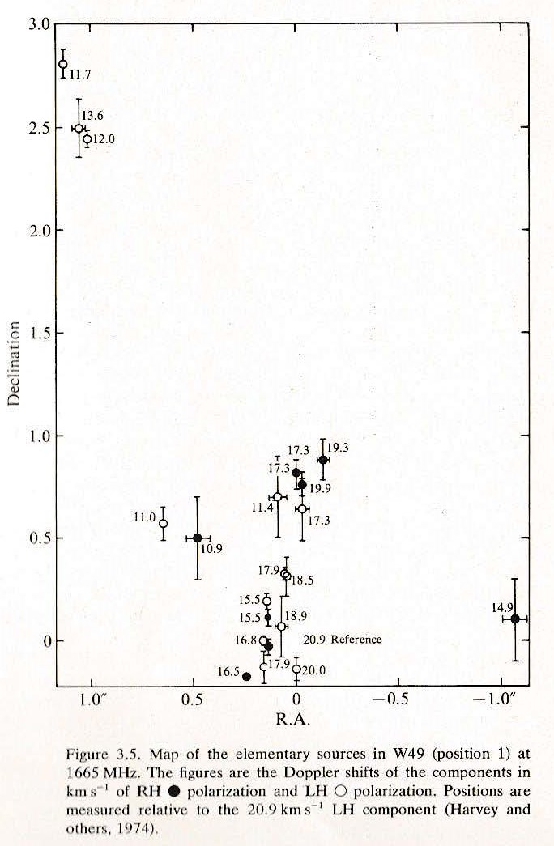
Maser Observing
Components
Observations with interferometers show that source regions contain several elements. From the prior slide W49 has 19 components at 1665 MHz.

Slide 22
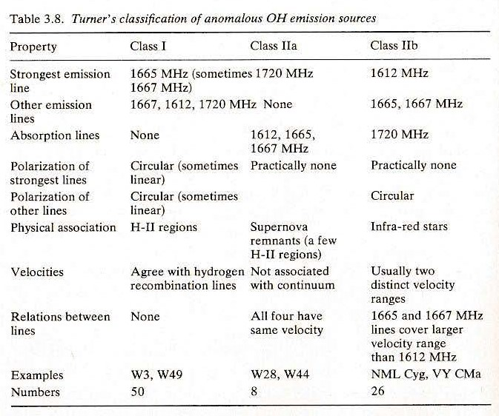
Maser Observing
Classification
Turner classified OH sources according to the strongest emission from the ground state lambda doublet system. Hydroxyl sources are distinguished between those sources which radiate most strongly at 1665 or 1667 MHz (H-II regions) and those which radiate most strongly at 1612 or 1720 MHz (predominantly Infrared stars).

Slide 23
Maser Observing
Classification
The difference between the two classifications concerns the physics of the pumping processes. For main line emission (1667/1665) to occur the lambda doublet must be inverted and the pumping mechanism does not discriminate between levels with different values of F. A similar scheme applies to the satellite lines (1720/1612), but where the lambda doublet is not inverted, but the pumping process does distinguish between different values of F. If the lambda doublet is inverted, stimulated emission may occur in satellite transitions as well as in main line transitions.

Slide 24
Maser Observing
Classification
Circumstellar – 1612 MHz: Found in circumstellar envelopes of late-type stars. These stars expel atmospheric molecules into circumstellar space due to radiation pressure on grains and the pulsation of the stars. In M stars, where oxygen is more abundant, masers from oxygen-bearing molecules (such as OH, H₂0, and SiO) are found. Interstellar ultraviolet radiation dissociates H₂O and forms OH.
Interstellar star forming regions - 1665 MHz: H₂O masers can exist. W 49 is the strongest maser source in the Galaxy. OH maser emission in star-forming regions is strongly circularly polarized due to the weak magnetic field in molecular clouds. Young stellar objects and compact H II regions embedded in molecular clouds support the bulk of masers by various pumping schemes, both radiative and collisional.

Slide 25
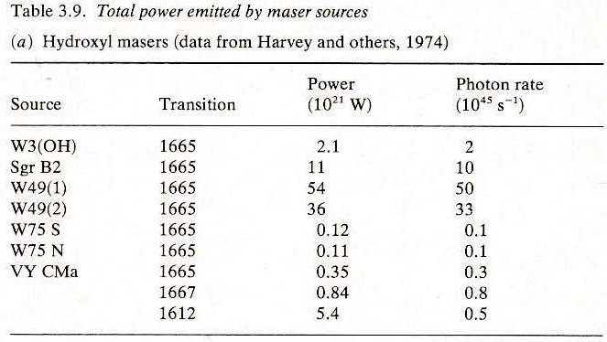
Maser Observing
Pumping Schemes
Consider an incident photon that causes a molecule to emit two photons of the same frequency, phase, and direction. This can only happen when there is a population inversion: i.e., more atoms have electrons in the higher energy level than the lower one. The population inversion requires an external energy source, which is known as the pumping mechanism.
This table estimates the total power radiated by some maser sources. The last column gives the rate of emission of photons, a quantity relevant to photon pumping mechanisms.

Slide 26
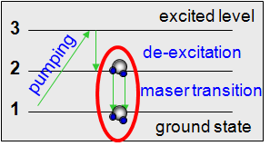
Maser Observing
Pumping Schemes
Radiation from an associated thermal source, from an H-II region, or an infra-red star within the shell of the maser, are thought to pump masers. In a stimulated emission, atoms or molecules already exist in an excited state. If the photon arrives which has exactly the frequency of the difference in these two energy levels, then it can stimulate this system to drop to a lower energy level and create the situation of the original photon plus an extra photon which had now been emitted in the same frequency, phase, and direction, creating an exponential amplification as the process repeats. A star’s pulsation can drive a velocity coherence that is needed for an inverted population with overlapping velocities. The star’s pulsation excites to a higher energy state and this energy state is preferentially de-exciting to another state which doesn’t de-excite very easily and becomes highly populated.
Left: Schematic of the stimulated emission process in a maser. The molecule is pumped to an excited state and decays (relaxes) non-radiatively (vibrationally) to a metastable state where a population inversion is created, before fully decaying to the ground state. Source: Swinburne University

Slide 27
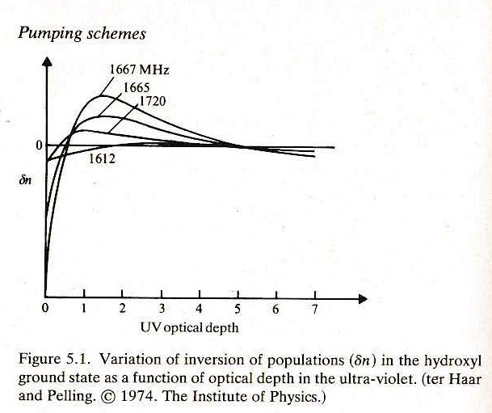
Maser Observing
Pumping Schemes
Hydroxyl molecules near a UV radiation source would absorb that radiation and be excited to the first excited electronic state. The hydroxyl molecules nearest to the source absorb preferentially at the stronger transitions, leaving the remaining incident radiation relatively enhanced in the weaker lines. The residual UV radiation would populate those levels of the first excited vibrational state that would decay preferentially to the upper levels of the lambda doublets of the ground states. Because transitions from a given level of negative parity in the state to each of the upper levels of the positive parity of the ground state quartet are equally likely, the mechanism inverts the lambda doublet as a whole and would lead to emission at 1667 and 1665 MHz.

Slide 28
SARA Sections Update 2021
Additional Properties of Masers
Maserdb (http://maserdb.net/search.pl) provides many properties including flux density and velocity.
Maserdb is multi-purpose tool for analyzing the maser spectral data in the lines of CH₃OH, H₂O, OH and SiO molecules, collected from the available literature and private sources.
The Maser Monitoring Organization (www.masermonitoring.com) is a global community of astronomers, observers and theorists collaborating to better understand the nature of astrophysical masers, their flaring behavior and their uses as tracers of astrophysical phenomena: To observe molecular clouds astronomer must rely on tracers, materials which make up only a small portion of a cloud, but which are easy to detect.

Slide 29
Maser Observing
List of Tracking Examples
OH808-19 at 1612 MHz (Tzikas)
OH2605+06 at 1612 MHz (Tzikas)
W3 at 1665/1667 MHz (Ghigo*)
W3OH at 1665 MHz (Ghigo*)
W49 at 1665/1667 MHz (Vayl Sorensen)
W49 at 1665/1667 MHz (Tzikas)
W49 at 1720 MHz (Quest Radio)
W51 at 1665/1667 MHz (Ghigo*)
W75 at 1665/1720 MHz (Quest Radio)
* GBO Emeritus Scientist
List of Raster Scan Examples
W3 at 1665/1667 MHz (Tzikas)
W3 at 1665/1667 MHz (Tzikas)
W3 at 1420 MHz (Tzikas)
W3 Low Resolution at 1395 MHz (Tzikas)
W3 Area (Frank Ghigo*)

Slide 30
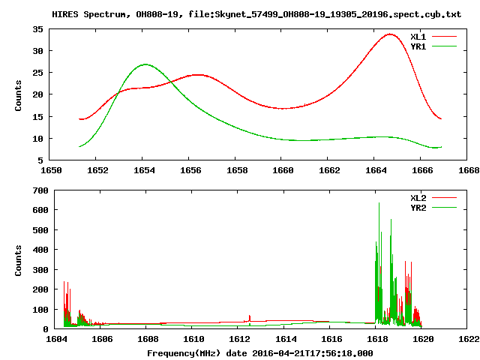
Maser Observing
Electron polarization: A property of electrons defined by the Pauli Exclusion Principle but simply described as up or down, or left and right. Radio telescopes are equipped with polarizing filters that distinguish between the two electron polarizations.
Tracking Example
Maser OH808-19
1612 MHz (Tzikas)
Shows the average spectra
averaged over all integrations. The upper and lower plots are for the two frequency bands and the two traces in each plot are for the two polarizations.

Slide 31
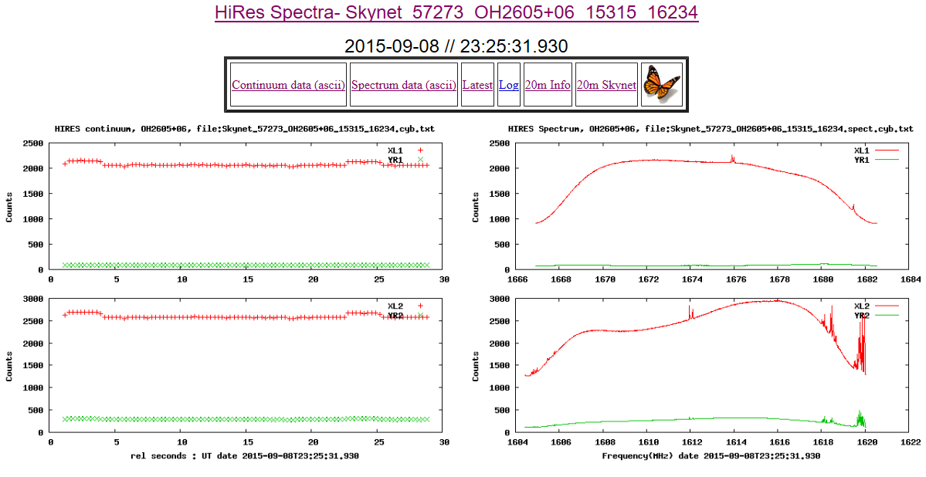
Maser Observing
Tracking Example
OH2605+06
1612 MHz (Tzikas)
Shows the continuum. This is the average of the central 80% of each spectrum pattern vs time. The four traces are two polarizations and two frequency bands. Note Baseline, Calibration, and Target traces.

Slide 32
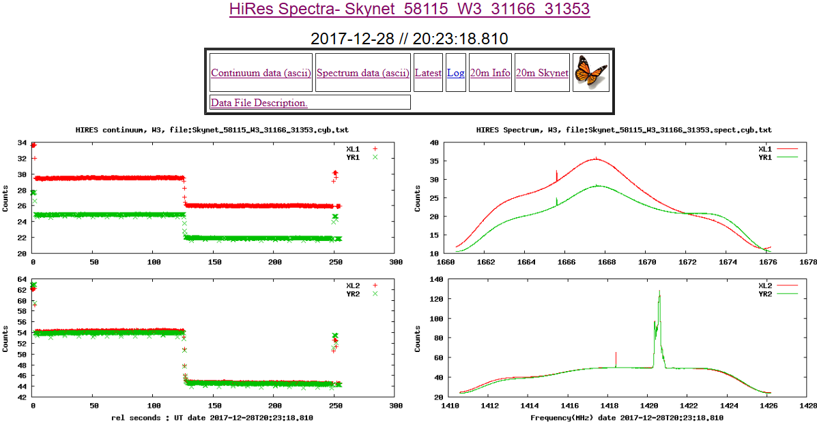
Maser Observing
Tracking Example
W 3
1665, 1667 MHz
Frank Ghigo, GBO

Slide 33
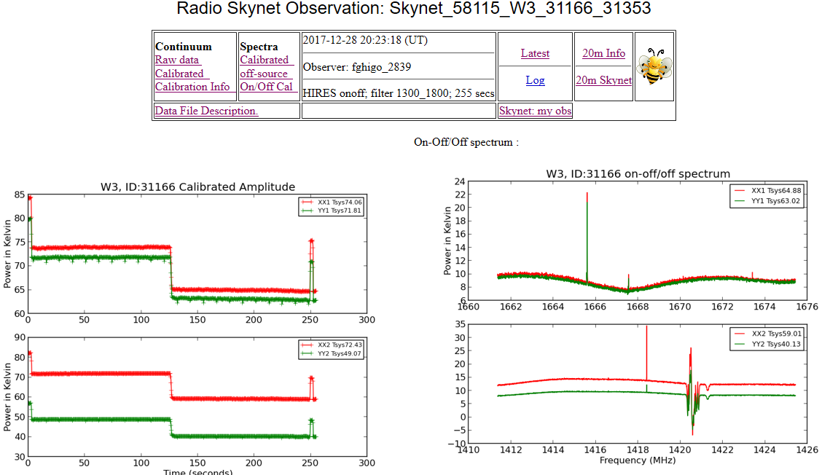
Maser Observing
Tracking Example
W3 Continued
1665, 1667 MHz
Frank Ghigo, GBO

Slide 34
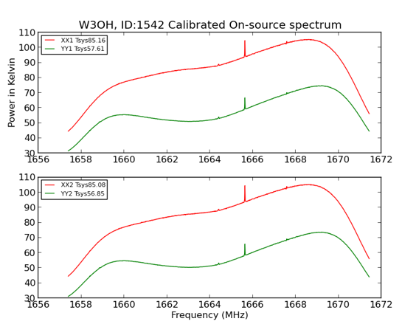
Maser Observing
Tracking Example
W3OH
HIRES Track 72 seconds
https://www.gb.nrao.edu/20m/peak/W3OH/2019_04_29_19:46:42.htm
(Frank Ghigo)

Slide 35
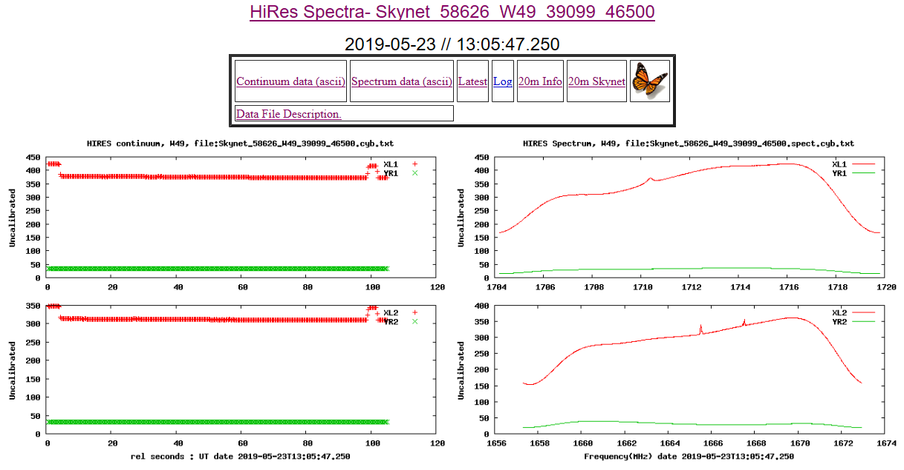
Maser Observing
Tracking Example
W 49
1665,1667 MHz
By Vayl Sorensen
University Student

Slide 36
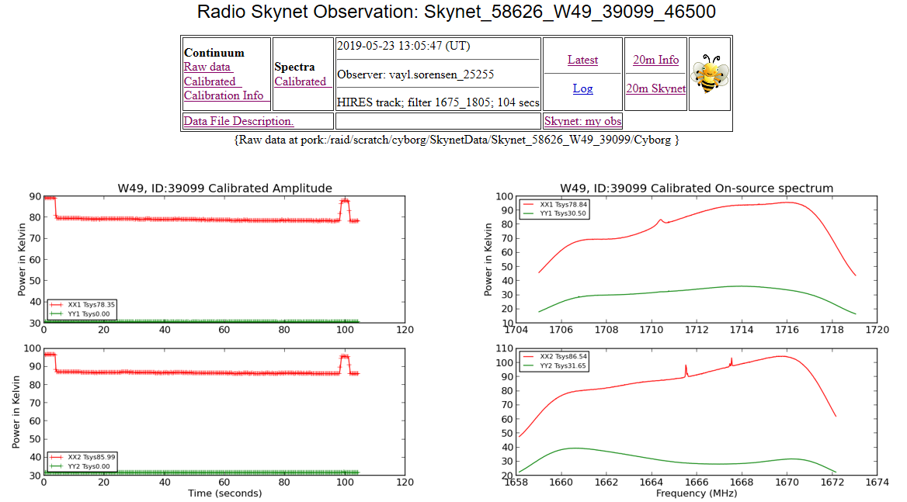
Maser Observing
Tracking Example
W 49, Continued
1665,1667 MHz
By Vayl Sorensen
(University Student)

Slide 37
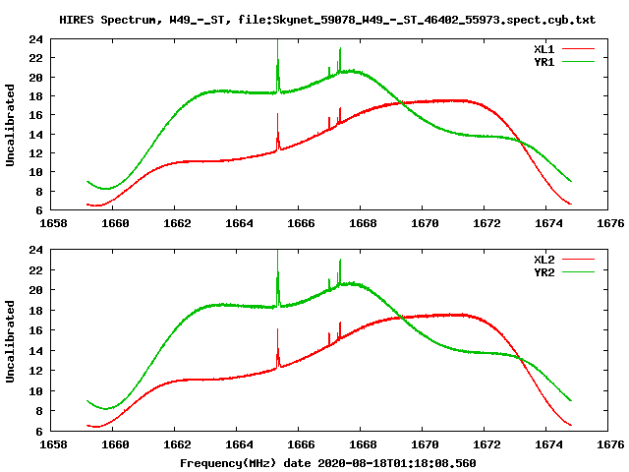
Maser Observing
Tracking Example
W 49
55 degrees min. elevation
120 second duration
0.3 sec. Integration Time
1665 MHz Center Freq
1667 MHz Secondary Freq
16,384 Channels
15.625 MHz bandwidth
(Tzikas)

Slide 38
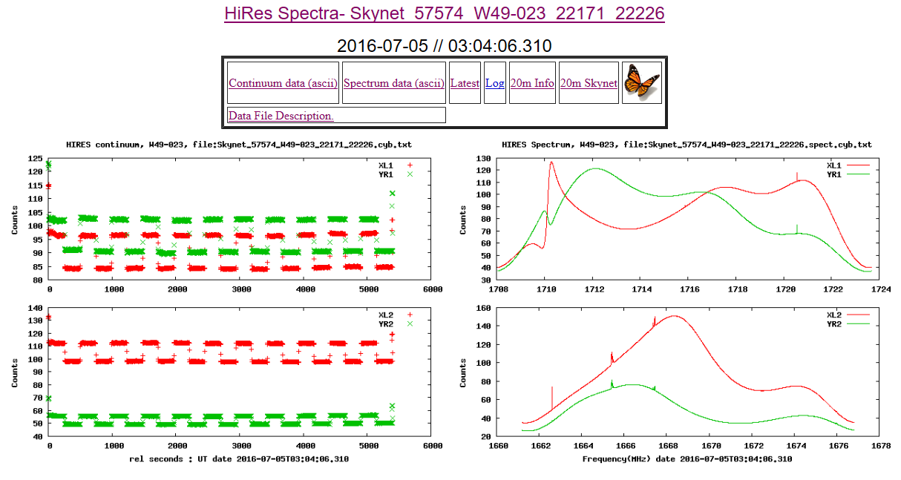
Maser Observing
Tracking Example
W 49
1720 MHz
By Quest Radio
Star Quest?

Slide 39
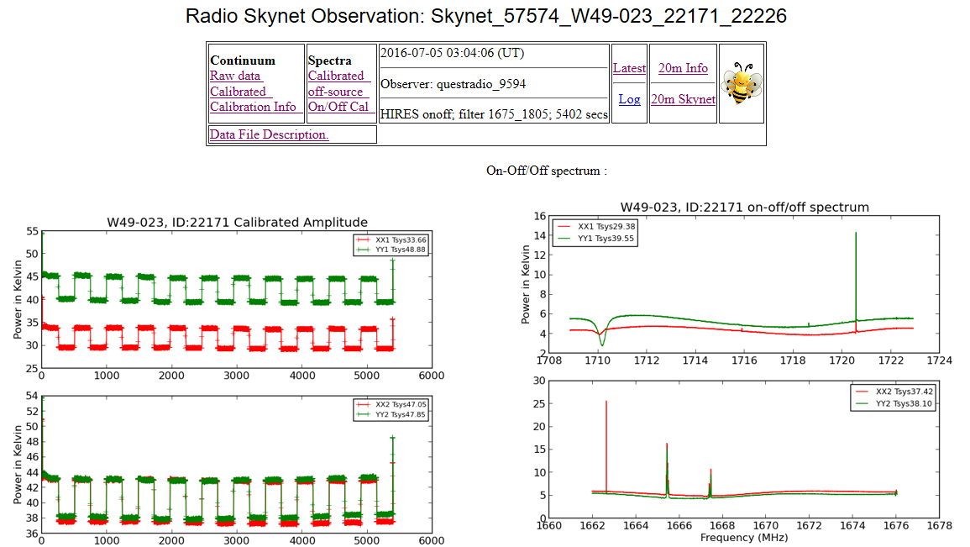
Maser Observing
Tracking Example
W 49, continued
1720 MHz
By Quest Radio
Star Quest?

Slide 40
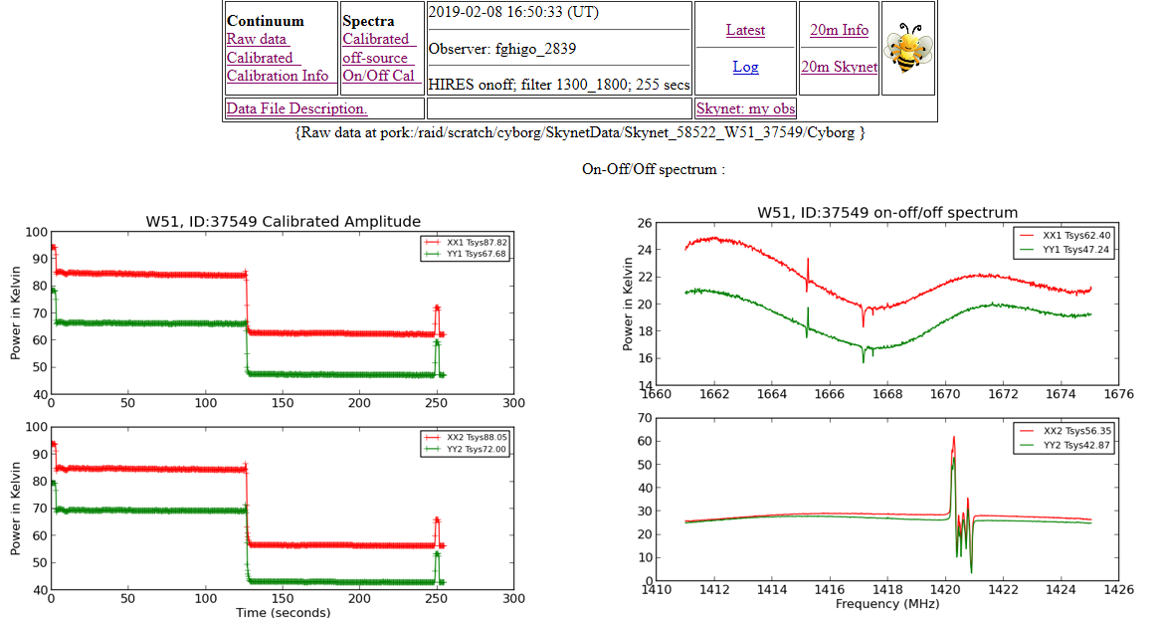
Maser Observing
Tracking Example
W 51
1665, 1667 MHz
Frank Ghigo, GBO

Slide 41
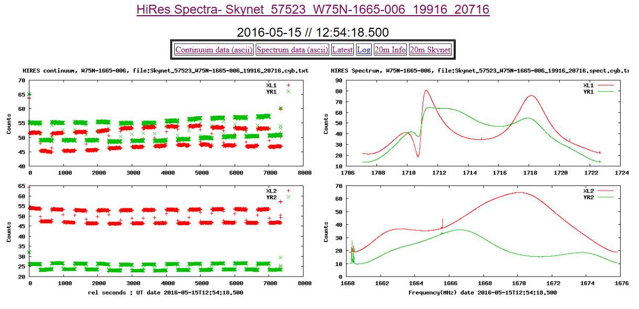
Maser Observing
Tracking Example
W 75
1665, 1720 MHz
By Quest Radio
Star Quest?

Slide 42
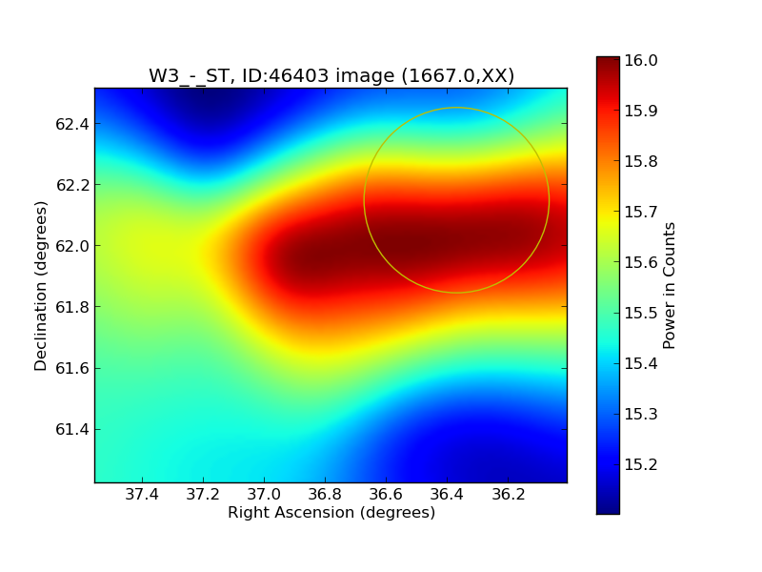
Maser Observing
Raster Scan Example (1 beam width)
W3 raster map 2020 8 18 by Tzikas (No. 1)
https://www.gb.nrao.edu/20m/idlinks/46403.htm
(Skynet_59079_W3_-_ST_46403_55974)
157 seconds, 60 degrees elevation
Center frequency 1665 MHz, Secondary 1667 MHz
16,384 channels, 0.3 sec. integration time
RA and Decl: 1 beam width (6 recommended)
Next 3 observations (No. 2-4) not successful, including one with 1612.231 MHz center and 1720.530 MHz secondary)

Slide 43
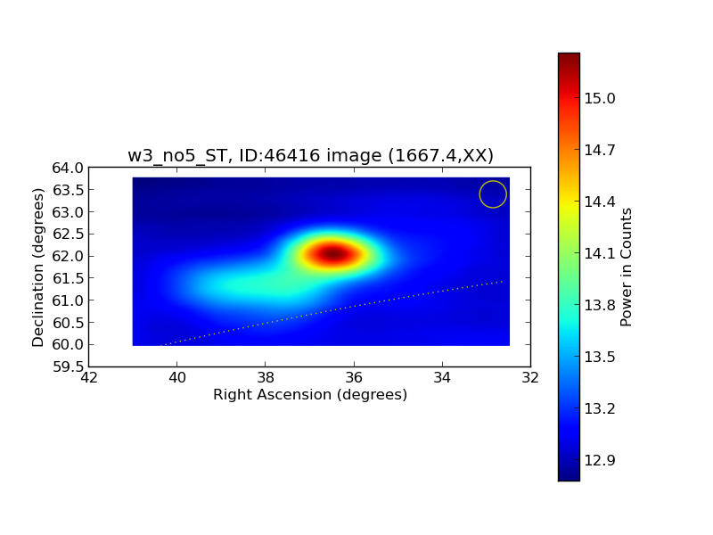
Maser Observing
Raster Scan Example (6 beam widths)
W3 raster map 2020 8 21 by Tzikas (No. 5)
https://www.gb.nrao.edu/20m/idlinks/46416.htm
18 minutes
60 degrees elevation
Center Frequency 1665.402 MHz
Secondary Frequency 1667.359 MHz
16,384 channels
RA/Decl. 6 beam widths each
0.3 second integration timeSkynet_59081_w3_no5_ST_46416_55990

Slide 44
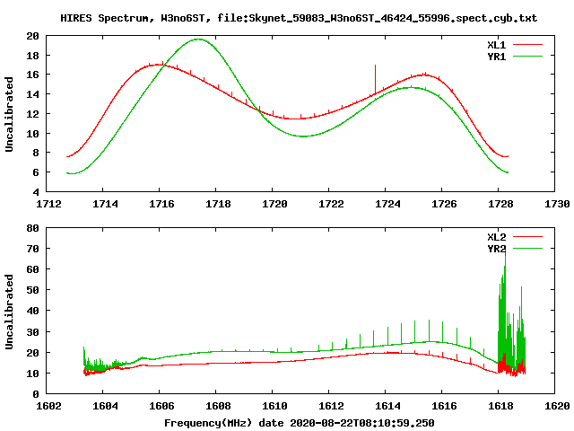
Maser Observing
Raster Scan Example (weak lines)
W3 raster scan by Tzikas (No. 6)
1612.231 MHz center frequency
1720.53 MHz secondary frequency
No raster produced, but 20m provided alternate results
Skynet_59083_W3no6ST_46424_55996
Question: What causes the series of spectral lines to the left? Is it the Zeeman Effect – the splitting of a spectral line due to a magnetic field?

Slide 45
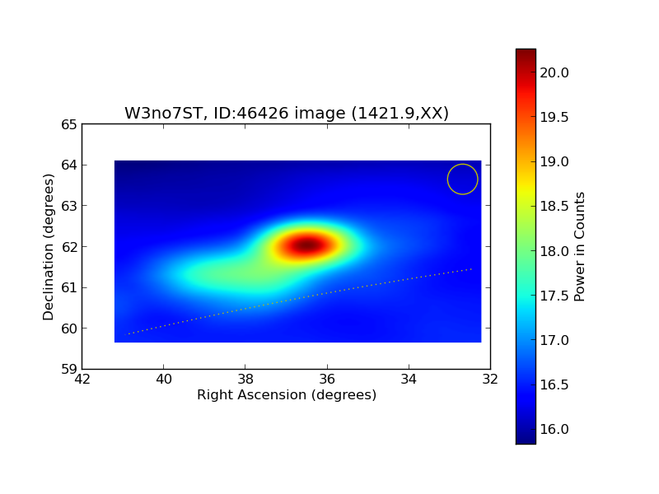
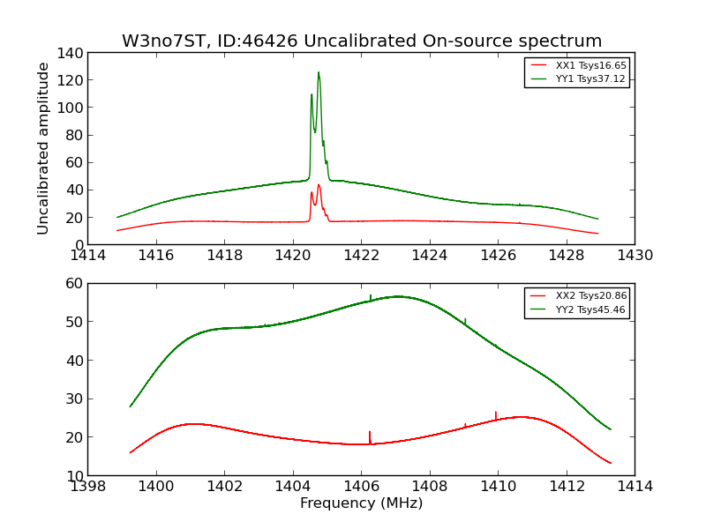
Maser Observing
Raster Scan Example (H Line)
W3 raster by Tzikas (No. 7) Skynet_59083_W3no7ST_46426_55998
1420.51 MHz center and 1406.25 MHz secondary frequency
RA/Decl. 6 beam widths each. Note chart was that of H line.
Observations No. 8 & 9 with some variations (1612.231 MHz center and 1665.402 MHz secondary not successful).
Observations No. 10 with 1667.357 center and 1720.53 secondary frequencies, and adjustments to RA and Dec (no map, just charts). No maps also with No. 11 (1665.402/1667.359) & No. 12 with RA/Decl. adjustments but 1665/1667 MHz frequencies.

Slide 46
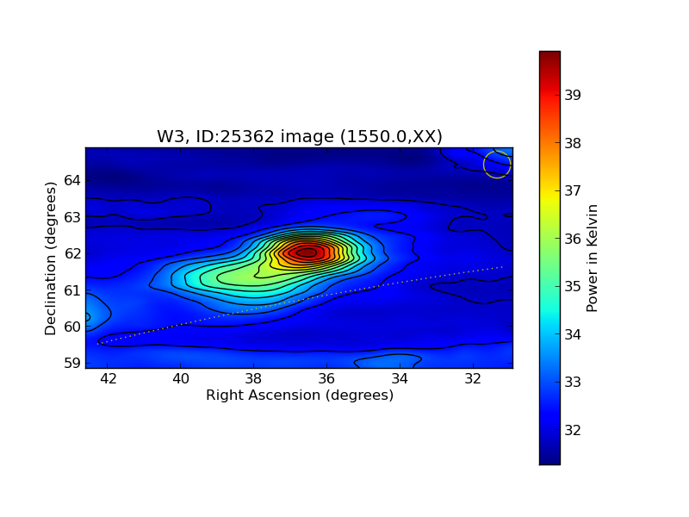
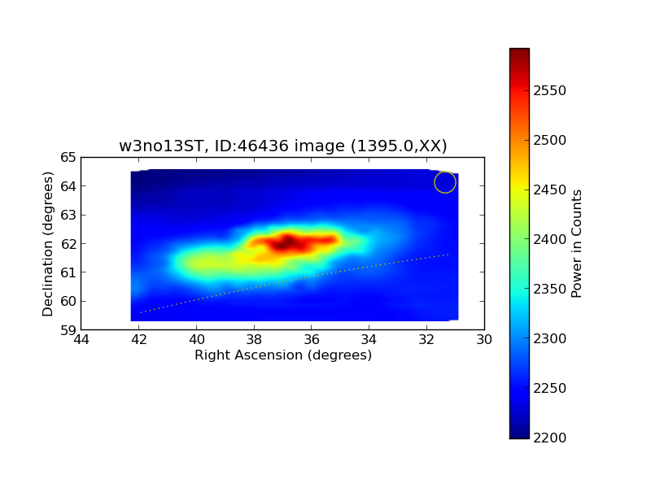
Maser Observing
Raster Scan Example (low resolution)
W3 raster by Tzikas (No. 13), Low resolution HI (1355 – 1435 MHz) LOWRES ralongmap; filter 1355_1435; 1303 secs
1395 MHz center frequency, 1024 channel, RA/Decl. 6 and 6 beam widths
18 minutes, 60 degrees. Same cost, but both good maps.
Skynet_59086_w3no13ST_46436_56008 & Skynet_57739_W3_25362_25435 (fghigo_2839, LOWRES ralongmap; filter 1355_1435; 690s)

Slide 47
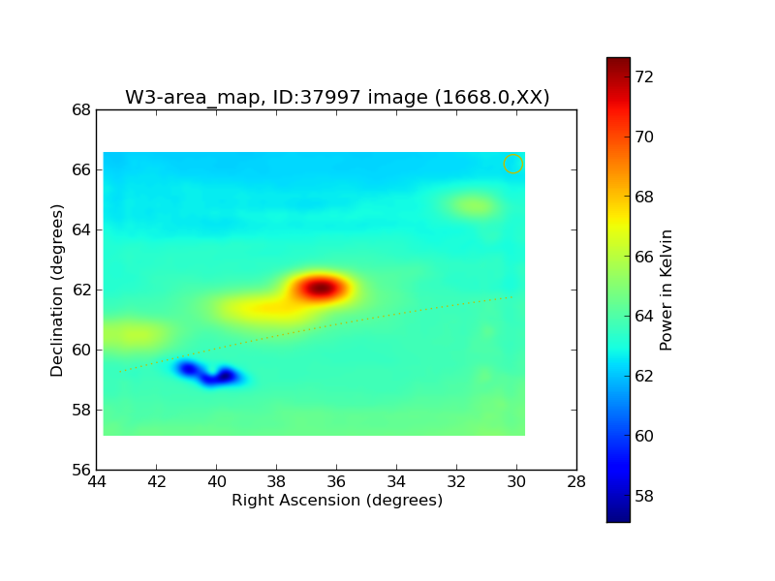
Maser Observing
Raster Scan Example (high resolution)
W3-Area
Skynet_58541_W3-area_map_37997_44703
2019-02-27 22:22:41 (UT)
Observer: fghigo_2839
HIRES mode, actual band center for frequency 1, in MHz "1668"

Slide 48
Contact
Questions, Comments, Volunteering?
Email SARA Section Analytical Section Coordinator
Tzikas@alum.rpi.edu
stephentzikas@gmail.com

