Slide 1
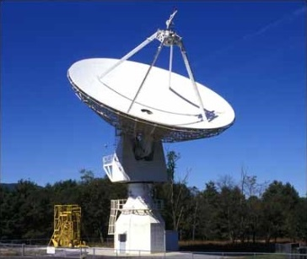

SARA Conference 2020
Analytical Section Meeting, Demo, & Programs

Slide 2
Agenda
20m Project Updates
20m Dish Demo
Pulsar Observing (Featured Demo based on Ryan S. Lynch’s “Searching for and Identifying Pulsars” guide posted on the internet)
Glossaries
Pulsar Search Collaboratory (PSC) Data
Other Projects Ideas
SARA Analytical Section Open Forum

Slide 3
20m Project Updates
This demo presentation and SARA Section Update are posted on SARA Analytical Section page
2019 demo presentation also posted (Cas A Flux Density Calculation)
Ongoing Project: Citizen Science Database for the Fading of Cas A
Links to new Astronomical Leagues Citizen Science “awards”
New Mission Statements
Pulsar Search Collaboratory (PSC)
Volunteer Roles: Manuals, Templates, Database, RASDR Integration

Slide 4
20 Meter Dish Demo
Green Bank Conference Account - Explore!
Skynet Account (free UNC Course) - Your Personal Account!
Demo Example – Watch the dish move outside!
Tutorial: Pulsar Observing

Slide 5
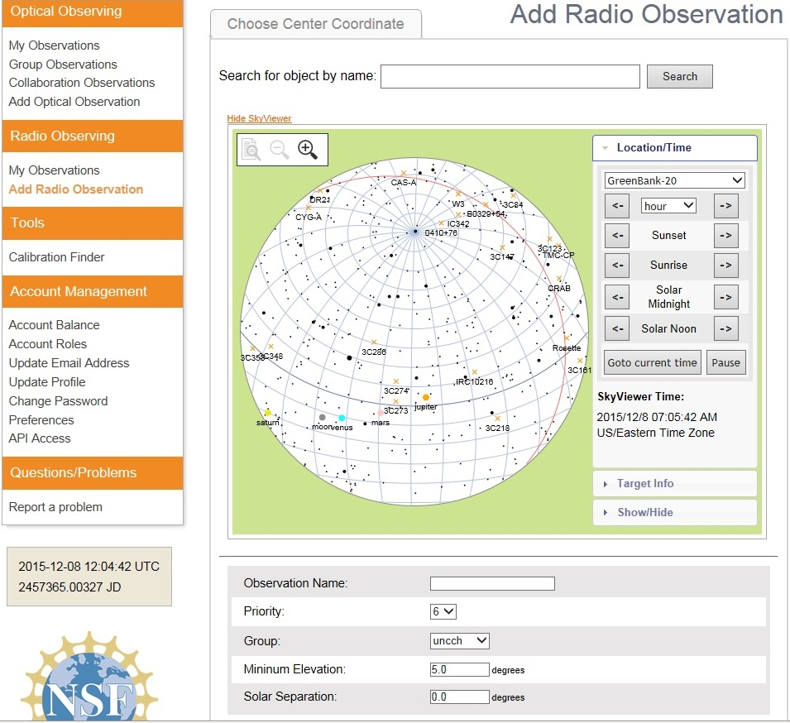
20 Meter Dish Demo
Add a Radio Observation
-Select an Object
(Database or RA/Dec)
-Minimum Elevation
(Used for mapping)
-Solar Separation
(to prevent solar side lobe
interference)

Slide 6
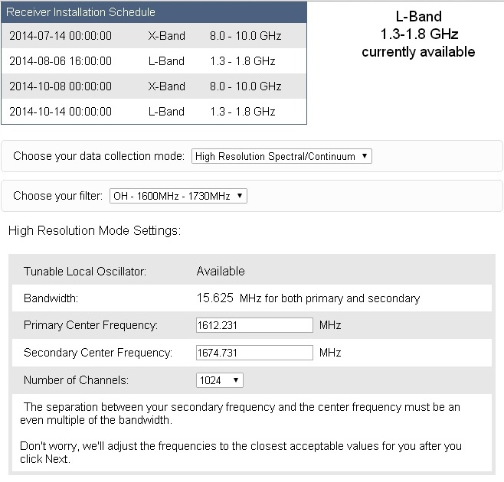
20 Meter Dish Demo
Configure Receiver
Low Resolution: continuum mapping/pulsars
High Resolution: Spectral Lines
No Filter Full Band (with interference)
H1 Filter (continuum maps, 1355-1455 MHz)
OH Filter (Iridium sat. interference, 1.6-1.73 GHz)

Slide 7
Pulsar Observing
Pulsar Search Collaboratory
http://pulsarsearchcollaboratory.com/home/about/
FREE Online training – Gain expertise in pulsar astronomy and pulsar data analysis through six 1-hour online classes on the PSC staff. Once you are certified, you will gain access to data.
http://pulsarsearchcollaboratory.com/online-workshop/
PSC Clubs – Teachers and students will form a PSC club at their school or other venue. PSC teams will conduct original research by analyzing data from the GBT with the expectation of discovering new pulsars and characterizing changes in previously-known pulsars.
PSC Camp – Each summer, astronomers, students and teachers gather together at the Green Bank Observatory for a week of intense learning. Work alongside astronomers to learn how to characterize pulsars.

Slide 8
Pulsar Observing
Input Your Observation
Name the object with a recognizable pulsar name, for example, "B0329+54".
Personalize by appending to the name, e.g. "B0329+54_mypulsar".
Select "Low Resolution Spectral/Continuum", and check the "Pulsar Mode" box.
Select "Track"
Bright pulsars can be detected with a duration of 60 seconds. Longer for weaker pulsars.
Set the integration time to a fraction (e.g., 1/30th of the pulsar period).
Possible range of integration times: 0.1 to 0.0001. The data acquisition system is unable to keep up with the data rate if the integration time is less than 0.0001 second. It will collect data, but what it collects will be mostly nonsense.
http://www.gb.nrao.edu/20m/psr20m_advice.html

Slide 9
Pulsar Observing
List of Pulsars
See the Australia Telescope National Facility (ATNF) website
ATNF Pulsar Catalogue
https://www.atnf.csiro.au/research/pulsar/psrcat/
Predefined Variables
Table of the ATNF database pulsars visible by the GBT as of 1 Jun 2007. All positions are J2000

Slide 10
Pulsar Observing
Folding
The technique of folding. If we know the period of the pulsar, ticks can be placed at an interval in the data. These tick marks are folded over. The signal is added in each layer of the fold. In this way, a weak pulsar is found that would otherwise be lost in the background noise. For pulsars, the noise that is inherent in the instruments makes a single pulse very diﬃcult to see, except in the case of the brightest pulsars. In order to solve this problem, astronomers must combine (fold) many pulses together in order to build up a detectable signal.

Slide 11
Pulsar Observing
Fourier Transforms
If we don’t know the period of a pulsar, there is a tool called the Fourier transform that can help. Fourier transforms are mathematical operations that are suited for ﬁnding periodic (repeating) signals in a set of data. The Fourier transform transforms the data from one form into another. For pulsar searches, the transformation takes data that is in a form of signal vs. time, and converts it to signal vs. frequency (Frequency is related to time). Frequency is in a unit called the Hertz, abbreviated as Hz -cycles per second.

Slide 12
Pulsar Observing
Harmonics
When we work in the frequency domain, we can also take advantage of harmonics. The harmonic of a signal occurs at an integer multiple of the main frequency. For example, if a pulsar has a rotational frequency of 100 Hz, we will also detect a signal at 200 Hz, 300 Hz, 400 Hz, and so on. We say that the spin frequency is the fundamental or ﬁrst harmonic.
Harmonics occur naturally in most periodic signals, not just pulsars. Musical instruments produce sound waves, and waves are periodic. So when a violin player plays a note, say an A-ﬂat, what you hear is actually all the harmonics of an A-ﬂat.

Slide 13
Pulsar Observing
RFI
Astronomers refer to interfering man-made sources of radio waves as Radio Frequency Interference, or RFI. RFI can make it diﬃcult to see faint sources of radio waves. To reduce the eﬀects of RFI, telescopes are built far from the sources of RFI. Sometimes, certain parts of the radio spectrum are simply avoided all together. Sometimes we can make ﬁlters that block RFI that we know exists at a certain point in the spectrum. And sometimes computers try to identify obvious sources of RFI and then ignore it in a given set of data.

Slide 14
Pulsar Observing
PRESTO Prepfold Plots: These are the results of a pulsar observed through the 20m radio telescope.
There are many diﬀerent packages of software designed for observing pulsars. One is called PRESTO. PRESTO takes the Fourier transform of a data set and uses algorithms to search for pulsars. When PRESTO ﬁnds a promising candidate, it can go back to the time domain data and use a program called prepfold to fold the data at the period of a candidate. What comes out is a plot like the following figure.

Slide 15
Pulsar Observing
Time Series & Pulse Proﬁle Panel.
The time series represents the strength of the signal as a function of phase and time. If we add up all the power we collect over our whole observation for a single phase, then we will have the pulse proﬁle. The pulse proﬁle is the folded signal from the pulsar that was collected over the entire observation. The time domain plot shows how the strength of our signal varies during the course of an observation. Each gray square represents the strength of the signal in some small piece of the data, called a bin. The darker the bin, the stronger the signal. This plot is a representation of our folding process.

Slide 16
Pulsar Observing
Time Series & Pulse Proﬁle Panel (Continued).
Each row on this plot is a sub-fold, i.e. a fold of a small chunk of our data that is a few seconds long. The small chunk is the “height” of a bin, and is called a sub-integration. The “width” of each row is equal to the length of the fold, which is the period of the candidate.
The y-axis is labeled as “Time (s)” and is the time in seconds since the start of our observation. The x-axis is labeled as “Phase” and goes from 0 to 2.0. A phase of 0.5 means that the pulsar has gone through half a rotation; a phase of 1.0 indicates one full rotation; a phase of 1.5 indicates one and a half rotations, and so on. Each sub-fold is equal to one full rotation, so showing the phase going from 0.0 to 1.0 is the same as showing a full sub-fold. Two full rotations are shown for clarity, should the pulse land at a phase of 1.0 and be on the edge of the plot and hard to see.

Slide 17
Pulsar Observing
Pulse Profile Panel
Shows the strength of the pulse as a function of phase. This is the result of the full folding process. To make it, we add up, or integrate, the results of all the sub-folds. The peak corresponds to when the pulsar is “on”, and the random lines that you see when we are “oﬀ-pulse” is the background noise.

Slide 18
Pulsar Observing
Phase and Observing Frequency Panel
This panel shows the strength of the signal as a function of both phase and observing frequency. The sub-band tells us how our instruments are breaking down the wide range of frequencies into small chunks. There is an increase in the strength of the signal at a single phase, and it is spread across all frequencies.

Slide 19
Pulsar Observing
Phase and Observing Frequency Panel
The phase on the x-axis, and the darker bins still mean that we detected a stronger signal. However, time on the y-axis has been replaced with frequency, or sub-band. This is the observing frequency (not the spin frequency). The frequency is measured in megahertz (MHz). The spin frequency is usually no higher than a few hundred hertz.
In addition to being labeled with “Frequency (MHz)”, the y-axis is also labeled as “Sub-band”. The instruments used to collect and measure the radio signals break down the signal into small chunks of observing frequency, called sub-bands. It is typical to use 32 or 64 sub-bands. Each gray bin in this image represents the power collected in a single sub-band over the full observation. It is the power collected in a small chunk of the observing frequency. If you look closely, you should see an increase in signal strength, which appears as a dark line on our plot. You should see it at the same phase in both the time series and frequency/sub-band plots. Examining the characteristics of this signal helps us to determine if we are looking at a real pulsar or some source of RFI.

Slide 20
Pulsar Observing
Dispersion Measure Panel
The next figure shows another part of the prepfold plot. The x-axis is labeled as “DM”, and the y-axis as “Reduced χ2”. DM stands for Dispersion Measure. The dispersion measure tells us something about the space between Earth and the pulsar. Space is ﬁlled with many things. One of the things are electrons. These electrons disperse the pulsar’s signal, causing lower observing frequencies to arrive later than higher observing frequencies. The electrons can also scatter the signal in much the same way smoke scatters visible light.
The symbol “χ” is the Greek letter “X”. The Reduced χ2 is a statistical value that indicates how well a model agrees with some actual data. A large value of Reduced χ2 means that the model and data are not in good agreement, and a Reduced χ2 of one means that they are. We use the Reduced χ2 in an uncommon way.

Slide 21
Pulsar Observing
Dispersion Measure Panel
The peak of the curve shows the most likely value of DM. Ideally, we would like to see a sharp peak at one value of DM. This would mean that the DM is well measured. If the peak is broader, it means that the DM measurement is less certain.
If the curve reaches its highest point at a DM of zero, then the signal must not have traveled through any electrons to get to Earth. That must mean that the signal actually originated at the Earth, and is actually RFI. The DM of a signal is one of the best ways we have of distinguishing between RFI and a true astronomical signal from space.
This panel shows the Dispersion Measure, or DM. The DM is a way of quantifying the number of electrons that the pulsar’s signal must travel through to reach the Earth. The y-axis is the Reduced χ2. A real pulsar should have a peak value of Reduced χ2 at a non-zero DM.

Slide 22
Pulsar Observing
Period and Period Derivative Panels
The next two plot panels look similar to the plot of dispersion measure, having “Reduced χ2” on the y-axis. In the panel on the left the x-axis is labeled as “Period (ms)” and in the panel on the right the x-axis is labeled as “P-dot (s/s)”. The Period and P -dot have a number being subtracted from them. This number is the center of the plot, and is subtracted so that we can easily tell how far the peak of the curve lies from this central value. It should be a sharp peak, indicating that we have measured the period well.
The P -dot, or Period Derivative, is the ﬁrst time derivative of the period. It shows how much the period is changing over time. It has units of “seconds per second”—the number of seconds by which the pulsar’s rotation speeds up or slows down over the course of a single second. The period of a pulsar changes very slowly, so these numbers are very small. Generally speaking, pulsars ought to be slowing down, but the motion of the pulsar relative to our solar system can cause the rotation to appear to speed up. This motion could be induced by something like a companion star or planets orbiting the pulsar. When determining whether a candidate is a true pulsar or RFI you should look for a sharp peak in the Reduced χ2 vs. P-dot curve. This indicates that the candidate has a well deﬁned Period Derivative. Isolated pulsars typically have a P -dot that is too small to measure in a short observation, and hence appears to be zero. If the P -dot is non-zero and the pulsar is real, then you have found a binary pulsar.

Slide 23
Pulsar Observing
Period and Period Derivative Panels
These two panels show the Period and P -dot. The y-axis is the Reduced χ2. Ideally, you should see a sharp peak in Reduced χ2, which indicates that the Period or Period derivative have been well measured.

Slide 24
Pulsar Observing
Period/Spin Frequency vs. P-Dot/F-Dot Panel
The next figure is the previous two plots put together. The x-axis is the Period or Spin Frequency, shifted so that the center of the plot corresponds to zero. The y-axis is P-dot or F-dot (F-dot being the change in spin frequency). The colors represent the Reduced χ2, with red meaning a high Reduced χ2 and purple meaning a low Reduced χ2. This is very similar to an elevation map. Instead of lines of constant elevation, we have colors of constant Reduced χ2. To make this plot, we take the two curves from the previous two plots, and combine them. If you imagined the plot coming out of the page and being three dimensional, the red areas would correspond to the peaks and the purple areas to the “lowlands” in the Reduced χ2 curves. You can also think of the prior two plots as cross-sections of the peak of next Figure.
Ideally, we should see a well deﬁned region of red, and only one well deﬁned region of red, in this plot. If there are other well deﬁned regions of red, then our measurements might not be very good. Usually, this is only an issue for weak pulsars or strong, variable RFI.

Slide 25
Pulsar Observing
Period/Spin Frequency vs. P-Dot/F-Dot Panel
In this panel, the Period and Period-dot are on the x- and y-axes, and the Reduced χ2 is represented by the diﬀerent colors. A high value of the Reduced χ2 is shown in red and a lower value in white or purple. This is similar to a topographic map that shows elevation using closely spaced lines. Notice that the x- and y-axis are also labeled with Frequency and Frequency-dot. Remember that frequency is essentially one divided by the period, so it is fairly easy to go between using Period and Period-dot and Frequency and Frequency-dot.

Slide 26
Pulsar Observing
Search Information Panel
In the original prepfold plot, there is a lot of text at the top. This is information about the search, the observations, and the candidate pulsar. The Dispersion Measure and Period are labeled as Ptopo or Pbary. While both of these numbers can be determined by looking at the plots, they are also printed in the Search Information area for you. There are numbers in parentheses at the end of each value. This number is the error in the last decimal place. If you are interested in what the other terms mean, see the glossary.
Ptopo is the period measured at the telescope, while Pbary is the period that would be measured if our telescope were placed at the center of mass of the solar system (also called the Barycenter). The solar system center of mass is just beyond the edge of the Sun (the photosphere). The telescope is accelerating as the Earth rotates on its axis and orbits around the Sun. Hence, the telescope is “running” towards or away from the pulsar, aﬀecting when pulses appear to arrive. The solar system center of mass isn’t accelerating very much, and so doesn’t suﬀer from this problem. It is a reference frame that all observers can agree on.

Slide 27
Pulsar Observing
Search Information Panel
The pulsar’s pulse proﬁle should be a narrow peak, not a broad bump. The figure shows an example of RFI that is spread out in phase, and consequently doesn’t have a narrow pulse proﬁle.
The beams of some pulsars can point at the Earth throughout most of the pulsar’s rotation, so some pulsars have fairly broad beams. Also, some pulsars don’t have a single, narrow beam, but instead have complicated beams with many diﬀerent bright and dim patches. This can cause the pulsar to have many peaks at diﬀerent phases.
A prepfold plot of some broadband RFI that shows up at a variety of phases. This RFI is also transient. Another clue that this is RFI is that the DM curve peaks at zero.

Slide 28
Pulsar Observing
Binary Pulsars
It is possible for a pulsar’s signal to drift in phase. This will happen when the pulsar is highly accelerated, possibly due to a nearby companion star. These are binary systems, and you can see this in figure. The time domain plot for binary pulsars will exhibit this wave-like structure. The signal still shows up as a narrow curve, and it is smooth without any sudden jumps from one phase to another.
A prepfold plot of a binary pulsar. You can see the eﬀects of the pulsar’s orbit as a wave-like structure in the time domain plot.

Slide 29
Pulsar Observing
RFI Signals
Contrast the previous figure with this figure, which is actually RFI. It seems to have a wave-like structure, but the signal abruptly jumps in phase. This is something a real pulsar doesn’t do.
On the right: A prepfold plot of RFI that drifts in phase. Notice the phase jump at 8000 seconds. There are other indications that this is RFI. The signal is narrowband, the DM curve is ﬂat, and the Reduced χ2 vs. Period curved doesn’t peak at one period. Notice that the period is almost exactly 3.3, corresponding to a spin frequency of almost exactly 300 Hz. This is a suspiciously “convenient” period.

Slide 30
Pulsar Observing
Narrowband/ Broadband Signals
Radio stations are examples of narrowband signals, and they are very common amongst RFI. Pulsars don’t have a way of restricting their emission to a very narrow range of observing frequency. Pulsars beam radiation at a wide range of frequencies, and this is known as broadband emission.
In a prepfold plot, pulsars and RFI would look diﬀerent in the Frequency/Sub-band plot. Since pulsar emission is broadband, we will see power at all the observing frequencies. We may see more power at some frequencies and less at others, but there should still be a clear increase in signal strength at all of our observing frequencies. Narrowband emission from RFI will only show up in a very narrow range of frequencies and often only in one sub-band. Going back to previous figure, you will see an example of narrowband RFI.

Slide 31
Pulsar Observing
Transient Emissions (Eclipsing Pulsars)
Sometimes, the source of RFI that is masquerading as a real pulsar is only turned on for some small fraction of our observation. This may occur if the source of RFI (like a communications satellite) is only active for a brief period of time. If this is the case, then you won’t see a continuous line in the Time Series. Instead, the signal will appear broken, sometimes being on and sometimes being oﬀ. This transient emission. If you see this, you should be cautious about labeling the detection as a real pulsar.
Pulsar emissions can turn oﬀ during an observation. In some cases, the pulsar itself suddenly stops sending out radio waves for reasons that not entirely understand. In other cases, something may block the signal from reaching the Earth. This can occur in binary (eclipsing) systems if the orientation between the Earth and the pulsar is just right. In these cases, the pulsar’s companion star will sometimes pass in front of the pulsar, stopping the signal from reaching us. Eclipsing systems will have transient emissions. If you see transient emission, it could be a sign of RFI. But it could also be a sign of an eclipsing system or nulling pulsar. To tell them apart, you will need to examine other parts of the plot, such as the Frequency/Sub-bands and the Dispersion Measure.

Slide 32
Pulsar Observing
Transient Emissions (Eclipsing Pulsars)
A prepfold plot of an eclipsing pulsar: This is actually the same pulsar that for the previous binary pulsar slide, but the eﬀects of the binary on the phase have been removed and a longer observing time has been displayed so that you can see the pulsar “turning oﬀ” as it is eclipsed. The pulsar seems to fade away rather than turn oﬀ abruptly. This is because of a wind from the pulsar’s companion star that acts like a cloud, slowly causing the pulsar to diminish in brightness before disappearing completely.

Slide 33
Pulsar Observing
Column Density
Some pulsars can have a fairly low DM (under 10 pc cm⁻³)⁶, so be sure to examine the plot closely to make sure you know where the DM curve is truly peaking.
Some sources of RFI can appear to have a non-zero DM. So seeing a signal that has a non-zero DM does not necessarily mean that the signal is from a real pulsar. Carefully examine other parts of the prepfold plot before making a judgement.
These units stand for “parsecs per centimeter cubed”. A parsec is about 3.3 light years. Notice that since we are dividing a distance by another unit of distance cubed, what we actually have is a number per distance squared. Astronomers commonly refer to this as “column density”. This is the number density of electrons integrated along the path from the telescope to the pulsar.

Slide 34
Pulsar Observing
Signals of “Convenience”
In some cases, you will see a signal that has a “convenient” spin period or frequency. The period or frequency seems very close to a nice, round number that humans might like to use. Some simple examples are a period of almost exactly 10 milliseconds (corresponding to a frequency of 100 Hz), or a frequency of 300 Hz (corresponding to a period of 3.3 milliseconds). A pulsar certainly could have these spin frequencies, but there is no reason why they should be more common than any other spin frequencies. As you examine many candidate pulsars, you will begin to recognize some common spin frequencies that correspond to RFI.

Slide 35
Pulsar Observing
Summary of Steps for Identifying Potential Pulsars
1. Look at the pulse proﬁle. Is the signal suﬃciently high above the noise level? Is the proﬁle free of strange signals that do not normally show up in real pulsars?
2. Look at the time series. Is the signal persistent? Does it occur at the same phase, or drift in phase in the way a binary pulsar would? Are there obvious sources of RFI?
3. Look at the sub-bands. Does the signal occur at a wide range of frequencies or is it narrowband?
4. Look at the DM curve. Does it peak at a non-zero DM? Is the DM well measured, or is there considerable uncertainty in the measurement?
5. Look at the period and frequency. Are they round or “convenient” numbers, such as P = 10 milliseconds or f = 100 Hz?
6. Look at the period and P-dot information. Are these well measured? Is there a strong peak in the Period vs P-dot plot?

Slide 36
Glossary
Bin: A small piece of data. We usually refer to time bins (data collected in a small chunk of time) or frequency bins (data collected in a small chunk of observing frequency).
Broadband: Emission that occurs over a wide range of observing frequencies.
Dispersion Measure: A way measuring the number of electrons that a pulsar signal must pass through while traveling through space to the Earth. The units are parsecs per centimeter cubed.
Fourier Transform: A mathematical tool that transforms data from one form to another. In pulsar astronomy, we use Fourier transforms to take our data from the time domain to frequency domain. Fourier transforms are very useful for ﬁnding repeating signals in a set of data.
Narrowband: Emission that occurs in only a small range of observing frequencies.
Period Derivative: The rate of change in the rotational period of the pulsar per unit time, which is unitless but usually written as seconds per second.
Phase: The fraction of a full rotation that a pulsar has gone through.

Slide 37
Glossary
Pulse Proﬁle: The strength of a pulsar signal as a function of phase. Pulse proﬁles are made by folding the time domain data and adding up all the power at a given phase.
Reduced χ2 : A mathematical tool for determining how well some data ﬁt to a given model. Normally, a Reduced χ2 of one is desirable. However, we want a high value for Reduced χ2, because in our case the model is data with no pulsar, so a high Reduced χ2 indicates that a pulsar (or at least RFI masquerading as a pulsar) does exist.
Sub-band: A small range of observing frequencies integrated together. Radio astronomy instruments typically break down the observing frequency into sub-bands.
Transient Emission: Radio wave signals that are only present for part of an observation.
Time Series: A representation of how the signal from a pulsar changes in time. Time series are plotted as the power at a given phase vs. time.

Slide 38
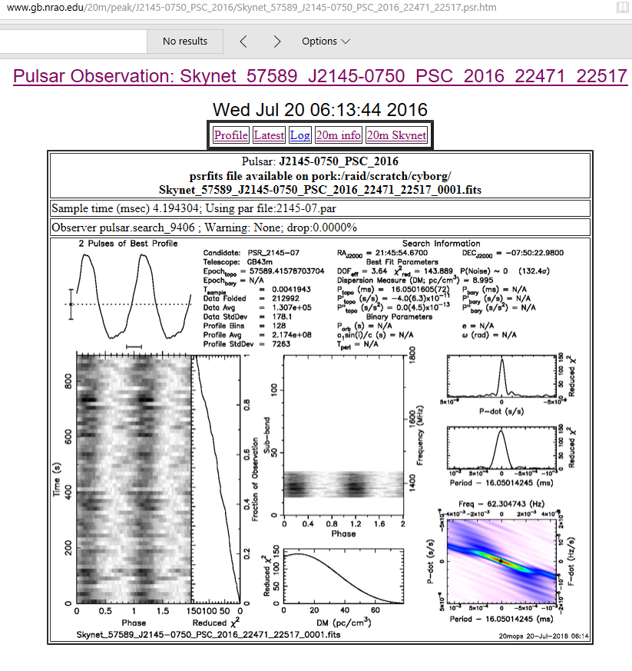
Example

Slide 39
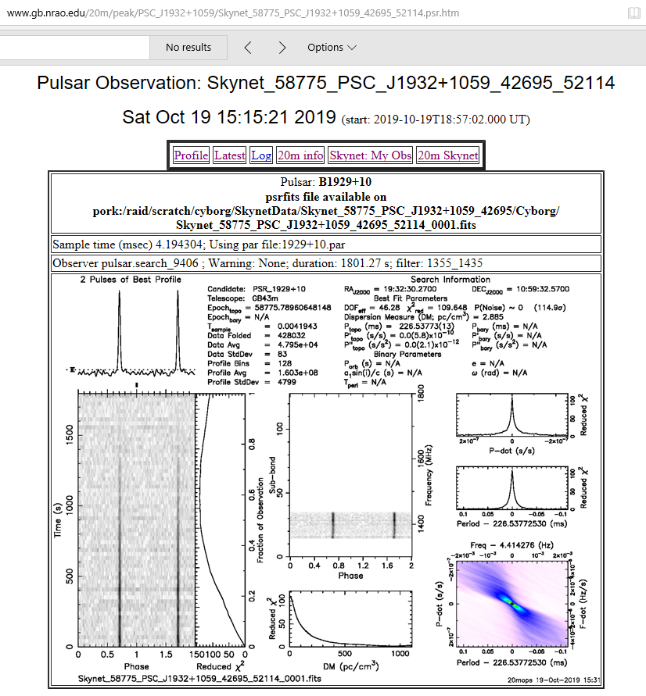
Example

Slide 40
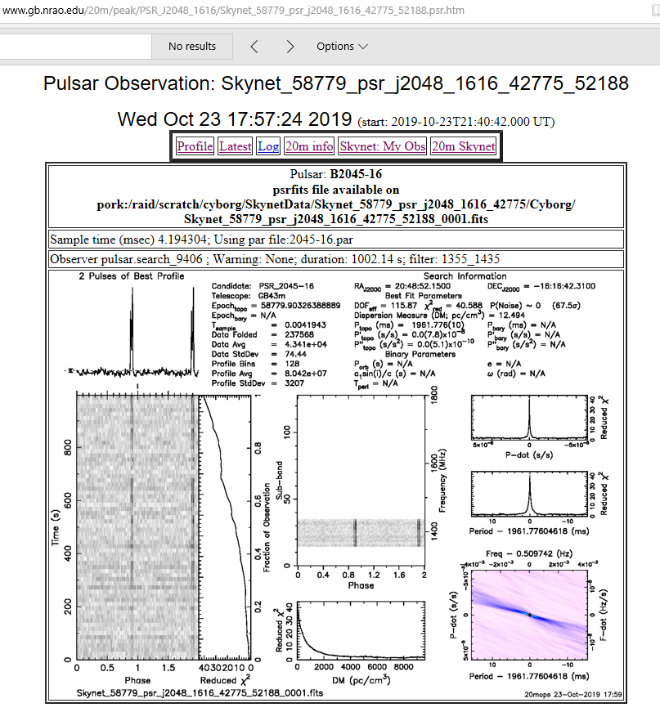
Example

Slide 41
Glossary Of PRESTO Terms
a1 sin(i)/c: A way of describing the size of the pulsar’s orbit if it is in a binary system.
Candidate: The name or label assigned to the current pulsar candidate.
Data Avg: The average value of the data.
Data Folded: The size of the data set being worked on.
Data StdDev: The standard deviation, a way of characterizing the spread in the values of the data.
DecJ2000: The declination of the source in the J2000 coordinate system.
Dispersion Measure: See the glossary above.
e: The eccentricity of the pulsar’s orbit, if it is in a binary system. Eccentricity measures how elliptical the orbit is, with a high eccentricity indicating a very elliptical orbit.
Epochbary: The Modiﬁed Julian Date of the start of the observation accounting for slight shifts due to the motion of the Earth.
Epochtopo: The Modiﬁed Julian Date of the start of the observation.
Proﬁle Avg: The average value of the pulse proﬁle.Proﬁle Bins: The number of phase bins in the pulse proﬁle.
Proﬁle StdDev: A way of characterizing the spread in the values of the pulse proﬁle.

Slide 42
Glossary Of PRESTO Terms
Pbary: The period of the pulsar, adjusted as if it were measured from the center of mass of the solar system.
P’bary: The P-dot of the pulsar, adjusted as if it were measured from the center of mass of the solar system.
P”bary: The second derivative of the period of the pulsar, adjusted as if it were measured from the center of mass of the solar system. The P-double-dot is the rate of change of the P-dot.
Porb: The orbital period of the pulsar, if it is in a binary system. This is the length of time it takes for the pulsar to go through one full revolution.
Ptopo: The period of the pulsar as measured from the observatory.

Slide 43
Glossary Of PRESTO Terms
P’topo: The P-dot of the pulsar as measure from the observatory.
P”topo: The P-double-dot of the pulsar as measured from the observatory. The P-double-dot is the rate of change of the P-dot.
RAJ2000: The right ascension of the source in the J2000 coordinate system.
Reduced χ2 : See the glossary above.
Telescope: The name of the telescope used to make the current observation.
Tperi: A way of describing when the pulsar is closest to the center of mass of its system, if it is in a binary system.
ω: The longitude of periastron. This is a way of describing the orientation of the pulsar’s orbit, if it is in a binary system. (This symbol is the Greek letter omega.)

Slide 44
PSC Data
PRESTO is a large suite of pulsar search and analysis software. It was primarily designed to efficiently search for binary millisecond pulsars from long observations of globular clusters (although it has since been used in several surveys with short integrations and to process a lot of X-ray data as well). PRESTO stands for: PulsaR Exploration and Search Toolkit.
PRESTO has discovered over 600 pulsars https://www.cv.nrao.edu/~sransom/presto/
https://en.wikipedia.org/wiki/Presto_(SQL_query_engine): Presto is a high performance, distributed SQL query engine for big data. Its architecture allows users to query a variety of data sources such as Hadoop, AWS S3, Alluxio, MySQL, Cassandra, Kafka, and MongoDB.
Long-term Observation Program: Radio pulsars are believe to be rotation powered neutron stars. As a result, the rotation frequency of an isolated radio pulsar is expected to be decreasing steadily with time as angular momentum is carried away from the neutron star via electromagnetic radiation and particle acceleration.

Slide 45
Other Projects Ideas
Applications
Masers
Variable Radio Sources (SNRs or revolving Solar System objects)
Pulsars (Intensity of pulses can vary, but frequency is extremely consistent. An analysis of the data variations can give new insight to the nature of pulsar radiation. 2250+ known pulsars and growing.)
Supernovae (recurring)
Galaxies
Sun (Active and Quiet) and Solar System objects
Mapping & Sky Surveys
Radio Occultations (See Analytical Section Observation Guide)
Calculations to Understand radio astronomy principles

Slide 46
Contact
Questions, Comments, Volunteering?
Email SARA Section Analytical Section Coordinator
Tzikas@alum.rpi.edu
stephentzikas@gmail.com

