Slide 1
Introduction to Radio Astronomy
Notes:
Radio astronomy is the use of a radio to tune into the universe. Fact: Only a little over a decade ago, over 65% of our knowledge of the universe was provided by radio astronomy. References:
SARA

Slide 2
Intro to Astronomy (In under 10 minutes)
Notes:
Astronomy is an ancient science (or at least is now). It was probably started by the ancient hunters needed to know when migrations were likely to happen. Again, by noting when stars rose at certain times of the year and traveling to different regions found their prey. Alternately, farmers needed to know when to plant their crops. By noting when stars rose at certain times of the year and planting then, they had better crops.
As those patterns were predictable and repeatable, they knew the date and therefore knew it was time to plant their crops or travel to new hunting grounds. Given knowledge is power, the knowledge eventually got obscured from the masses so that only chiefs, priests and astrologers knew how to 'predict' the night skies and their 'influence upon us'.

Slide 3
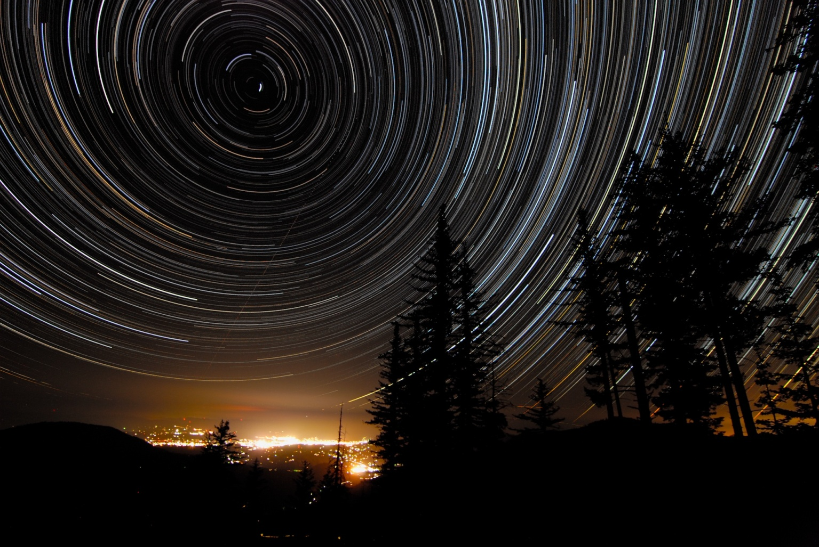
Notes:
Fast forward to today and you find that astronomy has definitely become a science and a scientific hobby that anyone can get into and enjoy.
Its use for power and mysticism has waned. The basic physics is well known and understood and accessible to everyone. (Just do a web search for 'Understanding Astronomy' and you will get millions of pages to view and learn from.) As the Earth rotates upon its axis, in 24 hours we see our closest star (our Sun) rise and set. Looking towards the poles of our planet, we can easily observe the star trails that are famous in photographs such as this one. References:Star trails: Astronomy Picture of the Day - 2009 September 9
Astronomy reference on Wikipedia

Slide 4
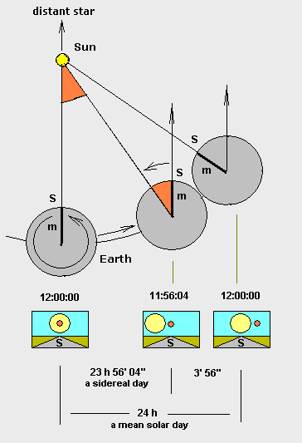
Notes:
We orbit around the Sun in a year and as we do so, we start to get to real astronomy. As the Earth orbits the Sun, the background stars at a given time of day shift position. This constant shift is what we have to adjust for in order to gather information and share it in a coherent manor. This is where star charts come into existence. References:
Wikipedia article about Sidereal day

Slide 5
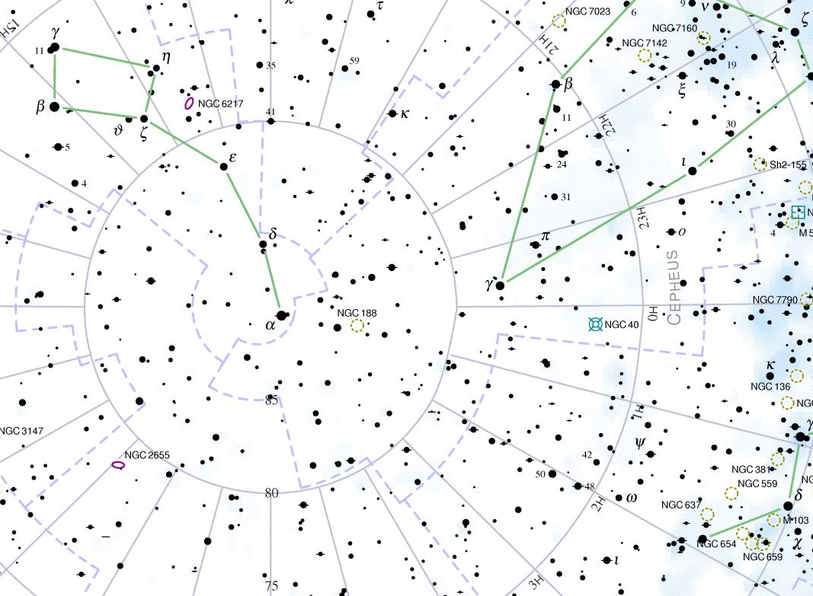
Notes:
Standard sky charts have been created over the years. To make them usable by everyone, a convention of three items has been accepted. 1) Directly up from the Earth’s equator is 0 degrees. Directly up from the North pole is 90 degrees north.
2) At the spring (vernal) equinox, the line directly from the north to the south pointing straight up at the Sun is declared as the zero-hour angle.
3) Greenwich England Observatory is defined as the zero point for longitude.
By knowing these three items, a simple equation will convert from the observer's current location and date/time to what would be overhead using any star chart. This lets all observers agree about where they are looking in the night sky and therefore compare notes about what they observe there. References:
Image:
Cloudy Nights Magnitude 7 Star Atlas Project Copyright Andrew L. Johnson

Slide 6
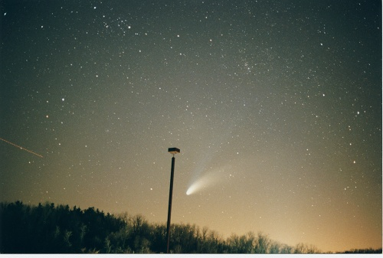
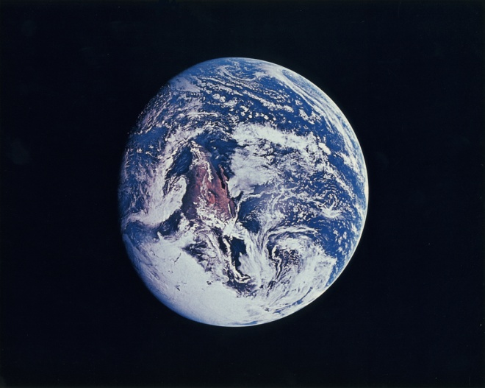
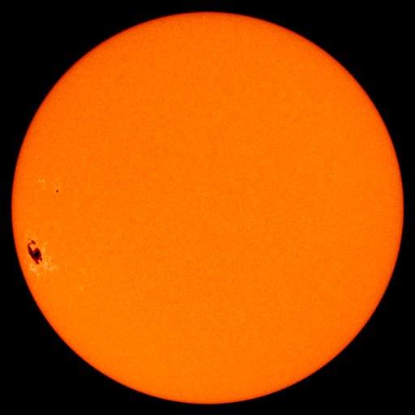
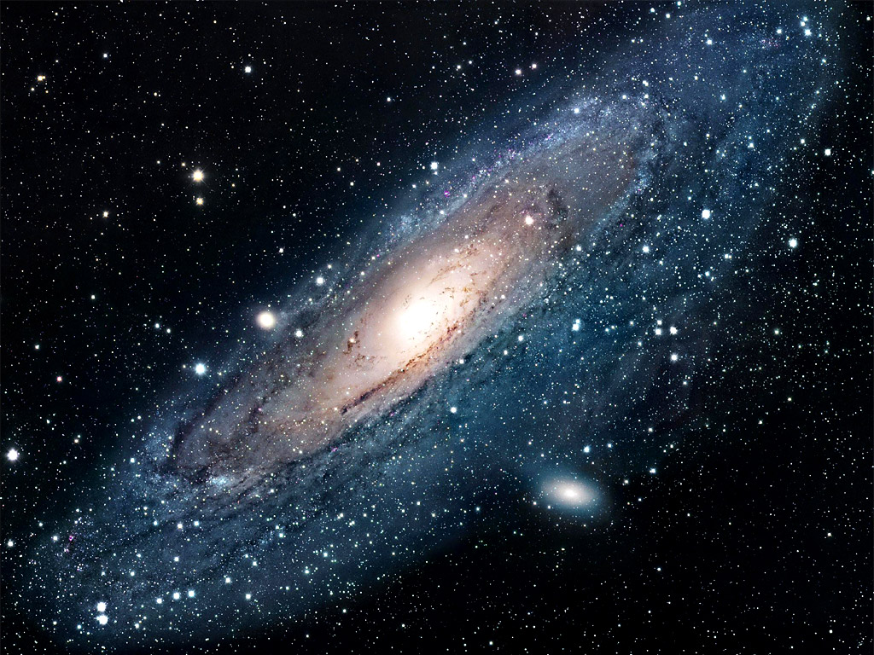
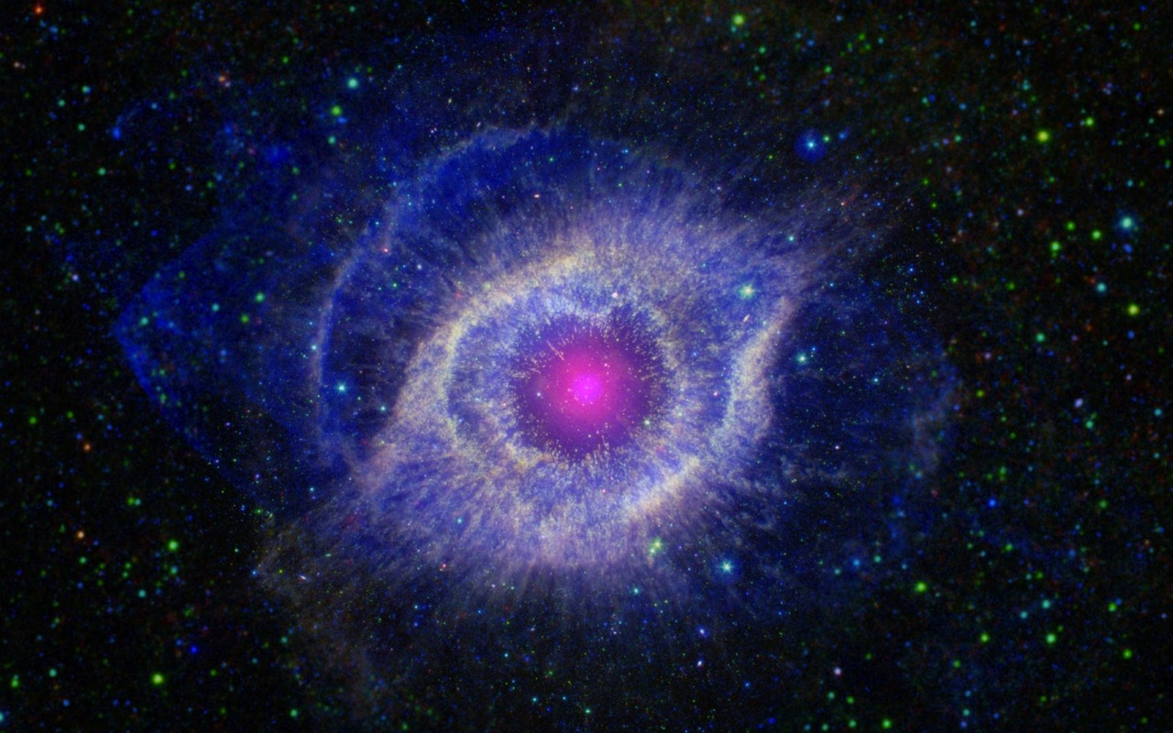
Notes:
So what is up 'there'? From the smallest to the largest we have: Gas – on average, about 1 atom per cc
Small bodies – dust, meteors such as in the comet tail in the upper left
Larger bodies – such as the comet itself, asteroids, planets such as our planet Earth
Stars like our Sun
Large clouds such as the Helix Nebula in the lower right
Galaxies such as the Andromeda galaxy in the lower left
With the exception of the Helix Nebula, all of these types of objects are visible to the naked eye. Note that each of these is constantly changing. Comets brighten and dim on their way through the inner solar system. Sunpots come and go. Nebula are either forming new stars or the results of stars dying. Galaxies collide. Every time we observe something, it may be the first time it’s ever been observed. References:
Small bodies – comets, asteroids (Ed Harfmann)
Larger bodies (planets) (Apollo 10 image of Full Earth)
Stars like our Sun (2005/09/09) (Ed Harfmann)
Helix Nebula Hubble
Galaxies (Andromeda) (NASA)

Slide 7
So where does Radio Astronomy come in?
Notes:
Where does the information about the universe come from for astronomers? Electro-Magnetic or EM waves are almost all that they have had to work with until the recent discovery of gravity waves. We will only discuss EM waves as this is the only thing that we can observe as a hobbyist. Both optical and radio waves are electro-magnetic waves - the only difference between them is the 'color' or frequency of the waves. There are basically three mechanisms that generate EM radiation. The first is black body radiation...

Slide 8
Notes:
For a solid, everything above absolute zero gives off energy in a range of frequencies. If your receiver is sensitive enough (or the source close enough), then you can pick up that radiation. This means that we on Earth can feel the heat of the sun on a summer's day. That is the good news. The bad is that the curves (intensity) drop by 1 divided by the wavelength multiplied by itself 5 times. In other words, picking up black body radiation (other than the Sun or something on Earth) with a radio receiver is almost practically impossible. The second source type is elemental or quantum emissions... References:
Evolution of the Universe, Radiation Laws and Big Bang

Slide 9
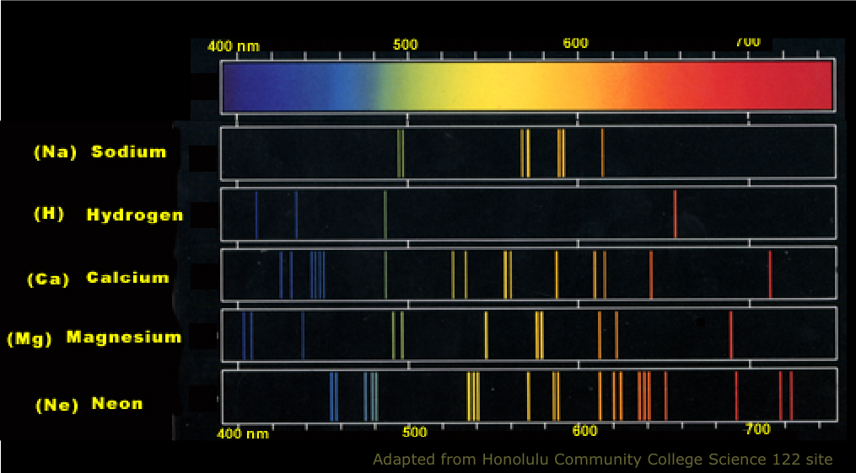
Notes:
All elements and molecules absorb or emit energy at certain ‘colors’ of light. Therefore if an element is somehow excited, it will emit light at certain colors. If it is not excited, but light of that color hits the element, it can absorb that light and retransmit it at a later time, in a random direction.
While this chart shows the optical lines for several elements, there is quite a list for radio frequencies that molecules emit at that are important to radio astronomy. Here is part of that table... References: Image:
Light, particles and waves

Slide 10
Substance | Rest Frequency | Protected Segment
Deuterium (DI) | 327.3840 MHz | 327.0 - 327.7 MHz
Hydrogen (HI) | 1420.406 MHz | 1370.0 - 1427.0 MHz
Hydroxyl radical (OH) | 1612.231 MHz | 1606.8 - 1613.8 MHz
Hydroxyl radical (OH) | 1665.402 MHz | 1659.8 - 1667.1 MHz
Hydroxyl radical (OH) | 1667.359 MHz | 1661.8 - 1669.0 MHz
Hydroxyl radical (OH) | 1720.530 MHz | 1714.8 - 1722.2 MHz
Methyladyne (CH) | 3263.794 MHz | 3252.9 - 3267.1 MHz
Methyladyne (CH) | 3335.481 MHz | 3324.4 - 3338.8 MHz
Methyladyne (CH) | 3349.193 MHz | 3338.0 - 3352.5 MHz
Formaldehyde (H2CO) | 4829.660 MHz | 4813.6 - 4834.5 MHz
Methanol (CH2OH) | 6668.518 MHz | 6661.8 - 6675.2 MHz
Ionized Helium Isotope (3HeII) | 8665.650 MHz | 8660.0 - 8670.0 MHz
Methanol (CH3OH) | 12.178 GHz | 12.17 - 12.19 GHz
Formaldehyde (H2CO) | 14.488 GHz | 14.44 - 14.50 GHz
Cyclopropenylidene (C3H2) | 18.343 GHz | 18.28 - 18.36 GHz
Water Vapour (H2O) | 22.235 GHz | 22.16 - 22.26 GHz
Notes:
This are just a small part of a long list of elemental and molecular frequencies that are important to Radio Astronomy. Notice quite a few are easily within the range of equipment that is commonly available. You just need enough sensitivity to detect the emission and a quiet enough location to not have these signals droned out by man’s emissions. The hydrogen line above is actually accessible to the beginner with the most modest equipment‎. Ok, for those who took chemistry in high school or college, you might remember the various emission series for – Hydrogen - Lyman, Balmer and others. None of these series get down to 1.4 GHz which is well known as a radio astronomy frequency, so where does that emission come from? References:
Significant Radio Astronomy Frequencies

Slide 11
Hydrogen line – 21 cm or 1420.405751 MHz
Notes:
The hydrogen line is given off as the spin of the proton and electron go to the ground state. It has a half life (when half of the atoms have reached this ground state) of about 11 million years. Lastly on our list of source mechanisms, is Bremsstrahlung... References:
SARA Presentation
http://www.cv.nrao.edu/course/astr534/HILine.html

Slide 12
Notes:
Bremsstrahlung (or breaking radiation) is when a charged particle (e.g. electron) is forced to change its direction either by another charged particle or a magnetic field. An example of this is when electrons in the solar wind get deflected by the magnetic field of planets. Synchrotron radiation (which is just another form of Bremsstrahlung) is when relativistic electrons are in a weak magnetic field. This type of radiation is detected from Jupiter in the 20MHz range as part of the Radio Jove project. References:
Synchrotron Radiation
Radio Jove Solar & Planetary Radio Astronomy for Schools

Slide 13
Notes:
When you add up these various sources, you find that the radio signals generated by the cosmos varies with frequency and you can find that at ‘low’ frequencies, you don’t need as sensitive equipment to easily hear the cosmos.
Note that at ~73 MHz that the galactic noise is very high and our atmosphere is relatively quite. This makes this an easy to observe region. Sadly, this is also where a lot of terrestrial transmitters operate so observing in this range is challenging… but not impossible.
References:
EME (Earth - Moon - Earth>
Radio Astronomy, 2nd Edition - Krause

Slide 14
Notes:
The ‘Water Hole’, which is where the hydrogen line at 1.4 GHz is located, is easy to spot in this graph as a low noise area from both cosmic and terrestrial interference. The water hole is observed by the various SETI studies to try to find life elsewhere in the universe.
Now, practically there is another reason for radio astronomy to observe the cosmos... References:
EME (Earth - Moon - Earth>
Radio Astronomy, 2nd Edition - Krause

Slide 15
Notes:
This is the center of our galaxy in various wavelengths. As you can see, different wavelengths have different views of the exact same object. Each band has its advantages and disadvantages. This illustrates the folly of thinking what we see with our eyes is all that there is to be known of our universe. Until telescopes were put into space, only the optical and the various radio views were available to scientists. (Radio is really the only way we can see the center of our galaxy from the ground. If you look at the optical image, you only see the dust between us and the center of our galaxy.) References:
Multiwavelength Milky Way

Slide 16
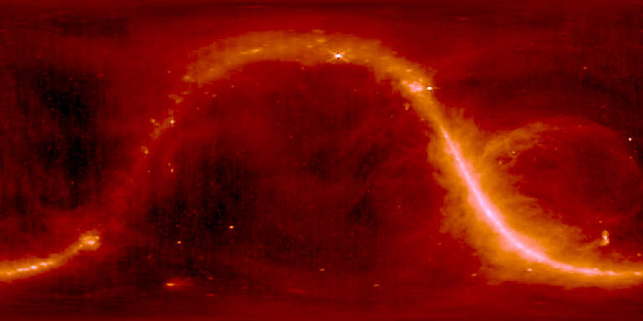
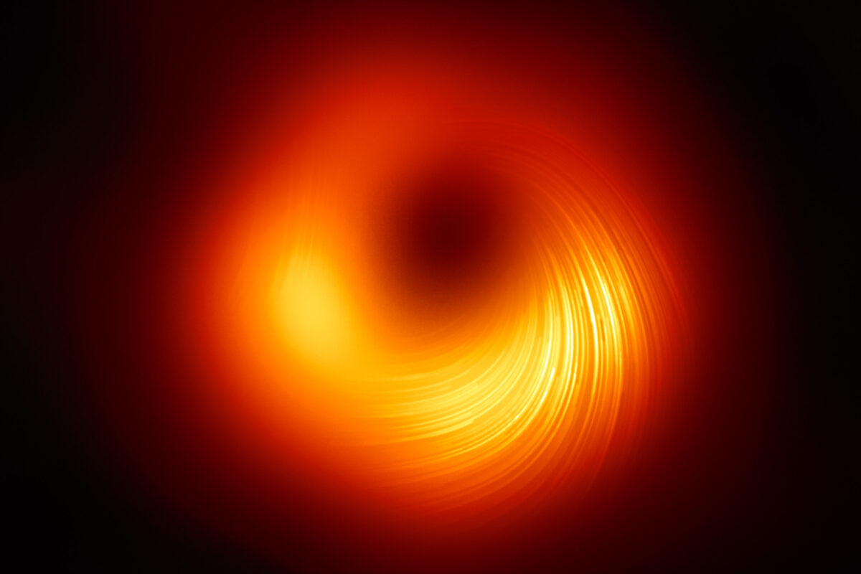
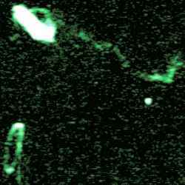
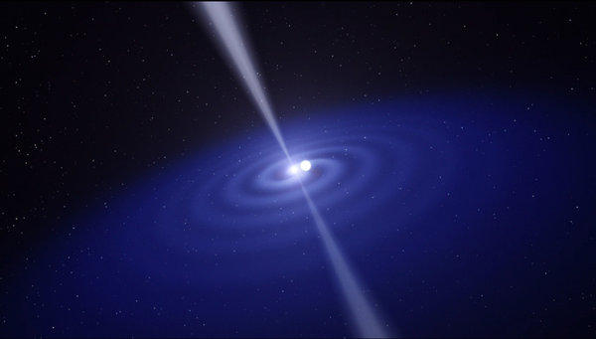
Notes:
But what sort of information has radio astronomy provided that our eyes and optical telescopes haven’t been able to provide? Some of the major discoveries of radio astronomy include:
Imaging a black hole
Non-thermal radiation from our Galaxy and many other astronomical sources (Top Right)
Coherent maser line emission from interstellar ions and molecules
Cosmic microwave background radiation from the big bang
Neutron stars
Evidence for dark matter, deduced from the HI rotation curves of galaxies and even dark galaxies. (Bottom Right)
Extrasolar planets
Indirect but convincing evidence for gravitational radiation (Courtesy of Dr. Joe Taylor who was the keynote speaker to SARA in 2014.) (Bottom Left)
Gravitational lensing
The violent universe of radio galaxies and quasars powered by supermassive black holes. (Top Left)
Cosmological evolution of radio galaxies and quasars
Thermal spectral-line emission from cold interstellar gas atoms, ions, and molecules
Coherent continuum emission from stars and pulsars
These and many other discoveries have made radio astronomy a key part of gathering knowledge about our universe. References:
Quasar concept image - http://www.space.com/17262-quasar-definition.html
408 MHz radio sky - https://www.cv.nrao.edu/~demerson/cs/radiosky.htm
Dark Matter galaxy - http://www.universetoday.com/11273/dark-matter-galaxy/
Pulsar in binary system - http://www.trbimg.com/img-517ad6cf/turbine/la-einstein-relativity-20130426-001/600/600x341
Black hole image - https://www.jpl.nasa.gov/edu/news/2019/4/19/how-scientists-captured-the-first-image-of-a-black-hole/

Slide 17
Some History About Radio Astronomy
Notes:
History you say? It's always interesting to see how something came into existence. With Radio Astronomy, you have some interesting situations and missed opportunities.

Slide 18
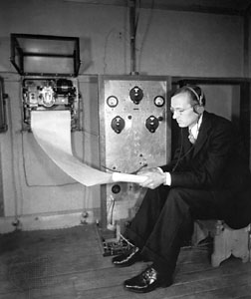
Father of Radio Astronomy
Notes:
Karl Jansky is recognized as the father of Radio Astronomy. Working for AT&T, he was task with finding out whether short wave radio could be used for trans-Atlantic communications. He found 3 noise sources that would interfere with these plans: Human made (ignition systems from cars), natural Earth (thunderstorms) and ‘a faint steady hiss of unknown origin’. At first, he thought it was the Sun, but (using the antenna above), he found the noise source repeated every 23:56 minutes, not every 24 hours and that the strongest source was in the constellation of Sagittarius. He published the results of his work in 1932-1933. While he wanted to follow up on his discovery that the universe was a radio source (and proposed a 100’ dish to AT&T), AT&T was not interested and being of poor health, he had to abandon his discovery and move on to other tasks. His work and insight was honored by the community declaring that the unit of power measurement in radio astronomy would be the Jansky – 10−26 Watts/(M^2 *Hz)
A replica of this antenna is on the grounds at the Green Bank Observatory. References:
Karl Jansky and the Discovery of Cosmic Radio Waves
Wikipedia article about Jansky unit

Slide 19
Radio Astronomy Kickstarter?
Notes:
Grote Reber (W9GFZ) was a ham operator and worked for several radio manufacturers designing receivers. He discovered some of Karl’s work in 1932 and was inspired to build his own radio telescope in his mother’s back yard... References:
NRAO article about Grote Reber

Slide 20
Notes:
He built this 31.4’ dish and started observing the skies. (This actual telescope is at the Green Bank Observatory.) He started observing at 3300 MHz… then 900 MHz and was unable to observe anything. But after moving to 160 MHz, he had success... References:
NRAO article about Grote Reber

Slide 21
Notes:
The spikes on these graphs are the ignition systems from cars, but the bottom of the curves shows the outline of the Milky Way and the position of the Sun. While these were interesting graphs - people relate to pictures, so he took a lot of curves and started making contour plots... References:
NRAO article about Grote Reber

Slide 22
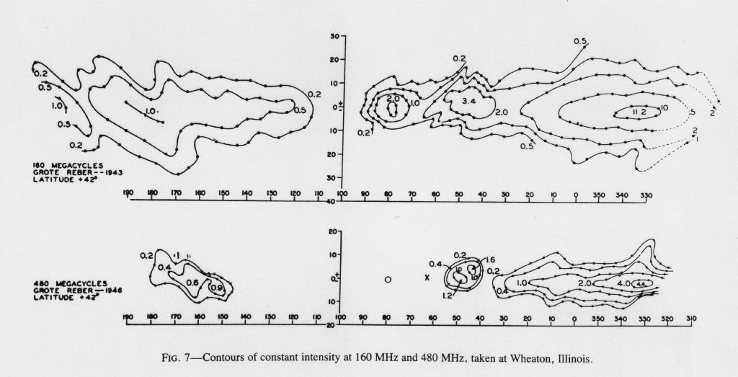
First Radio Graph of our Galaxy
Notes:
He surveyed the sky and produced the first plot of the Milky Way in radio frequencies. Some observatories were put together, but the depression and World War II initially interfered. Post World War II astronomers were concerned with other topics, and they thought that most emissions would be thermal in nature and therefore radio astronomy would not add a lot of information. Therefore, since optical had higher resolution (at least the time), the thought was that you could learn everything from optical telescopes. However, in the 1960’s, that changed. References:
NRAO article about Grote Reber

Slide 23
Active Radio Galaxy 3C 273
Notes:
One event in the early 1960s was with Maarten Schmidt who was using both radio and optical telescopes to measure the optical spectra associated with radio sources. He found some very bright radio objects in the sky but initially could not find a bright optical object to associate with the object. He had to use the 200” at Mt. Palomar to find some of his sources. One object that he found at Mt. Palomar was a quasi-star like objects that had remarkable properties (very high red shift). Sadly, the radio telescopes of the time had very low angular resolution, so the various astronomers were not convinced the object found optically were the actual radio source.
Fortunately, this object – 3C273 – was going to be occluded by the Moon 5 times over the next few years. Therefore, by monitoring the exact time it disappeared and reappeared, they knew its location in the sky. They then definitely found the optical object, but a lot of confusion ensued as to what these things were and how far away they were. The astronomers finally decided that these objects must be far away. The only far away object that matched the observations was a super-massive black hole that was actively feeding. This was the first recognized radio galaxy. References: The Madness of Black Holes

Slide 24
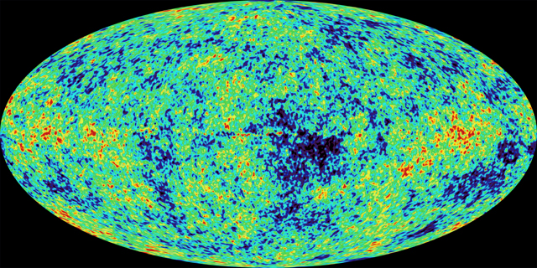
Cosmic Microwave Background
Notes:
Accidently discovered by Arno Penzias and Robert Wilson, the Cosmic Microwave Background was initially thought to be noise due to pigeon poop in the antenna! They measured a temperature of about 3 Kelvin wherever they pointed their antenna. The Steady-State universe calculated that a 2 Kelvin temperature would result from scattered starlight as a non-thermal spectrum. After more measurements were taken, the radiation was shown to follow a thermal (black body) curve. This was part of the body of works used to change ‘The Big Bang’ from a joke into the leading candidate for how the universe was created and evolved.
References:
Image: https://www.nasa.gov/centers/goddard/news/topstory/2003/0206mapresults.html
Information: https://en.wikipedia.org/wiki/Cosmic_microwave_background

Slide 25
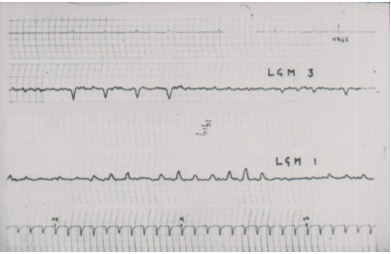
Pulsars discovered
Notes:
One event that I’ll mention was in 1967 – Cambridge England. Jocelyn Bell Burnell was studying under Dr. Anthony Hewish. Dr. Hewish was studying the scintillation of EM waves in the interstellar medium. He had Ms. Burnell supervise the construction of a radio telescope out of over 2,000 dipole antennas and the collection of the data from that telescope. While studying the data, Ms. Burnell found something strange. (Remember that at this point, you had to use pen chart recorders to record your data so there were thousands of feet of charts to go through every day.) A cosmic source was producing pulses at the rate of a pulse every few seconds. Ms. Burnell brought this to the attention of Dr. Hewish. This source was designated LGM-1… Little Green Men 1. After a few days' reflection, they decided that the source was actually what had been a fringe theory up to this point by Fritz Zwicky - a pulsar. Dr. Hewish went on to receive a Nobel prize which he shared with Fred Hoyle. (Hoyle harshly criticized Hewish and the Nobel committee for leaving Jocelyn out of the prize, however in her own words: “…I believe it would demean Nobel Prizes if they were awarded to research students, except in very exceptional cases, and I do not believe this is one of them.”
Fast forward 50 years and Jocelyn Burnell was awarded the Breakthrough award on 9/6/2018 for her discovery of pulsars and her leadership in astronomy.
Her accomplishments include:
Head of the Royal Astronomical Society.
First female president of the Institute of Physics
First female president of the Royal Society of Edinburgh.
Chancellor of the University of Dundee in Scotland.
References:
Wikipedia article about Jocelyn Bell Burnell
Pulsar chart from http://www.aut.ac.nz/__data/assets/pdf_file/0006/364335/Jocelyn-Bell-Burnell-OrewaPSRrefln.pdf
Pulsar breakthrough - https://www.space.com/41733-jocelyn-bell-burnell-pulsar-discovery-breakthrough-prize.html
"The plan is, broadly, to use the money to fund research students — graduate students, particularly students from underrepresented groups in physics,”
Bell Burnell will officially receive the award on Nov. 4, during the 2019 Breakthrough Prize ceremony in California's Silicon Valley. Laureates of the organization's annual prizes in physics, life sciences and mathematics will also be honored at the ceremony, as will winners of the Breakthrough Junior Challenge.

Slide 26
B1933+16
0.356 S
B0531+21
33.4 mS
B1937+21
1.56mS
Notes:
So what is a pulsar you might ask...
Pulsars are the remains of a large star that blew up. Most of the star is blown off to form a nebula. The core of the star is compressed until it becomes almost nothing but neutrons. These stars are about the size of a large city, about 10 miles across.
They provide for beamed radiation due to particles moving down the magnetic field lines to the poles. This radiation can be exceptionally bright and due to the star spinning can appear as a flash at up to almost 1,000 times per second. Hence the star pulses energy in in that beamed radiation and is therefore called a pulsar. A slowly spinning pulsar is B1933+16 which is spinning at only about 3 times per second.
Pulsar B0531+21 has been observed optically for years by almost everyone who has looked through a telescope, but no one could see the flashing as its light was faint in comparison to the Crab nebula that it hides within. It spins at about 30 times per second.
A faster spinning pulsar is B1937+21 which is spinning at over 600 times a second.
Just think – These sounds are being made by something the size of a city spinning multiple times per second. I’ll note that pulsars are only directly observable for each pulse by using a very large radio telescope… much larger than amateurs normally have access to.
These three, and many other discoveries and realizations changed radio astronomy into a serious astronomy tool of discovery. References:
Neutron Stars Sound files: Pulsar Sounds (http://hosting.astro.cornell.edu/~deneva/psr_sounds/pulsars_sounds.htm)
B0531+21 - https://www.parkes.atnf.csiro.au/people/sar049/eternal_life/supernova/pulsars.html

Slide 27
What does the Radio Sky look like?
Notes:
Is the radio sky really that much different than the optical sky that we see with our eyes?

Slide 28
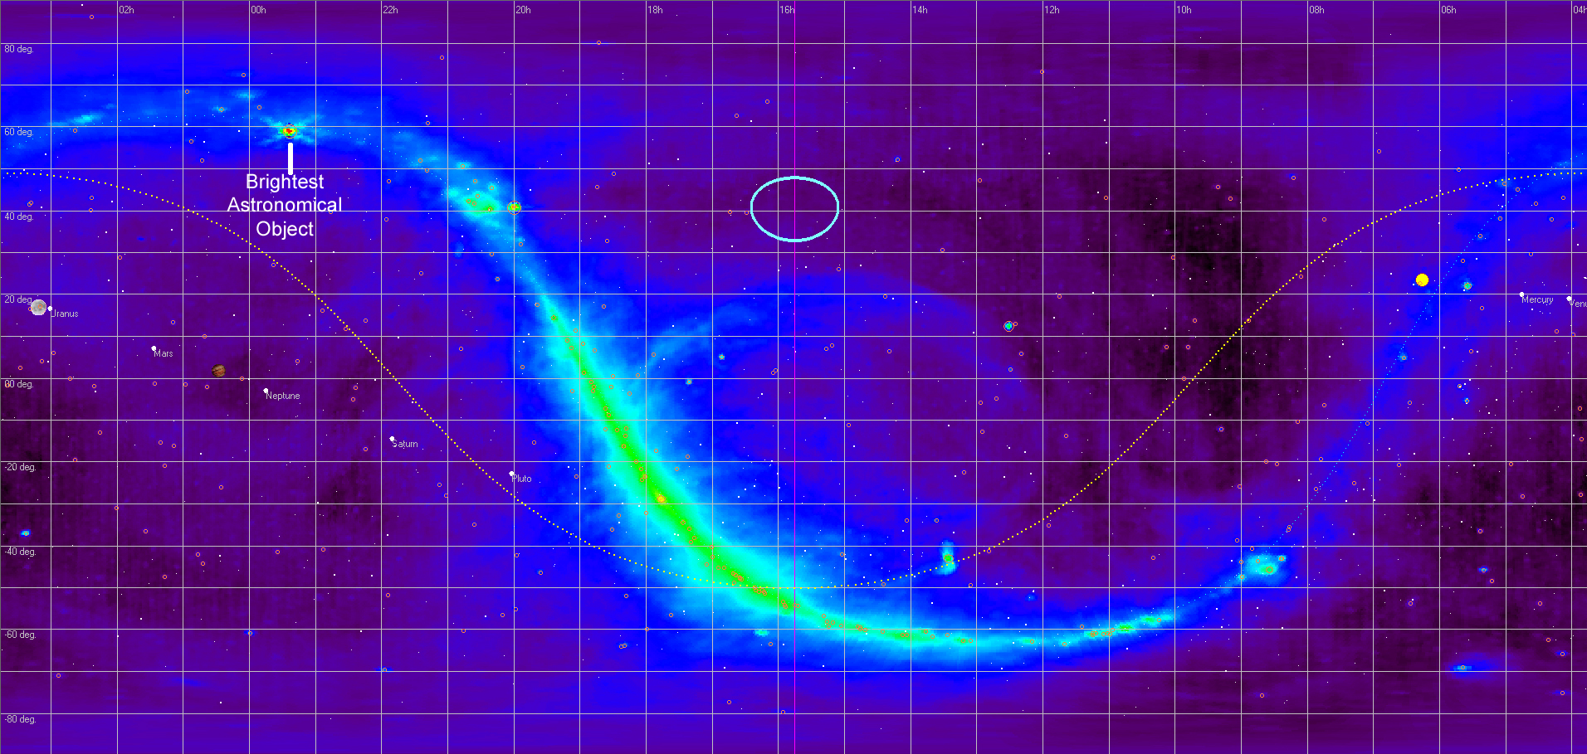
The Whole Sky at 408 MHz.
Notes:
This is the view of the sky at 408MHz. You can clearly see the outline of the Milky Way and you see the brightest object in our radio sky – our Sun. However, excluding the Sun, the brightest object is not our galactic black hole. Located in the upper left is a small object that is exceptionally bright... References:
Image generated using RadioEyes

Slide 29
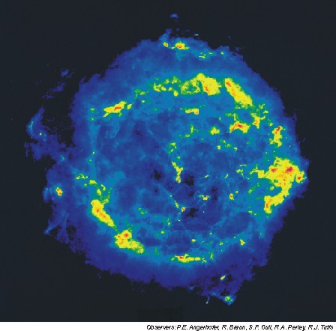
Supernova Remnant Cassiopeia A
Notes:
Cassiopeia A is that bright object. As you can see on the left in an optical telescope, the area is fairly plain, but in radio the same area is dramatically different. This object is the result of a super nova that is 'glowing' in the radio frequencies.
(Images are the same scale.)
References:
Cassiopeia A (3C461) data from RadioEyes

Slide 30
What the professionals use
Notes:
It is interesting to see what professional astronomers have to use and where so much of that knowledge of the Universe has come from. While the amateur is not able to get a huge dish, the electronics available today to the amateur would be envy of the professional astronomer of 20-40 years ago.

Slide 31
Notes:
This is the five-hundred-meter Aperture Spherical Telescope in China and saw first light in September of 2016. At 500 meters (1,600 feet) diameter, this scope currently holds the ‘brass ring’ for the largest single radio telescope. Again, being spherical only a fraction of the surface is used, about 60%.
References:
Wikipedia https://en.wikipedia.org/wiki/Five_hundred_meter_Aperture_Spherical_Telescope
Image: foxnews.com

Slide 32
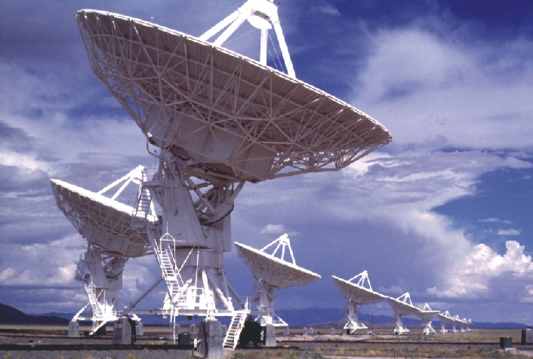
VLA
Notes:
The Very Large Array or VLA is another of the world’s premier astronomical radio observatories. It has 27 movable radio antennae each 25 meters in diameter in a Y-shape configuration. The antennae work together as one large antenna. As the individual antennae move apart, the resolution increases. At their maximum distance of 34 kilometers apart, the facility is able to get 0.04 arcsecond resolution. (Hubble is 0.05 arcsecond resolution.) How big is an arcsecond? One arcsecond is approximately the angle subtended by a U.S. dime at a distance of about 2.5 mi. References:
NRAO Very Large Array

Slide 33
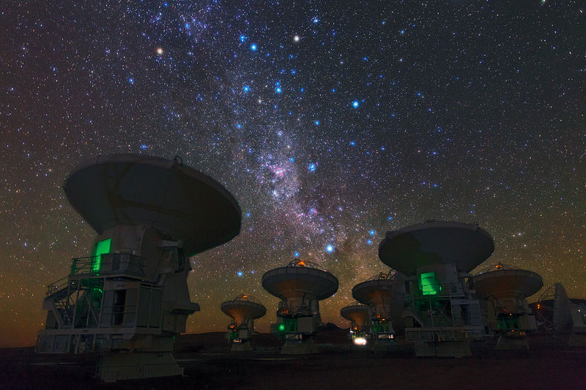
VLBI
Notes:
The Very Long Baseline Interferometer (or VLBI) is actually radio telescopes that are located around the globe including a few of those shown earlier. Together they work the same as the VLA does and create a telescope that is almost the diameter of the Earth is size. By creative use of the distances between the various telescopes (and a LOT of computer power), the VLBI has a resolution of 170 micro arc-seconds. This is how the professionals got their image of the event horizon of a black hole in 2019 and learned more about the magnetic field lines in 2021. Astronomers have also been using these telescopes to push Einstein's equations to the breaking point. While no new physics has been found yet, the search continues as they gather new knowledge while observing what is happening in the extreme environment around black holes. References:
VLBI imaging with an angular resolution of 100 microarcseconds
Very Long Baseline Array

Slide 34
Image courtesy of NRAO/AUI
Notes:
This is the 100-meter radio telescope in Green Bank, West Virginia. Located in a radio quiet zone, the site routinely does research in various bands from 300MHz to 100GHz. The Green Bank Telescope (or GBT) regularly observes signals in the micro Jansky area. While this telescope does not have quite the resolution of the prior telescopes, it is much more sensitivity. In other words, the picture might be a bit more fuzzy, but you do see much fainter objects.
However, this was not the first huge radio telescope at Green Bank...
References:
Radio Astronomy, July-August 2014 p 84.
Green Bank Telescope

Slide 35
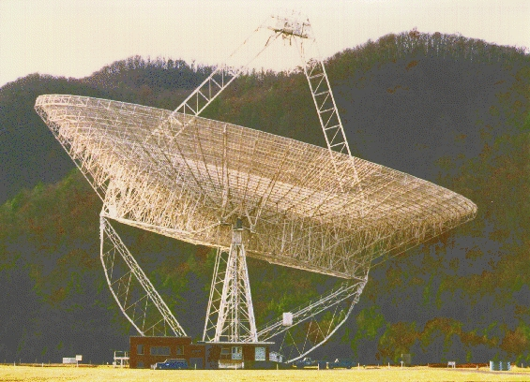
Notes:
This is the original 300’ radio telescope at Green Bank right before... References:
300 Foot Telescope

Slide 36
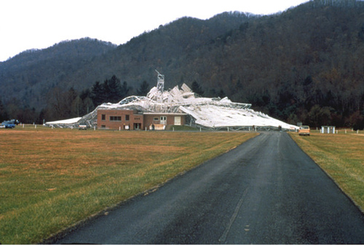
Notes:
it collapsed. On November 15, 1988, a gusset plate failed which caused the whole structure to collapse. The telescope had been in operation for 26 years. It was designed for a shorter lifespan but had its operation extended due in part to some of its many discoveries. At that time, the telescope was controlled from the building you see in the foreground which is VERY close to the scope. So close... References:
300 Foot Telescope

Slide 37
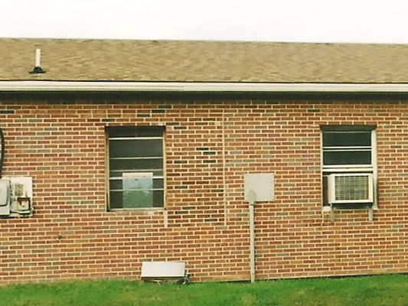
Notes:
...that I-beams went through between the control room and the bathroom. (Notice that the brick work doesn't quite match near the center of the photo.) The operator had just come on duty when the dish collapsed. References:
Photo Ed Harfmann 2014

Slide 38
Does the amateur Radio Astronomy community work with the professionals like the optical community does?
Notes:
Yes, yes they do. The amateur radio astronomy community is actively recruited to do observations. There are several active collaborations going on now.

Slide 39
ITU Radio Bands | Radio Projects | Sources of Radio Signal
SLF (30-300 Hz) ULF (300-3000Hz) VLF (3-30KHz) LF (30-300KHz) | Whistler Radios and VLF Radios | Earth-based phenomena associated with lightning, auroras, and solar activity.
 | SID (Sudden Ionospheric Disturbance) Radios - (AAVSO (American Association of Variable Star Observers) and Stanford are sources for these radios and plans for them as well.) | Ionospheric disturbances caused by the Sun. Some have investigated Gamma Ray Bursts with these radios as well.
HF (3-30 MHz) | Jupiter and Solar (18-30 MHZ) (Radio Jove is a source for these radios) Pulsar Detection | Jupiter storms due to Io charged particles. Solar storms - Flares et. al. Some Pulsar work has been done in this band.
VHF (30-300MHz) | FM Meteor Detection | Meteor detection - signal bounces off ionized gas.
UHF (300-3000 MHz) | Continuum/Drift Scan (usually at 406 MHz; 1420 MHz (Hydrogen gas spectral line); 1667 MHz (OH molecule spectral line). | Galactic Sources - Supernova remnants, Active star forming regions, etc. Gamma Ray Bursts SETI (Search for Extra Terrestrial Intelligence - uses the "water hole" (H and OH lines) as a search frequency zone.
 | Spectral Scans (1420 MHz) | Doppler shift work usually with regions in our own galaxy.
SHF (3-30 GHz) | Extra-terrestrial satellites. | Cassini, Venus probe, Planck, etc.
 | Itty-Bitty radio Telescope (IBT) | Demonstration telescope and possible research capabilities.
 | SETI (Search for Extra Terrestrial Intelligence)
Notes:
While the professionals have the sensitivity and resolution advantage without any doubt, amateurs are able to monitor many bands and gather information from around the globe. Two of the most notable collaborations are the SuperSID program and the Radio Jove program in the SLF and HF bands of this chart. SuperSID and Radio Jove are excellent projects to get started in radio astronomy. Observing in the SHF range can be done in a limited manor very cheaply via the Itty-Bitty Radio Telescope. Observing neutral hydrogen at 1.4 GHz is a slightly more challenging than these projects but, in some ways, more rewarding.
-----
In addition to these current programs, let’s go take a trip in the way-back machine about 20 years or so to the turn of the millenium. Spurious spikes had been observed for a long time by the amateurs in the RF realm. Additionally, Marshal Space Flight Center had seen mystery pulses at gamma ray frequencies. A bright sole put these to observations together and a collaboration was started. This didn’t pan out since the amateur systems could not be calibrated fine enough to be of research quality.
Time of event was hopefully within 10 minutes instead of fractions of a second. Frequency calibration was not very precise. Amplitude calibration was virtually unheard of. After 20 years they have found out what was being observed. What was everyone picking up you may ask? Either supernova’s or one black hole crashing into another. Given readily available timing via GPS and that frequency standards can be more easily obtained, at least two of the three original problems can be addressed by the amateur today. So much for memory lane… now back to the story.

Slide 40
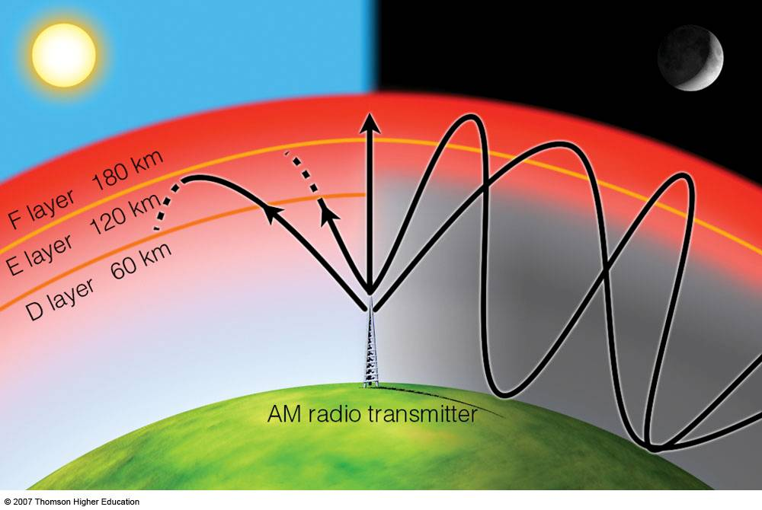
Notes:
At the HF and SLF ranges, we use the ionosphere to our advantage. As shortwave radio listeners can attest, the Ionosphere creates a wave guide that keeps low frequency signals trapped between the Earth and the Ionosphere. Whenever the ionosphere reacts to the solar wind from the Sun, the height at which waves get reflected changes. If we had a transmitter to monitor, we could just monitor its signal strength to detect changes in the ionosphere.
Fortunately, several transmitters exist around the world that are extremely powerful that are used at super low frequencies. Normally these transmitters are used to communicate with submarines. We don’t need to understand that what they are transmitting, we just need to measure how strong of a signal we can receive from them.
References:Shortwave Central

Slide 41
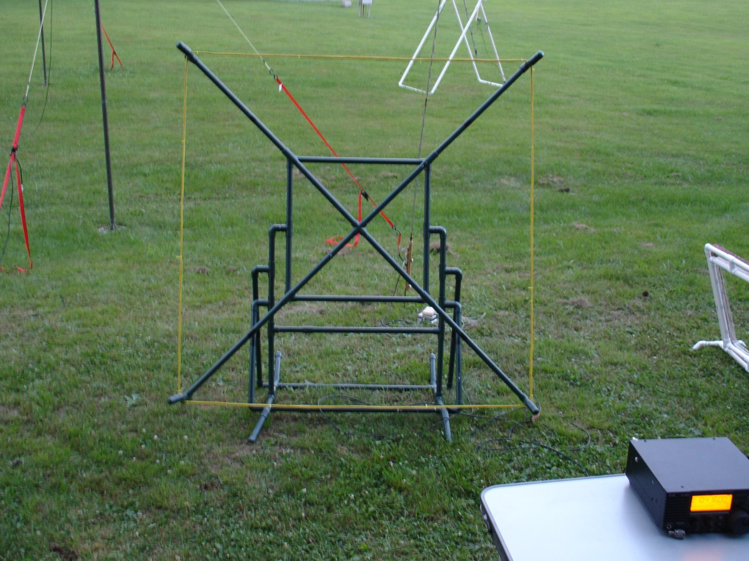
SuperSID
Notes:
That premise brings us to SuperSID, which is a Stanford program that gathers information about Sudden Ionosphere Disturbances. The system works by monitoring VLF radio stations (only 15 to 30 kHz – barely above hearing range if it were sound) and watches their signal strength change. Whenever Earth’s ionosphere is disturbed by the solar wind, the signal strength changes. This system is easy to bring online for automatic data collection and upload to Stanford (and NASA). The receiver is preassembled and creating the antenna is very easy. (Technically, the receiver is really just a very low noise op-amp and the sound card in most PCs. The antenna is a simple loop antenna.) References:
Bottom left photo – Ed Harfmann SARA Conference 2013
Space Weather Monitors - Stanford SOLAR Center

Slide 42
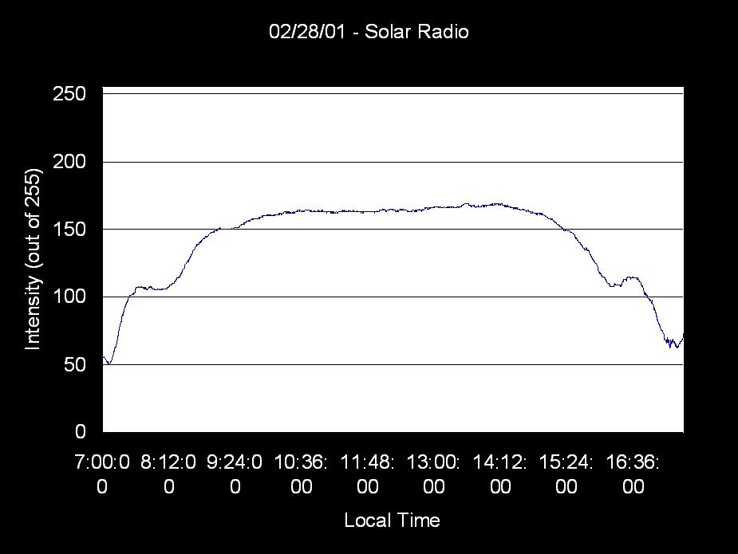
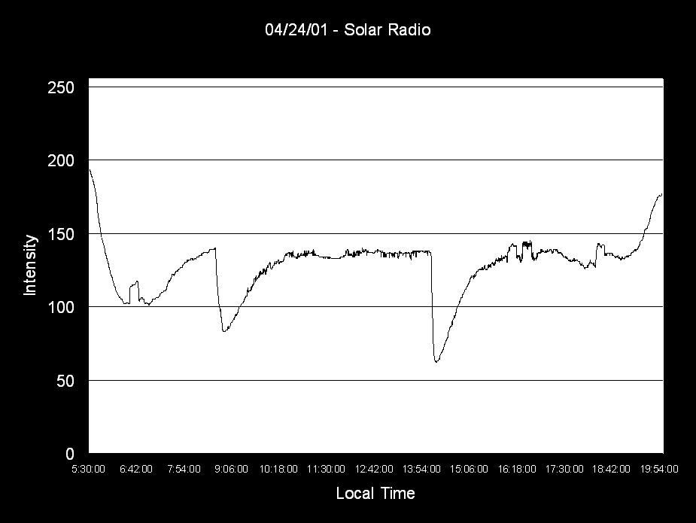
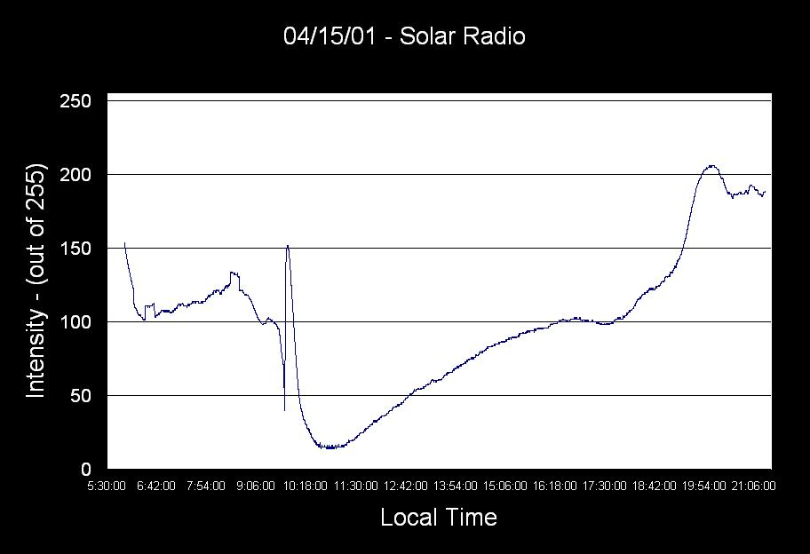
Notes:
With that setup, people around the world are submitting plots like these for professional research. These plots were made of the signal strength of a 24kHz transmitter on several days at a given location. The signal strength is a direct reflection of what the Sun has done to our atmosphere. This observation of the radio universe shows the indirect effects of the Sun (and the cosmos) upon our planet. Upper Left - A clear day devoid of flares
Upper Right - A day with several large flares. These are M1.6 & M2.3 flares (respectively). The signal changes very quickly and over the course of an hour or two, the signal recovers.
Bottom - A day with an amazing X 14.4 flare! It took almost the entire day for the atmosphere to recover from this one flares effects.
I’ll note that the person who put this system together actually has the charts inverted from the way most of these plots are usually displayed. When you flip the chart over, you get a nice shark fin. References:
Wesleyan Amateur Radio Astronomy Presentation
Another form of these graphs is on SARA site: Solar Radio Observing

Slide 43
Notes:
Another way to monitor the indirect effects of the cosmos on our atmosphere is to listen to FM station signals bouncing off of meteor trails. A single antenna FM or TV antenna and receiver are all you need. Basically you point your antenna towards a station that you shouldn’t be able to receive due to no direct line-of-sight to the transmitter and wait for a meteor to ionize the atmosphere. This will provide a brief reflected signal from that transmitter. This can be done with either a VHF ham rig, FM receiver or an SDR. Another way to work is with an interferometer... References:
Image from: Detecting Meteors with an FM Radio

Slide 44
Jupiter has a dynamic output over a range of frequencies.
Notes:
Moving back to direct measurement of an astronomical body, Jupiter has some interesting behavior that is easily monitored with a shortwave receiver. When Jupiter and Io are in the correct locations, you can hear a slide whistle effect. However, the behavior is more interesting if you have a wider bandwidth to examine than just the normal audio from most shortwave receivers. With more bandwidth, you see that the signal being received from Jupiter is changing in intensity and frequency over a large range at the same time. This effect is caused by electrons caught in Jupiter’s magnetic field coming into the magnetic poles of the planet. As they do, they give off the synchrotron radiation of increasing frequency as they get closer to the poles and its closer magnetic field lines. Two known interactions are the L and S bursts, these two sources are relatively well understood as being produced by ions from Io spiraling in Jupiter’s magnetic field. References:
A Project to Detect Radio Emissions From Jupiter

Slide 45
Itty Bitty Telescope
Notes:
Itty Bitty Radio Telescope is possibly the easiest radio telescope to put together and it is a great proof of concept. Just turn it on an you have a radio telescope at 12GHz with a 3-degree field of view. The only modification to the electronics is to the meter, and that is easily done. If you don't want to modify the meter, there are websites that describe how to use an SDR to monitor the output of the telescope.
Cosmologically, only the Sun is visible. Terrestrially - people, trees or anything above absolute zero is visible. This is a great proof of concept and very cheap way to get started. People have started with these and then moved the feed horn onto larger telescopes to get a smaller field of view and more sensitivity. References:Procedure for Making the Itty Bitty Radio Telescope

Slide 46
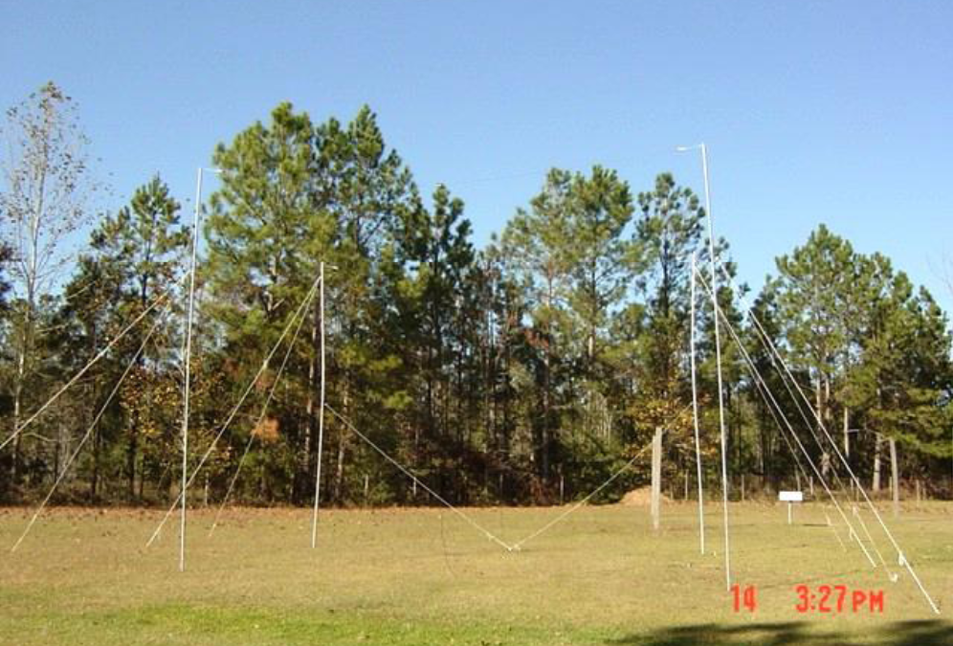
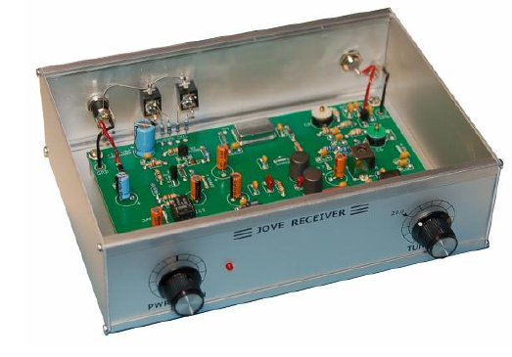
Radio Jove http://radiojove.gsfc.nasa.gov/
L Burst
S Burst
Notes:
NASA started the Radio Jove project to monitor the Jovian system and is today still gathering and analyzing the data from hundreds of sites around the world. A side benefit is that this research is providing insights into our atmosphere here on planet Earth. Bursts are not always recorded at all sites despite being ‘relatively’ close by. Ionization pockets in our own atmosphere are now known to play a part in this behavior and are actively being researched as to their cause and size. The receiver you see on the right is actually a kit that you assemble as part of the project. People from around the global get the kits, assemble them, construct the antenna and start recording data. This is a custom designed direct conversion receiver by the Radio Jove team. (One of its main features is a LACK of automatic gain control.) Now, if you already had a decametric antenna and wanted to swap receivers, you’d be well on your way. If you wanted to use your own equipment, the Radio Jove site has advice on how to do that as well.
To listen to an L burst: Most people are reminded of waves crashing into the shore.
To listen to an S burst: Most people are reminded of popcorn popping. But when these bursts are slowed down, this is what they sound like…
References:
Radio Jove Solar & Planetary Radio Astronomy for Schools

Slide 47
Radio Jove 2
Notes:
Within the past year, the Radio Jove team has released an update to the project. Rather than receiving a narrow band from Jupiter, they are now using cheap SDR dongles to record a wide band from Jupiter. By using an SDRplay receiver, they can observe an 8MHz wide band and view the Jovian emissions as they span a wide frequency area and change over time.

Slide 48
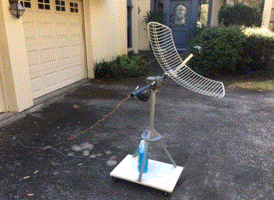
Scope In A Box
https://www.radio-astronomy.org/store/projects/scope-in-a-box
Notes:
The SARA group has been doing research and found that they can use off-the-shelf parts to build a simple Hydrogen line system for around $300! While the antenna’s dipole is cut for 2.4GHz, it still works very well at the Hydrogen line’s 1.420 GHz. An inexpensive pre-amp from Nooelec (their SAWbird+ H1) provides bandpass limiting to reduce RFI from local sources as well as amplification. A cheap RTL-SDR dongle is used as the receiver. Together with your computer, you can observe the abundant hydrogen within our galaxy and with some work detect the arms of the Milky Way.
Ref:
https://www.radio-astronomy.org/store/projects/scope-in-a-box

Slide 49
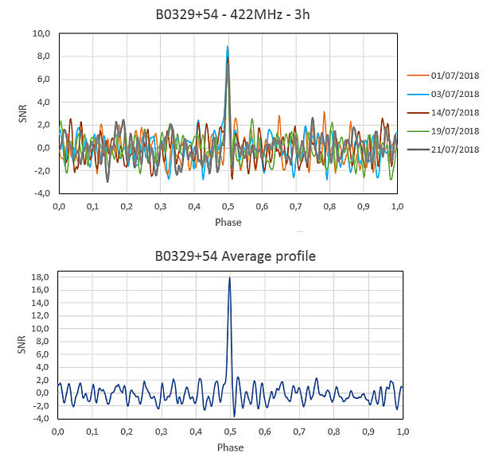
Pulsar detection is possible.
Notes:
Believe it or not, pulsars are able to be detected by amateur radio astronomers. Ok, not new ones but existing ones. By knowing the cycle of the pulsar signal, you can fold hours (or in this case 5 days) of signal into a detection as shown for the antenna shown.
Steve Onley at the HawkRAO used a 3-meter dish to detect a glitch of the Vela pulsar and was co-credited in the professional community alert “Astronomers Telegram” (specifically numbers 12,466 which is referenced by numbers 12481 and 12482) with its detection.
Now, I mentioned the TV dongle as a receiver, and it is a very hot topic throughout the amateur community...
Reference: http://hawkrao.joataman.net/index.html
I have engaged in this pursuit for a number of years (more than 5 years) and, after 20 months of daily observations of the Vela Pulsar, on the 1st February, 2019, the HawkRAO system detected a 'glitch' in the Vela pulsar. (refer to ATel #'s 12466, 12481 & 12482)
Reference: http://neutronstar.joataman.net/sites/iw5bhy_barga_3/index.html
Neutron Star Group
Still Further Pulsar Observations – Andrea (IW5BHY)
Still Further Pulsar Observations - Andrea (IW5BHY)
NOTE: All the information and images presented here are reproduced with permission by Andrea.
Andrea Dell'Immagine (IW5BHY) has made still further observations with yet another different antenna (previous antennas were a 4 metre dish and a 3D corner reflector) of B0329+54 @ 422 MHz.
A change in receiver to the Airspy SDR replacing the RTL-SDR has resulted in an increase of observational bandwidth from 2 MHz to 10 MHz - a theoretical improvement of 3.5 dB in sensitivity (but with increased influence from RFI).
Background
Andrea has now installed a Double Bi-Quad antenna and conducted observations of B0329+54 at 422 MHz.
Receiving System
Antenna Type: Double Bi-Quad panel (constructed by Maurizio Gragnani IU5BEC) Dimensions: 160 cm x 80 cm Operating frequency: 422 MHz, 10 MHz of usable bandwidth Drift scan mode: 3 hours integration time Simulated Gain: 13.2 dBi Simulated aperture: 0.84 m² equivalent to a 1.46 m dish at 50% efficiency Measured performances: 4.7 dB ground to quiet sky; 2.5 dB sun to quiet sky; 2.0 dB milky way to quiet sky (-15° declination) Estimated Tsys: 100 K LNA: LNA 03-70 cm from US4ICI (NF = 0.3 dB) Receiver: Airspy, 10 MHz BW Recording SW: GNU radio channeliser, 2 KHz/25 channels format Back-end SW: PRESTO
Antenna
The Double Bi-Quad antenna used by IW5BHY to observe pulsars at 70cm.
The Results
An example of a PRESTO result from the new antenna is shown below...
Improving Signal-to-Noise by Averaging Several Days' Results
One way of improving S/N is by averaging the results over several days. The top part of the following graphic shows an overlay of 5 days' results. The bottom part shows the average of the 5 days.
Another excellent result from a small antenna !!!

Slide 50
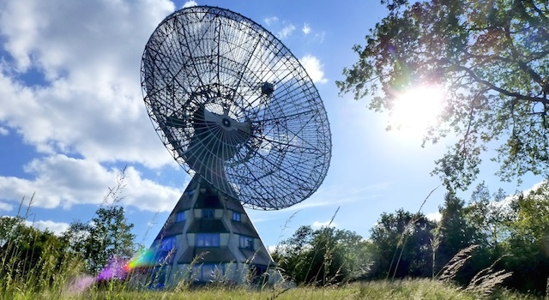
Even detection of Fast Radio Bursts
ATel #14556: Extremely bright pulse from FRB20201124A observed with the 25-m Stockert Radio Telescope (astronomerstelegram.org)
Notes:
Ok, some members have access to really nice equipment and have detected a Fast Radio Burst (FRB). These are single pulses emerging from objects at cosmological distances, travelling for hundreds of million of years or even billion of years before reaching the observing telescope. The nature of these FRBs is unknown and subject of current research. These are very rare events, and the Astropeiler group has observed a location on the sky for 90 hours with their 25-m telescope. They detected a pulse of 1.5 millisecond with 100 MHz of bandwidth centered around 1380 MHz. This detection on April 15, 2021 resulted in an Astronomers Telegram #14556 that was sent out and credited the many people involved in operating the facility. A very notable accomplishment for amateurs regardless of what equipment they have access to.
Additionally, other amateurs have detected masers and magnetars with more modest equipment.
Ref:

Slide 51
NooElec.com
Notes:
TV dongles are actually Software Defined Radios and are the latest twist in radios and is causing quite a stir. By using this type of receiver, you are able to create a very sensitive and selective radio receiver very (relatively) cheaply. NooElec has several SDRs which are based upon the popular TV dongles from the far east. They have ‘souped them up’ with SMA connectors which are more readily available, replaced the clock with a 0.5 PPM clock and an aluminum enclosure to minimize noise generated by the electronics. These have a frequency range of about 24MHz to about 1.7GHz. Costing between 20 and 30 dollars, these are extremely affordable to get started in radio astronomy.
That all being excellent improvements, it is still an 8-bit digitizer and you are limited to about 3 MHz bandwidth.
http://www.nooelec.com/store/sdr/sdr-receivers/nesdr-smart-xtr-sdr.html

Slide 52
Notes:
It is possible to build a hydrogen line radio telescope for the not a lot of money… possibly less than $200. The cheapest way is with one of the USB TV tuner dongles (for ~$20). These dongles have a wide bandwidth (~3 to 5MHz a plus in radio astronomy), but they have poor resolution, additionally they have frequency and gain stability. One step up is the FUNcube dongle (pictured above) for ~$200 it has a much better resolution and gain-stability but the bandwidth is relatively narrow (~192kHz). As an example of what someone has done with a FunCube... References:
An SDR Radio Telescope‎
FUNcube Dongle

Slide 53
Notes:
This is a scan from a FunCUBE receiver. A clear detection of the center of our galaxy. The antenna is a 3 meter dish with a 1.4GHz feed horn. Now there are some steps up for the serious radio astronomer... References:
Further Developments of an SDR Radio Telescope - Using FunCube Dongles and Spectrum Lab

Slide 54
Airspy.com
Notes:
This SDR has a 12-bit ADC and almost 8 MHz bandwidth. It also has several programmable pins for controlling equipment as well as an input port so that you could run several of these off of a standard clock (e.g. synced to the GPS signals.) It has an issue with the internal clock causing a spike at 1420 MHz which is very annoying for hydrogen line work, but it is manageable.
Coming in at about 170 dollars, this is a very good SDR to use.

Slide 55
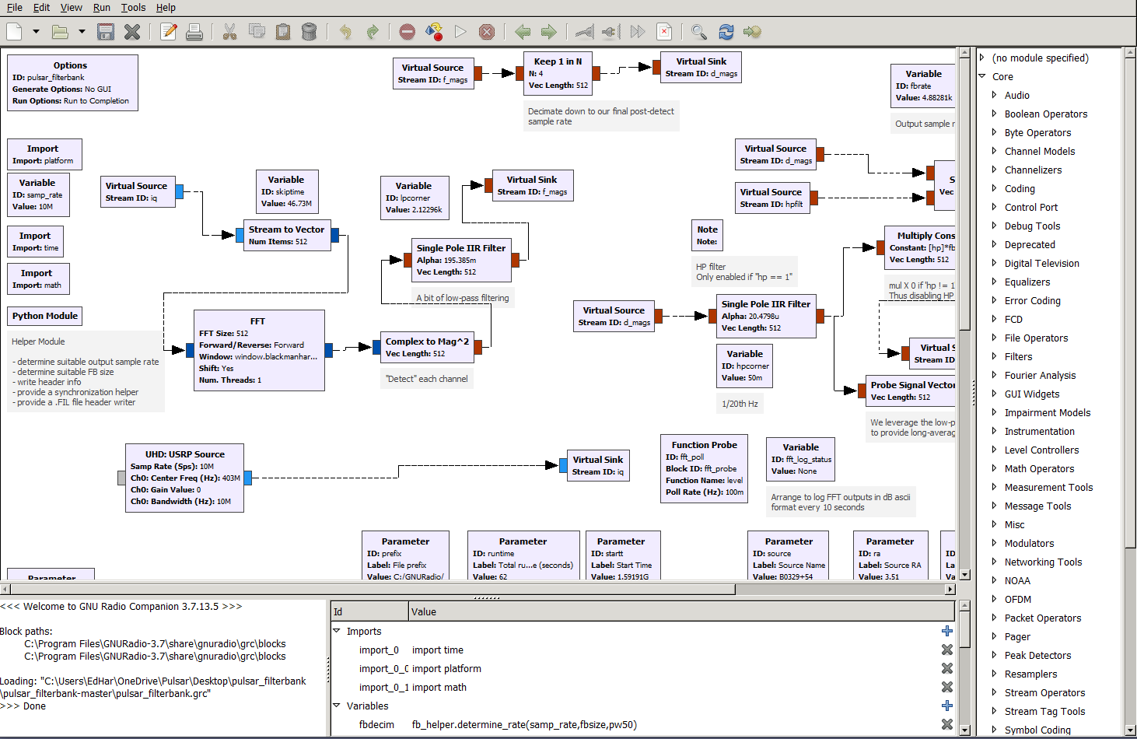
Gnu radio
Notes:
Gnu Radio is a core piece to any SDR usage and it’s use in radio astronomy is no exception. It allows for the easy design of a receiver and then the raw processing of the data. Shown here is a sample sketch to perform pulsar reception.

Slide 56
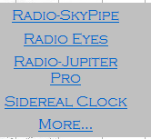
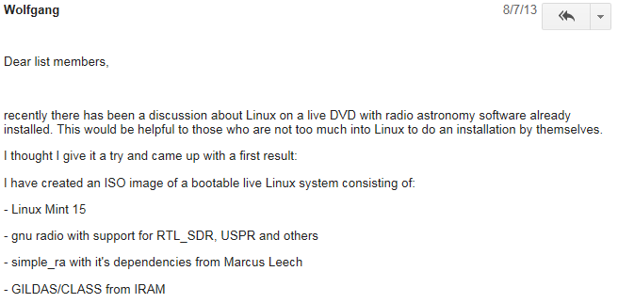
Software
http://gnuradio.org
http://radiosky.com/
Notes:
There is a software community to go with all the hardware in radio astronomy. While many packages have been ported from the professional realm (e.g. Tempo), more than a few have been developed within the community. On the commercial side, some such as Jim Sky have a presence and published some of their works (at very reasonable prices) for people to buy and use. Some of Jim’s utilities include Radio Eyes – a sky chart program that presents the sky in the radio sky rather than optical. Radio SkyPipe is the standard used by many in SuperSID, Radio Jove and by many other fields. Mr. Sky also has some of his work available for free. So even if you cannot setup an antenna and observe yourself, there are other opportunities. Outreach. Helping with the software listed above. References:
GNU Radio
Simple RA
GNU Radio Radio Astronomy Blocks
RASDR web site
Radio-Sky Publishing

Slide 57
Getting started

Slide 58
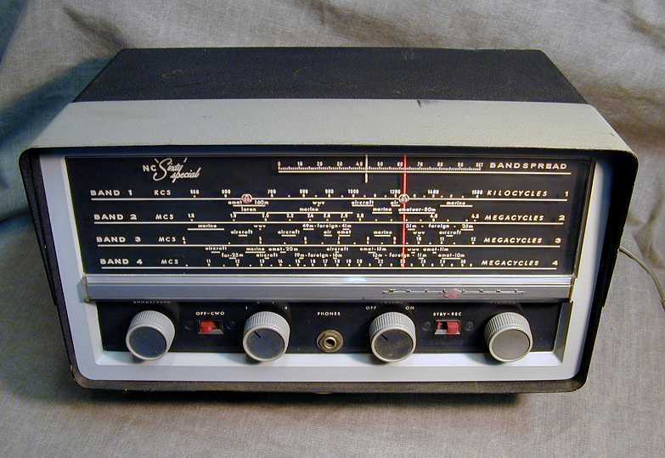
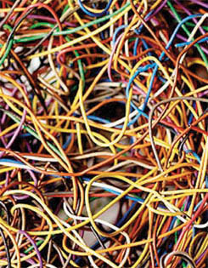
Expensive or hard to get started?
Notes:
Have you got a shortwave radio receiver? Some wire laying around? If so, you can tune in Jupiter.
Like in optical viewing, you can start on the ‘easy’ items (such as Jupiter) and progress to more difficult observing as your talents get refined.
As I mentioned earlier, you can buy a great SDR for less than what some people spend on a single eyepiece.

Slide 59
Is light pollution an issue?
Notes:
The good news is that Radio Astronomy does not have any issues with light pollution. In fact, you can observe 24 hours a day. The bad news is that electrical noise pollution is possibly even a bigger problem than light pollution.
You need a relatively quiet area to setup your observatory.
If you go to the SARA web site, you can find help on how to determine whether a site is suitable as well as suggestions on tracking down interference.

Slide 60
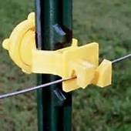
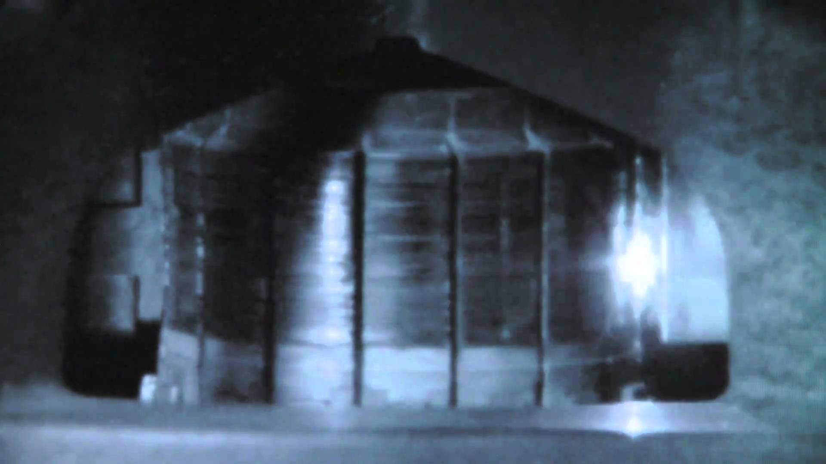
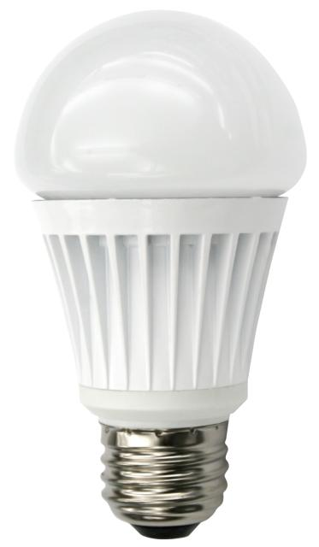
What is RFI?
https://groups.google.com/g/sara-list
Notes:
Just as you may have to talk to your neighbors about a poorly designed outdoor light, you may have to spend some time tracking down bad power line insulators, nearby electric fences with bad insulators, arcing motors, noisy LED lights…
While a problem, these are all issues that are actually easier to address than bad lighting. The FCC is your friend as RFI is a finable offence so large companies are quick to comply. In the case of arcing motors or noisy LED lights, these are items that often are a problem for the owner. (The noise my be interfering with their TV or radio or the noise may be an early indicator of failure. They may actually thank you for tracking that that troublesome problem.)
I’ll say these issues are solvable and therefore should not prevent you from getting started. There are also a lot of resources from fellow enthusiasts and online to help you find and solve these issues. A quick search for “RFI Mitigation” has thousands of hits. Additionally, your local amateur radio group should be able to assist as well.

Slide 61
Notes:
Final thoughts from Mrs. Burnell before the end...

Slide 62
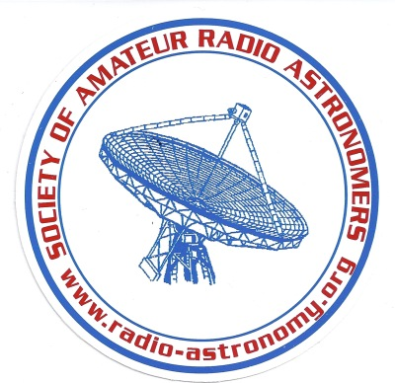
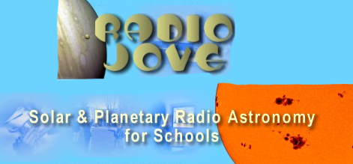
Questions?
http://radiojove.gsfc.nasa.gov/
Notes:
Thank you for your time. I hope I’ve given you the basic information to start thinking about radio astronomy as a hobby. If you go to the SARA web site and click on the education menu, you can get a lot of good information. Additionally, a lot of information is on the Radio Jove site. SARA is a non-profit organization that does a LOT of outreach and education such as Radio Jove.
Questions?

