Slide 1
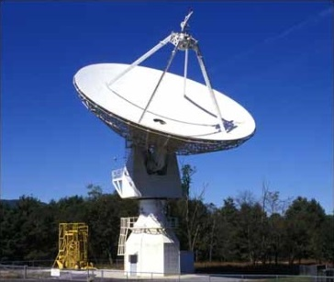

SARA Conference 2019
Analytical Section Meeting, Demo, & Programs

Slide 2
Agenda
What’s New?
20m Dish Demo
Cas A Observation Program
Useful Information
SARA Analytical Section Open Forum

Slide 3
20 Meter Dish Demo
Green Bank Conference Account - Explore!
Skynet Account (free UNC Course) - Your Personal Account!
Demo Example – Watch the dish move outside!
Cas A Observation Program
Fading at an average rate of 0.67 percent per year in the L-band

Slide 4
20 Meter Dish Demo
Observing Advice
Track
Set to 60 seconds for galactic hydrogen and strong pulsars
On-Off
Offset to a few beamwidths or 3-4 degrees
Durations generally larger than optical: Use 30 to 60 seconds
For hydrogen in nearby galaxies 200-300 seconds
For 1.4 GHz receiver
Daisy maps should have radius of 2 degrees or more
Set radius to 120-180 arcmin. (3-4 beamwidths); 4 petals quick look.
0.1 – 0.2 sec integration time
Raster maps no smaller than 3.5x3.5 degrees; or 6x6 beamwidths
For gap sweep, use ¼ or 1/3 beamwidth for quick maps; 1/5 or 1/10 for detailed
Map depth: time in integration is the time corresponding to the gap along the sweeps, and it will calculate the slew speed.

Slide 5
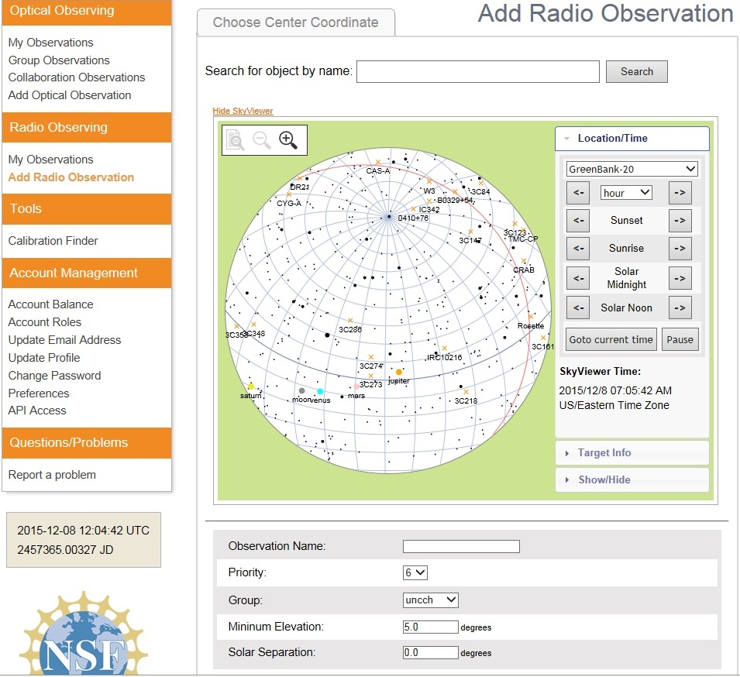
20 Meter Dish Demo
Add a Radio Observation
-Select an Object
(Database or RA/Dec)
-Minimum Elevation
(Used for mapping)
-Solar Separation
(to prevent solar side lobe
interference)

Slide 6
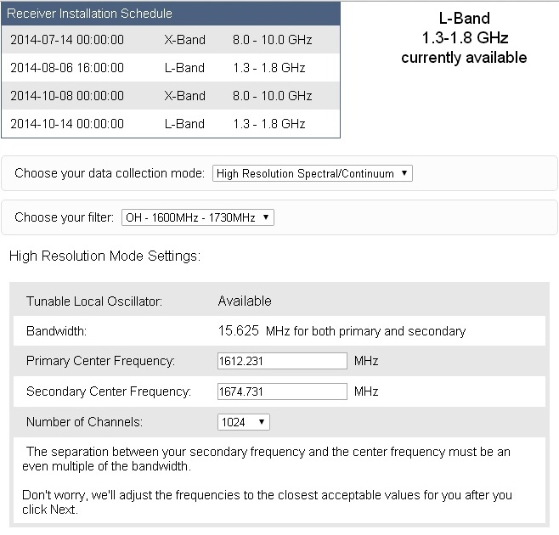
20 Meter Dish Demo
Configure Receiver
Low Resolution: continuum mapping/pulsars
High Resolution: Spectral Lines
No Filter Full Band (with interference)
H1 Filter (continuum maps, 1355-1455 MHz)
OH Filter (Iridium sat. interference, 1.6-1.73 GHz)

Slide 7
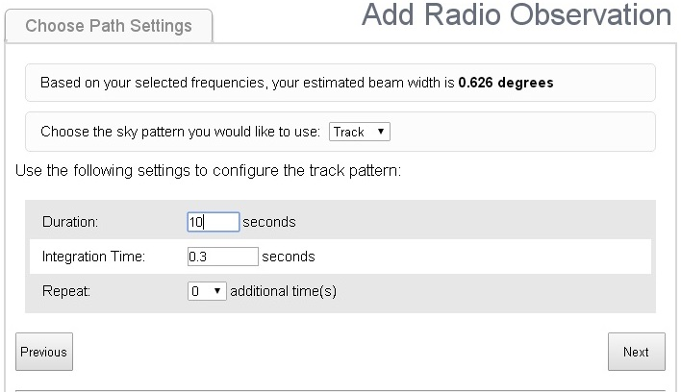
20 Meter Dish Demo
Choose Path Setting
Track: Good for spectra in high resolution & pulsars
On/ Off: Compares to a reference & good for fainter spectral lines
Daisy: Petal pattern maps for preliminary observations
Map (Raster): Back & forth detailed scans (wide band continuum observations)

Slide 8
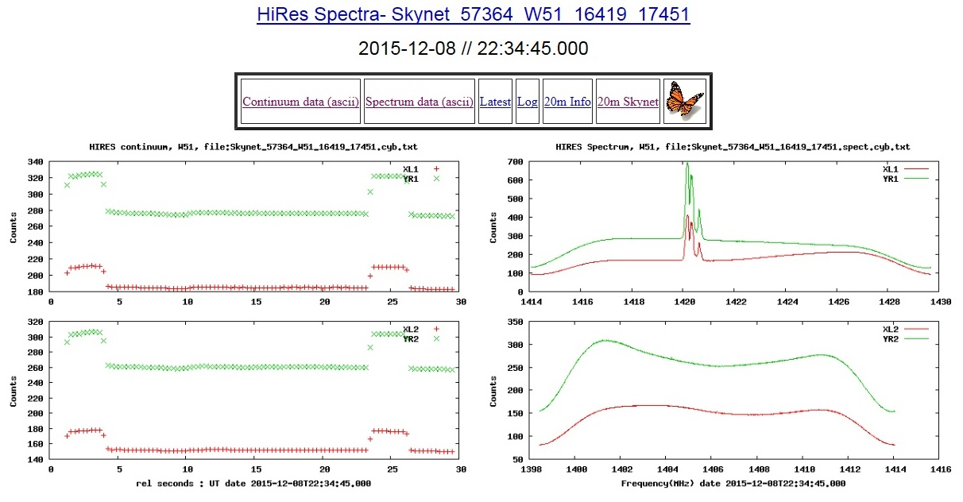
20 Meter Dish Demo
Electron polarization: A property of electrons defined by the Pauli Exclusion Principle but simply described as up or down, or left and right. Radio telescopes are equipped with polarizing filters that distinguish between the two electron polarizations.
Output (Track) : Molecular Cloud W51
Shows the continuum. This is the average of the central 80% of each spectrum pattern vs time. The four traces are two polarizations and two frequency bands. Note Baseline, Calibration, and Target traces.
Shows the average spectra
averaged over all integrations. The upper and lower plots are for the two frequency bands and the two traces in each plot are for the two polarizations.

Slide 9
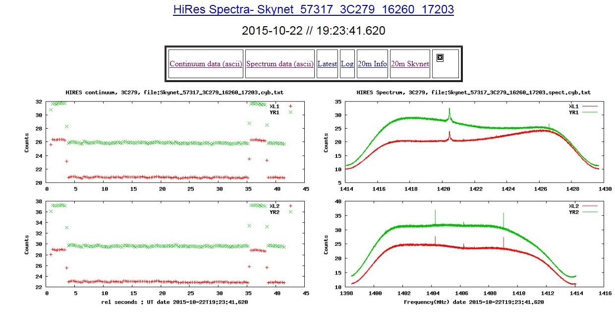
20 Meter Dish Demo
Output (On/Off): 3C279

Slide 10
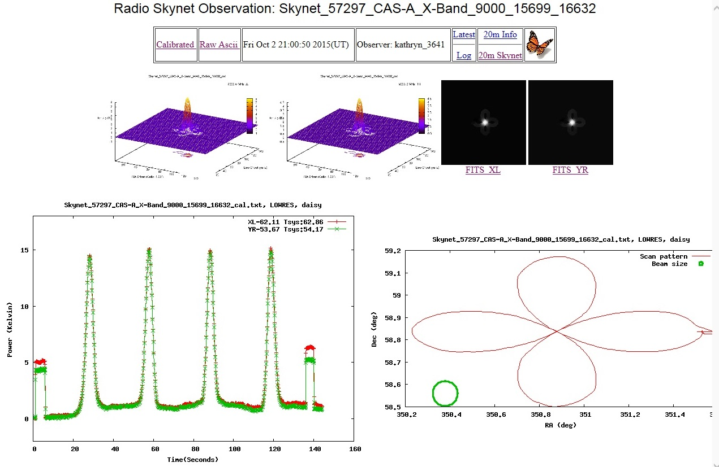
20 Meter Dish Demo
Output (Daisy): Cassiopeia A
The color wedge on the right represents the intensity of the source in Kelvins, not the physical temperature of the object but rather the increase in temperature the telescope feels when pointed at the source.
Sharp peaks of intensity correspond to the telescope pointing directly
at the source which is at the center of the daisy pattern.

Slide 11
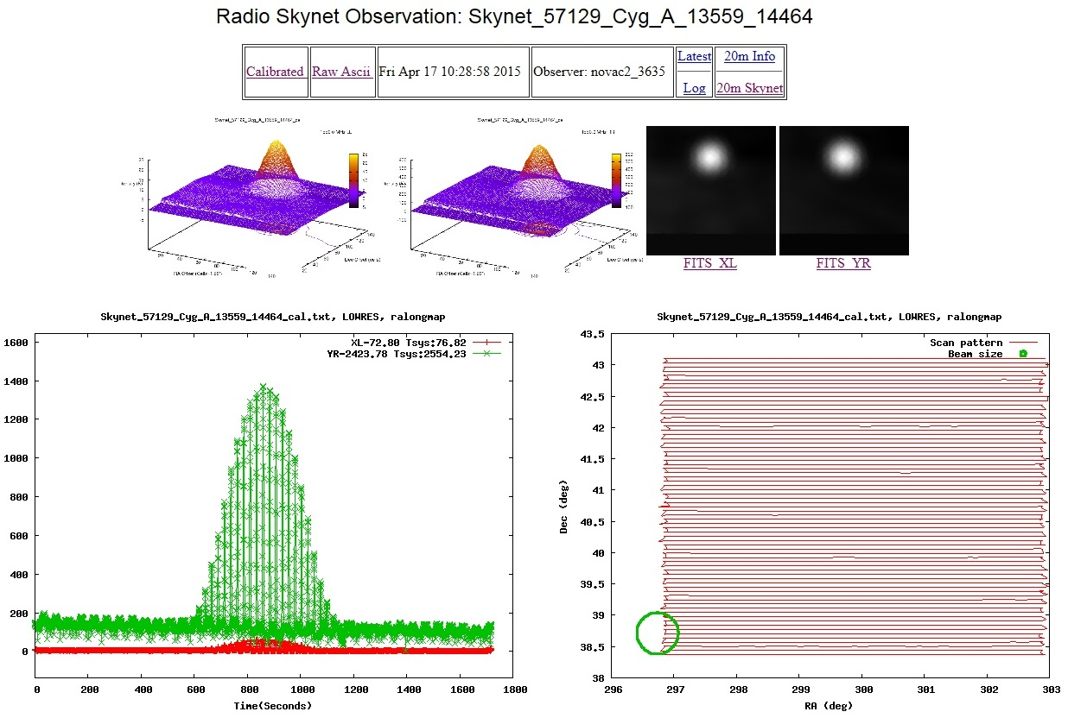
20 Meter Dish Demo
Output (Map): Cygnus A

Slide 12
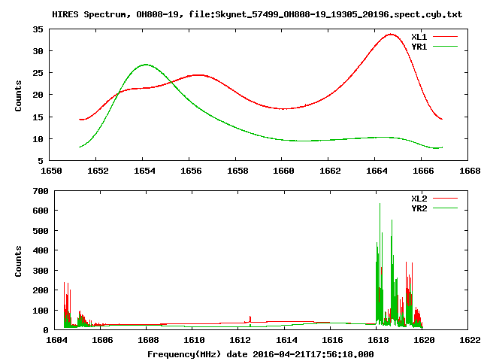
20 Meter Dish Demo
Maser OH808-19
Maser – Microwave Amplification by Stimulated Emission of Radiation.
OH/IR Stars: 1612 MHz, 1667
Late stages of asymptotic giant branch stars develop a super wind with extreme mass loss. Gas in the wind condenses OH radicals produced by photo-dissociation or collisional dissociation.

Slide 13
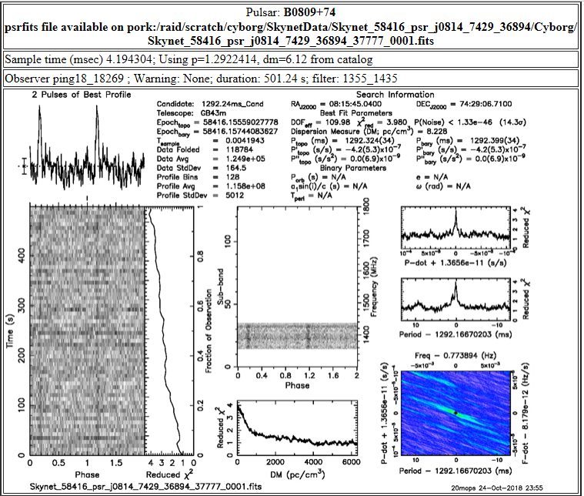
20 Meter Dish Demo
Pulsar Observation: Skynet_58416_psr_j0814_7429_36894_37777 Wed Oct 24 23:52:24 2018 (start: 2018-10-25T03:44:03.000 UT)
Suggested Integration time: For spectra: 1 second; for Pulsars 1/20 of pulsar period

Slide 14
20 Meter Dish Demo
Quality Control
Interference
Doppler
Galactic hydrogen and arms
Internal instrumentation noise
On-Off Techniques
Solar temperature effects
Ground/building reflections, sky blockage, side lobes
Secondary frequency: comparisons, problem identification
Band width & other parameters chosen
Ubiquitous neutral hydrogen
SARA Analytical Section Observation Tips

Slide 15
20 Meter Dish Demo
Output and Data Processing Screens
Output screen provided (Skynet 20 m dish)
Widely available output screens (Radio SkyPipes, GNU Radio)
User programmed output screens (Python – Princeton 18 m)
Other: Audio; Paper Strip Chart
Interpretation of Data
Manuals and papers
Cross comparisons
Resolution Expectations (Can the target be resolved?)
Repeating Observations by adjusting input parameters

Slide 16
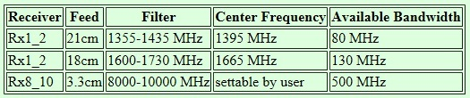
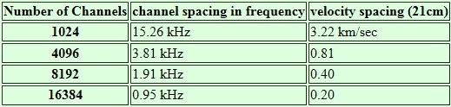
20 Meter Dish Demo
Data Processing
Low resolution mode provides 1024 spectral channels in a 500 MHz band. The channel spacing is 0.488 MHz
High resolution mode allows the number of channels to be selected.

Slide 17
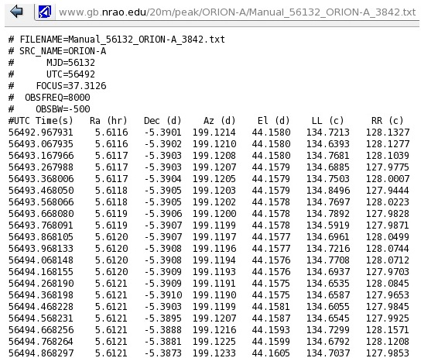
20 Meter Dish Demo
Data Processing
When the 20m telescope observes an object it is recording data 10x a second.
Time, position, and the amount of counts received by both polarizations of the telescope are recorded.
Raw data
Calibrated
Raw Ascii
Continuum Data (Ascii)
Spectrum Data (Ascii)

Slide 18
Cas A Observation Program
Development of a Citizen Science Database
Primary Target: Cas A (SNR) with 40 ft and 20m
Distance: 11,000 ly; Brightest extrasolar radio source above 1 GHz
Other Targets: Tau A (fading at 0.102%/yr in L-band), Cyg A, Vir A
Goal: Track Fading Rates
Guide: Reichart Paper on Cas A:
http://www.gb.nrao.edu/20m/projdocs20m/FadingofCassA_MN469p1299_2017.pdf
Observation Inputs for Raster Map
Central Frequency 1395 MHz; Duration: About 14 min.
Bandwidth: 80 MHZ; Beamwidth 0.75; Integration Time: 0.3 sec
See SARA Journal article on the proposed CasA Observation Program
Strive towards similar models and fits per Reichart Paper

Slide 19
Cas A Observation Program
Tables 1 & 3 Reichart Paper

Slide 20
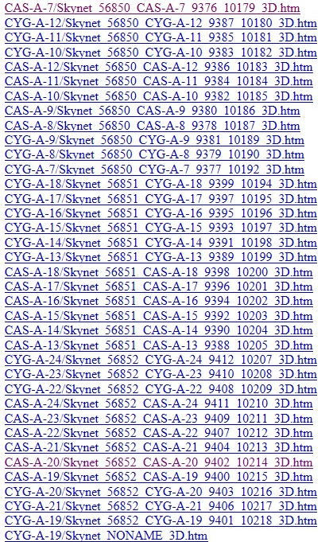
Cas A Observation Program
Reichart Data Files: www.gb.nrao.edu/20m/peak/log2014

Slide 21
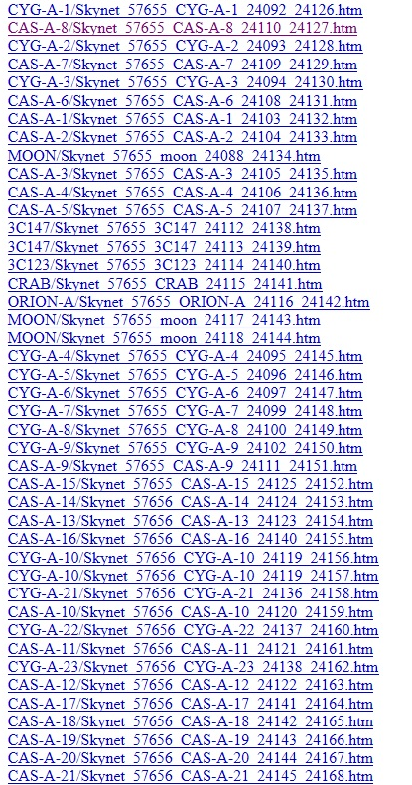
Cas A Observation Program
Reichart Data Files: www.gb.nrao.edu/20m/peak/log20146.htm#2016_09_01

Slide 22
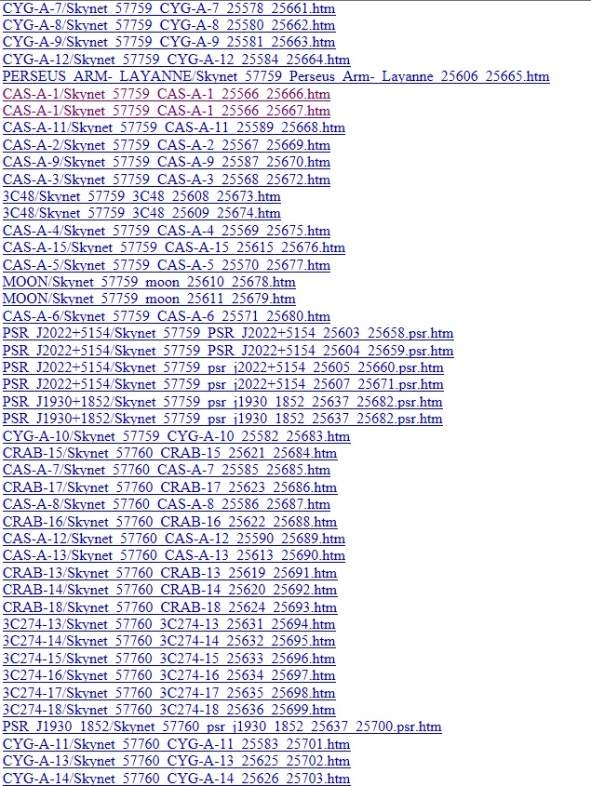
Cas A Observation Program
Reichart Data Files: www.gb.nrao.edu/20m/peak/log20147.htm#jan2017

Slide 23
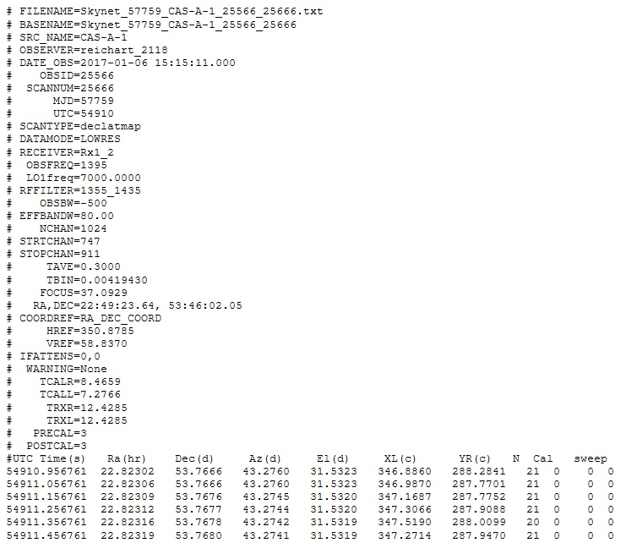
Cas A Observation Program
Reichart Data Files (ASCII Counts): www.gb.nrao.edu/20m/peak/CAS-A-1/Skynet_57759_CAS-A-1_25566_25666.txt

Slide 24
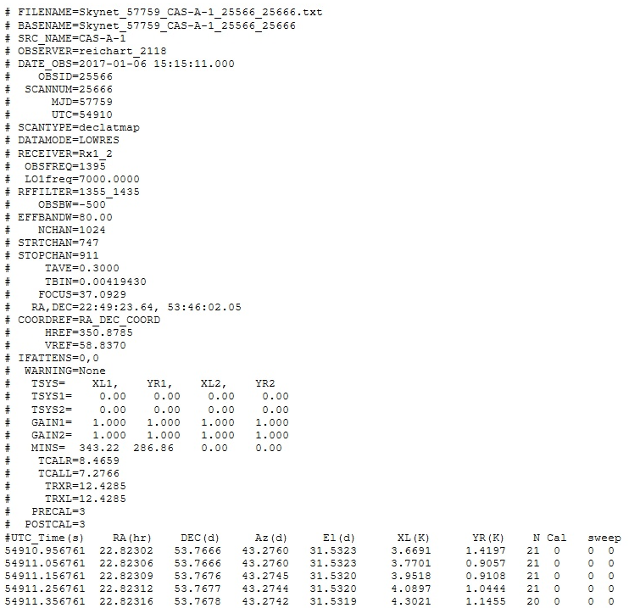
Cas A Observation Program
Reichart Data Files (Kelvin): www.gb.nrao.edu/20m/peak/CAS-A-1/Skynet_57759_CAS-A-1_25566_25666_cal.txt

Slide 25
Cas A Observation Program
Calculation for Counts, Kelvins, and Jankys
Counts (20m ASCII Raw Data): A measure of the intensity of a signal created by photons bouncing off of the dish and into the receiver. This unit can be converted to a temperature (K) and subsequently to Janskys (intensity per unit area).
Kelvin (20m Calibrated Data): The intensities in the ASCII file are total intensities, meaning the object intensity and the system intensity. You need to subtract the system values for the left and right polarizations (which can be found in the corner of the 2D plot) and then use the following conversion factors that can be found in an Excel table on the website.
Jansky: A unit of measurement of flux density equal to 10-26 Watts / meter2 / Hz, named after the radio astronomy pioneer Karl Jansky.
Use Kelvin data to convert to Janskys:
S = 2 σ T_{A} / A η _{A}
Where:
S = Flux Density (Janskys)
σ = Stefan-Boltzman constant (1.38 x 10⁻²³)
T_{A} = Average temperature (Left, Right polarization, in K)
η_{A} = Telescope Efficiency (elevation dependent, available on website)
A = Area of dish (available on website)

Slide 26
Cas A Observational Program
Flux Density Calculations
1. Open a Cas A observation (Raster Scan) from Dr Reichart.
2. For this example, select Cas A observation number Skynet_57760_CAS-A-13_25613_25690.htm
www.gb.nrao.edu/20m/peak/log20147.htm#jan2017 ; Date: Sat Jan 7 04:51:13 2017(UT), 2017
3 Get Calibrated (Kelvin) data and place it into an Excel file. (Note: The Calibrated data file processed the raw data found in the ASCII data file, which has left and right intensities (in counts). These are total intensities of the object intensity and system intensity. One would need to subtract the system intensities for the left and right polarizations (that are found in the corner of the 2D plot), and then convert to Kelvin.)
4. Next we convert from Kelvin to Jansky to obtain the flux density and compare it to published data. The equation on the previous slide can be reduced to:
S = 2761 • Ta/(100πe). [Note, the 20m scope provides Ta. Area = πr ², so A=100π.]

Slide 27
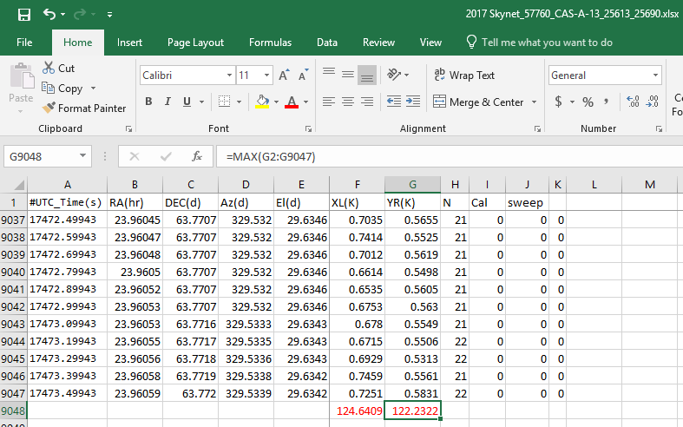
Cas A Observational Program
Flux Density Calculations
1. Format the Excel file with the Kelvin data.
2. Find the maximum for the XL and YR columns.
3. Average the two Kelvin maxima and use that for Ta in the previous slides’ flux density equation. In this example Ta = 123.43655 K

Slide 28
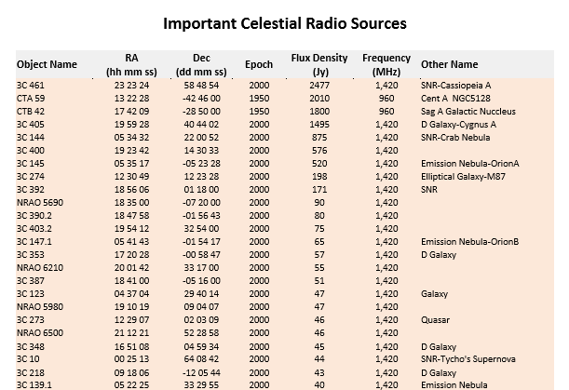
Cas A Observational Program
Flux Density Calculations
The list of celestial radio sources at the right was obtained from the National Radio Astronomy Observatory (NRAO) library.
Courtesy of W. Reeve, File: Reeve_CelestialRadioSources.doc.

Slide 29
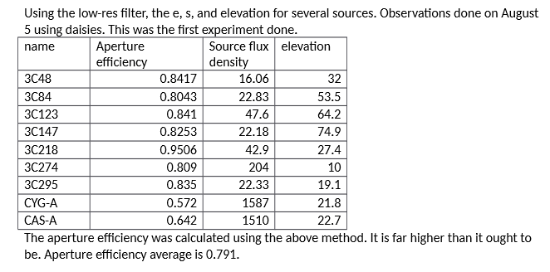
Cas A Observational Program
Flux Density Calculations
20-meter Calibration and Efficiency, 17 August 2015, Annike Salmi, NRAO-Green Bank

Slide 30
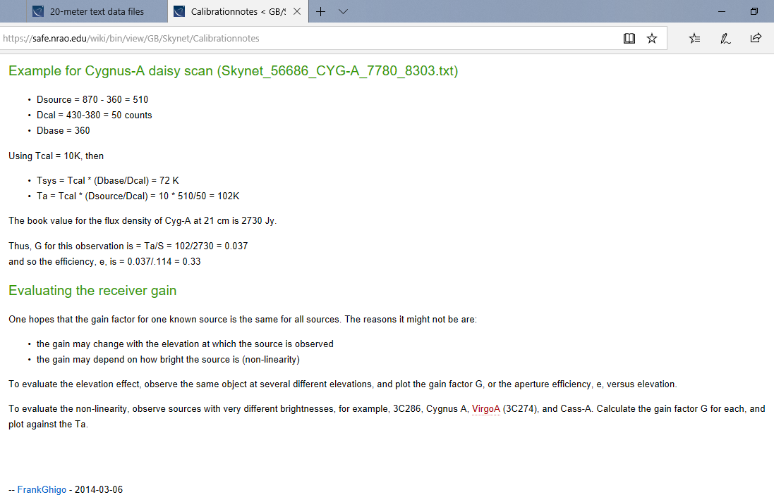
Cas A Observational Program
Flux Density Calculations
2014 Aperture Efficiency.
Note: Telescope Efficiency is also elevation dependent.

Slide 31
Cas A Observational Program
Flux Density Calculations (@ 1420 MHz)
S = 2761 • Ta/(100πe)
If e = 0.791, S = 2761 * 123.43655 / 100 * 3.14 * 0.791= 1372 Jy
If e = 0.642, S= 2761 * 123.43655 / 100 * 3.14 * 0.642= 1690.6 Jy
If e = 0.33, S = 2761 * 123.43655 / 100* 3.14 * 0.33= 3289 Jy
If S = 2577 Jy (Epoch 2000), e = 2761 * 123.43655 / 100 * 3.14 * 2577 = 0.42
Typically, total losses amount to 35%-50% of the theoretical limit. That is, 50%-65% of the power from the observed source reaches the receiver. So what’s the right answer?

Slide 32
Cas A Observational Program
Flux Density Calculations
Let’s try this with Cyg A, a non-variable radio source. Chose one of Dr. Reichart’s Cyg A observation near the Cas A observation above: Radio Skynet Observation: Skynet_57759_CYG-A-10_25582_25683, Date: Sat Jan 7 00:15:51 2017(UT)
Since Cyg A is non-variable, let’s do this in reverse to find e. Cyg A’s published = 1495 Jy
Obtain Cyg A average maximum kelvin at 112.41945K
If answer = 1495 (published). What is e? e = 2761 * 112.41945 / 100 * 3.14 * 1495, e= 0.66
[Note, 20m calibrated e values on Aug 5, 2015 were: Cyg A = 0.572, and Cas A 0.642, with scope average of 0.791]

Slide 33
Cas A Observational Program
Flux Density Calculations
Next, get an additional Dr. Reichart Cas A and Cyg A observation at a similar time but from the previous year (2016). Calculate the non-statistical density flux ratios. Dr. Reichart had dozens of observations to do a proper statistical fit model analysis including the removal of rejected outlier data. Dr. Reichart also had a large team (see credits on his paper). Skynet data only goes back to Feb. 2013, hence dr. Reichart reviewed data from the 1960s onward obtained using the 40-foot radio scope.
Kelvin data (X and Y values) for the 4 observations are:
Cas A 2017: 124.6409 & 122.2322, average max. = 123.43655
Cas A 2016: 126.7922 & 122.26, average max. = 124.5261
Cyg A 2017: 114.7158 & 110.1231, average max. = 112.41945
Cyg A 2016: 117.8629 & 113.6769, average max. = 115.7699

Slide 34
Cas A Observational Program
Flux Density Calculations
Radio Skynet Observation: Skynet_57656_CAS-A-16_24140_24155; Sun Sep 25 02:38:04 2016(UT)
If we back into the answer of Cas A = 2477 Jy (published), What is e?
e = 2761 * 124.5261/ 100 * 3.14 * 2477 e= 0.44 (too low)
If e = 0.642, S=2761 * 124.5261/ 100 * 3.14 * 0.642 = 1706 Jy (too low)
Hence, we are in the approximate range, but a rigorous statistical analysis of many data points is required for a proper Cas A result.

Slide 35
Cas A Observational Program
Flux Density Calculations
Radio Skynet Observation: Skynet_57656_CYG-A-10_24119_24156; Sun Sep 25 03:13:24 2016(UT), 2016
The equation is S=2761 • Ta/(100πe). Cyg A published = 1495 Jy.
If answer = 1495 (published) What is e?
e = 2761 * 115.7699/ 100 * 3.14 * 1495 e= 0.6808
[Note, 20m calibrated e values on Aug 5, 2015 were: Cyg A = 0.572, and Cas A 0.642, with scope average of 0.791]
Once again, we are in the approximate range, but a rigorous statistical analysis of many data points is required even for a proper Cyg A result.

Slide 36
Cas A Observational Program
Flux Density Calculations
Even the density flux ratios, though in the general range, require a rigorous statistical analysis. The Kelvin values are slightly lower in 2017 lower than 2016, so data with 2 points is not sensitive enough for trends.
Kelvin data (X and Y values) for the 4 observations are:
Ratio 2017: 123.4/112.4 = 1.098
Ratio 2016: 124.5/115.8 = 1.075
Notice the relatively stable Kelvin results compared to the aperture efficiency variations
Conclusion: SARA can collect data with some proper guidelines, but how reliable this data is will be answered through a statistical fit model testing at some future point. Meanwhile, we have a better understanding of the Cas A observations. Let’s look a few more concluding thoughts.

Slide 37
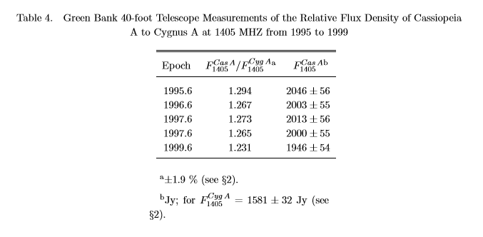
Cas A Observational Program
Concluding Thoughts
Ref: Accepted to The Astrophysical Journal: The Fading of Supernova Remnant Cassiopeia A from 38 MHz to 16.5 GHz from 1949 to 1999 with New Observations at 1405 MHz. Daniel E. Reichart and Andrew W. Stephens. (Submitted on 1 Feb 2000)

Slide 38
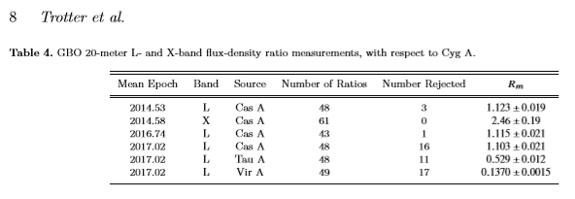
Cas A Observational Program
Concluding Thoughts
Ref: The fading of Cassiopeia A, and improved models for the absolute spectrum of primary radio calibration sources
A. S. Trotter, & D. E. Reichart (Submitted on 30 Mar 2017)

Slide 39
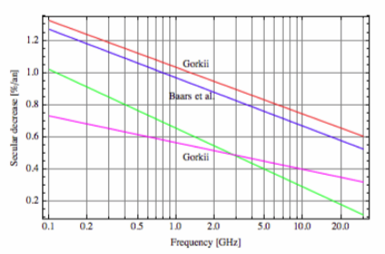
Cas A Observational Program
Concluding Thoughts
Ref: History of Flux-Density Calibration in Radio Astronomy, Jacob W.M. Baars,
Max-Planck-Institute fur Radioastronomie Auf dem Hugel 69, 53121 Bonn, GERMANY e-mail: jacobbaars@arcor.de.
The Radio Science Bulletin No 348 (March 2014)
Figure 8. The secular decrease in the flux density of Cas A in percent per year as a function of frequency. The red and blue lines refer to measurements at Gorkii and the derivation by Baars et al. over the period 1960-1975. The green line applies to 1969-1984. The magenta line is for the period after 1984 to 2000 from the Gorkii data.

Slide 40
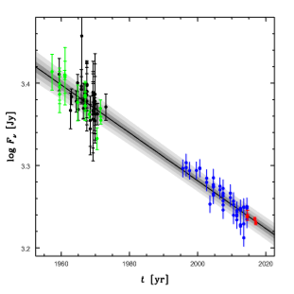
Cas A Observational Program
Concluding Thoughts
Ref: Trotter and Reichart: Figure 8. Absolute (black) and relative (green) measurements of the ﬂux density of Cas A from Baars et al. (1977), our (also relative) GBO 40-foot (blue) and 20-meter (red) measurements, and our best-ﬁt, one-segment temporal model of both epochs. Relative measurements have been multiplied by the best-ﬁt spectral model of the reference source, and all measurements have been referenced to 1405 MHz using the best-ﬁt spectral model of Cas A, for better visualization. 40-foot measurements have additionally been corrected for imperfect pointing and non-constant focus using the best-ﬁt values of α and β, as in Figure 5, also for better visualization. The fading-rate priors of §4.1 apply only to the epoch of the Baars et al. (1977) data and consequently have not been included in this ﬁt. The shaded regions show the 1-, 2-, and 3-σ statistical uncertainty in the best-ﬁt values of log F0, a1, a2, a3, mν0, and m∆ log ν. The uncapped error bars show the best-ﬁt 1-σ sample scatter of the 40-foot measurements (that of the other measurements is negligible).

Slide 41
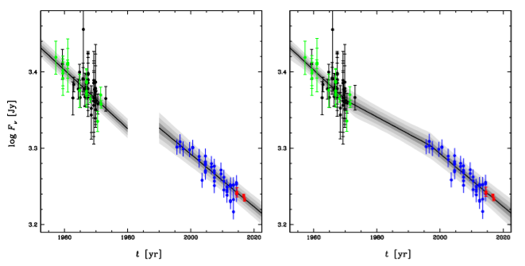
Cas A Observational Program
Concluding Thoughts
Figure 9. The same as Figure 8, but for our best-ﬁt two-segment (left) and three-segment (right) temporal models. The fading-rate priors of §4.1 have been applied to the ﬁrst segment of each model.

Slide 42
Cas A Observational Program
Concluding Thoughts
Suppose you are asked to develop an analytical method to determine the concentration of lead in drinking water. There are four levels of analytical methodology: techniques, methods, procedures, and protocols.
A technique is any chemical or physical principle we can use to study an analyte. There are many techniques for determining the concentration of lead in drinking water. In graphite furnace atomic absorption spectroscopy (GFAAS), for example, we first convert aqueous lead ions into a free atom state—a process called atomization. We then measure the amount of light absorbed by the free atoms. Thus, GFAAS uses both a chemical principle (atomization) and a physical principle (absorption of light).
A method is the application of a technique for a specific analyte in a specific matrix. The GFAAS method for determining lead in water is different from that for lead in soil or blood.
A procedure is a set of written directions telling us how to apply a method to a particular sample, including information on obtaining samples, handling interferents, and validating results. A method may have several procedures as each analyst adapts it to a specific need. The American Public Health Agency and the American Society for Testing Materials publish separate procedures for determining the concentration of lead in water.
A protocol is a set of stringent guidelines specifying a procedure that must be followed if an agency is to accept the results. Protocols are common when the result of an analysis supports or defines public policy. When determining the concentration of lead in water under the Safe Drinking Water Act, for example, labs must use a protocol specified by the Environmental Protection Agency.
There is an order to the four levels of analytical methodology. Before developing and validating a procedure, a method of analysis must be selected. This requires, in turn, an initial screening of available techniques to determine those that have the potential for monitoring the analyte.

Slide 43
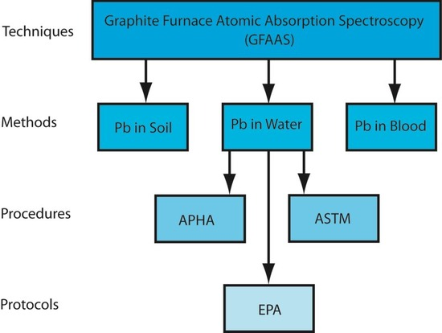
Cas A Observational Program
Concluding Thoughts
Chart showing the hierarchical relationship among a technique, methods using that technique, and procedures and protocols for one method. The abbreviations are APHA: American Public Health Association, ASTM: American Society for Testing Materials, EPA: Environmental Protection Agency.

Slide 44
Cas A Observational Program
Concluding Thoughts
Next Steps:
Tighten up calculations
List of projects
SARA Section Team meetings, work groups, workshops?
Setting of goals? Assigning people tasks?
Kraus book calculations
NRAO calculation examples

Slide 45
Useful Information
Documentation
Instruments Available
Technical Information
Projects
Contact

Slide 46
Documentation
Educational Links
http://www.gb.nrao.edu/20m/spectra20m_advice.html
http://www.gb.nrao.edu/20m/obsadvice.html
http://www.gb.nrao.edu/20m/map20m_advice.html
http://www.gb.nrao.edu/20m/beginnersadvice.html
http://www.gb.nrao.edu/20m/
https://safe.nrao.edu/wiki/bin/view/GB/Skynet/DocumentSeries
http://www.gb.nrao.edu/20m/projdocs20m/FadingofCassA_MN469p1299_2017.pdf
http://www.gb.nrao.edu/20m/projdocs20m/g20_2012_08_BigManual.pdf
https://safe.nrao.edu/wiki/bin/view/GB/Skynet/WebHome
https://safe.nrao.edu/wiki/bin/view/GB/Skynet/Calibrationnotes

Slide 47
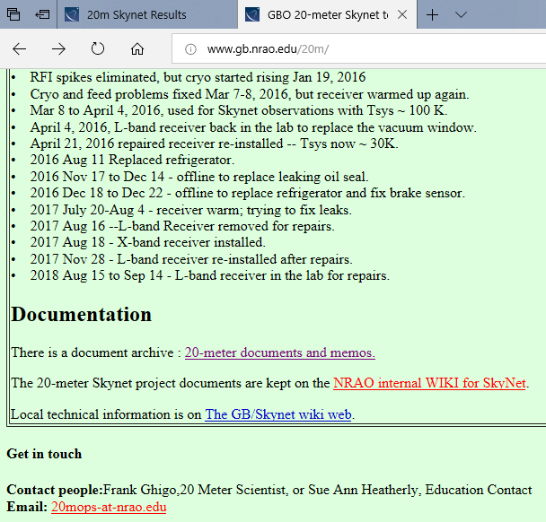
Documentation

Slide 48
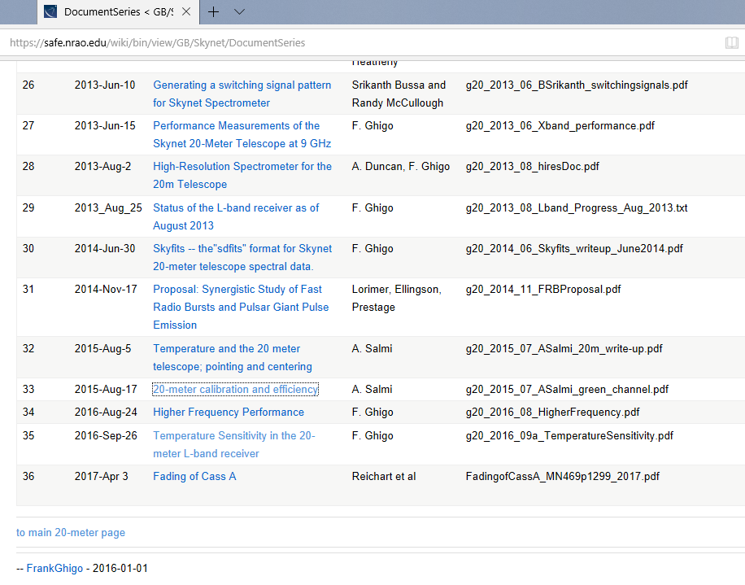
Documentation

Slide 49
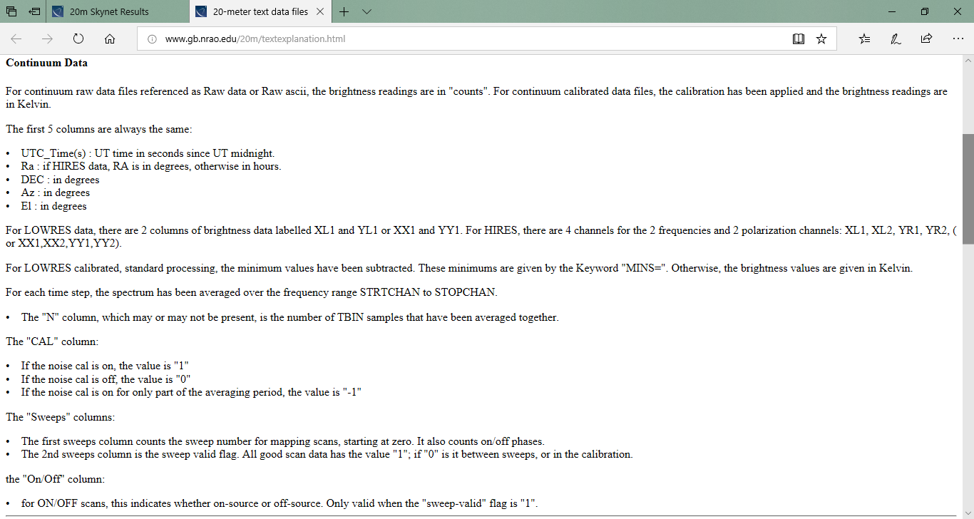
Documentation

Slide 50
Instruments Available
Matrix of Various Radio Telescopes Popular with SARA Members
Scope Frequency Purpose Output Issues
INSPIRE 0-110 KHz Natural Radio Software Event
SuperSID 25.2 KHz Ionosphere Software 24 hour
Radio Jove 20.1 MHz Jupiter Software Event
Radio Meteors 55 -78 MHz Meteors Live Internet Saving
IBT 1.2 GHz Sun/ Satellites Analog Demo
40 Foot 1.42 GHz Gal. H, Pulsars Strip Chart GBO
20 m 1.4-10 GHz Remote Ops Internet Analytics
RASDR 3 KHz - 30 GHz “Universal” Software Pilot

Slide 51
Technical Information
NRAO’s 20 m vs. 40 foot Dishes (for SARA use)
Differences
40 Foot: 1420 MHz receiver front-end
40 Foot: 80 MHz bandwidth 1350 to 1430 MHz
40 Foot: 1 degree of arc
40 Foot: Transit Instrument, moves along celestial meridian
20 m: Beamwidth: 8-10 GHz receiver at 7 arcmin; 1.4 GHz at 44 arcmin
Resolution controlled by beamwidth as only targets separated by more than 1 beamwidth can be displayed separately. The uncertainty in the measurements will be reduced for larger integration times. Radio telescopes are like camera with one pixel.

Slide 52
Technical Information
Technical Questions & Answers (FACT Sheets)
Gain: The ratio of the maximum power that can be extracted from the receiving antenna to the power delivered to the back end of the system. It can be thought of as "volume".
Front End: A term used to describe the dish, receiver and any other equipment mounted on the antenna itself.
Electron Polarization: A property of electrons defined by the Pauli Exclusion Principle but simply described as up or down, or left and right. Radio telescopes are equipped with polarizing filters that distinguish between the two electron polarizations.
Counts: A measure of the intensity of a signal created by photons bouncing off of the dish and into the receiver. This unit can be converted to a temperature (K) and subsequently to Janskys (intensity per unit area).
Beam Width The angle within which an antenna receives radio waves.
Back End: The equipment, including computers, Analog to Digital converters, and tuners that aid in the processing of radio signals by the operator.

Slide 53
Technical Information
Technical Questions & Answers (FACT Sheets)
Side lobes: Far field radiation that is not the main lobe
Continuum: A spectrum of radiation distributed over an uninterrupted range of wavelengths with no lines
Resolution: The ability of a telescope to show detail
Integration Time: An averaging of data – an observation is done by “integrating” over some integration time. Integration greatly reduces the receiver output fluctuations.
Sensitivity: Is define by the smallest flux that a radio telescope can detect, where B is bandwidth, tau is integration time, and Ae is effective area.
Spectral Index: +0 to 2 at radio frequencies indicates thermal emissions. Steep negative index indicates synchrotron emission.

Slide 54
Projects
Applications
Masers
Variable Radio Sources (SNRs or revolving Solar System objects)
Pulsars (Intensity of pulses can vary, but frequency is extremely consistent. An analysis of the data variations can give new insight to the nature of pulsar radiation. 2250+ known pulsars and growing. Different types of pulsars. The Crab Nebula is a pulsar.)
Supernovae (recurring)
Galaxies
Sun (Active and Quiet) and Solar System objects
Mapping & Sky Surveys
Radio Occultations (See Analytical Section Observation Guide)
Calculations to Understand radio astronomy principles

Slide 55
Contact
Questions, Comments, Volunteering?
Email SARA Section Analytical Section Coordinator
Tzikas@alum.rpi.edu

